Slide 1

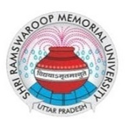
Biotechnology Colleges in Lucknow
Visit - https://srmu.ac.in/program/b-tech-biotechnology

Slide 2

Shri Ramswaroop Memorial University’s B.Tech in Biotechnology is a four‐year engineering degree combining biological sciences with modern technologies. Designed for research, pharma, food science, clinical research and bio-manufacturing, it features hands-on labs, industry-aligned curriculum, and internships. Graduates pursue advanced degrees (M.Tech, M.Sc, MBA) or roles in biotech companies

Slide 3
Innovate, Explore, and Engineer Life with Biotechnology at SRMU
Shri Ramswaroop Memorial University
Village - Hadauri, Post - Tindola, Lucknow-Deva Road
Phone: 18001026004, +91-9120007948
Email: examination.cell@srmu.ac.in, admissions@srmu.ac.in

Slide 4
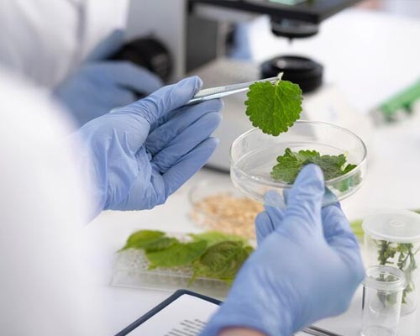
Thank You
Visit - https://srmu.ac.in/program/b-tech-biotechnology

