Slide 1
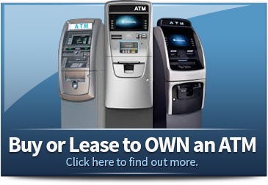

ATM for Sale
Visit - https://www.goldcoastatm.com/buy-or-lease-to-own.php

Slide 2
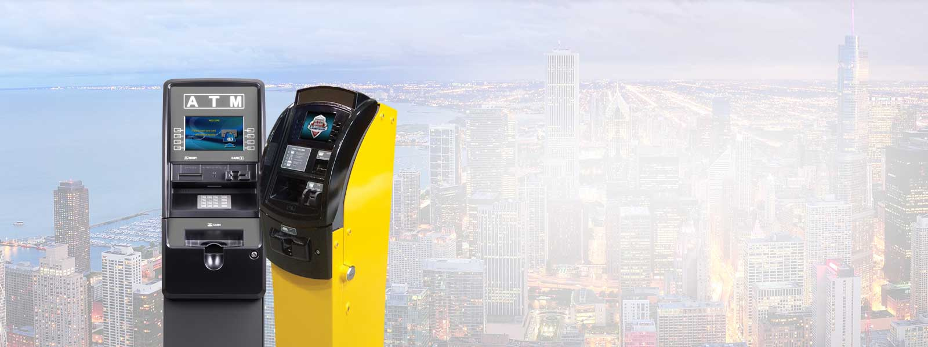
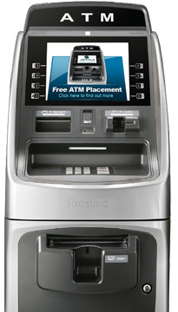
Gold Coast ATM provides convenient buy or lease-to-own options for ATM machines, ideal for businesses seeking extra income. Enjoy full support, professional installation, and dependable service without upfront investment. A smart solution for retail and high-traffic locations

Slide 3
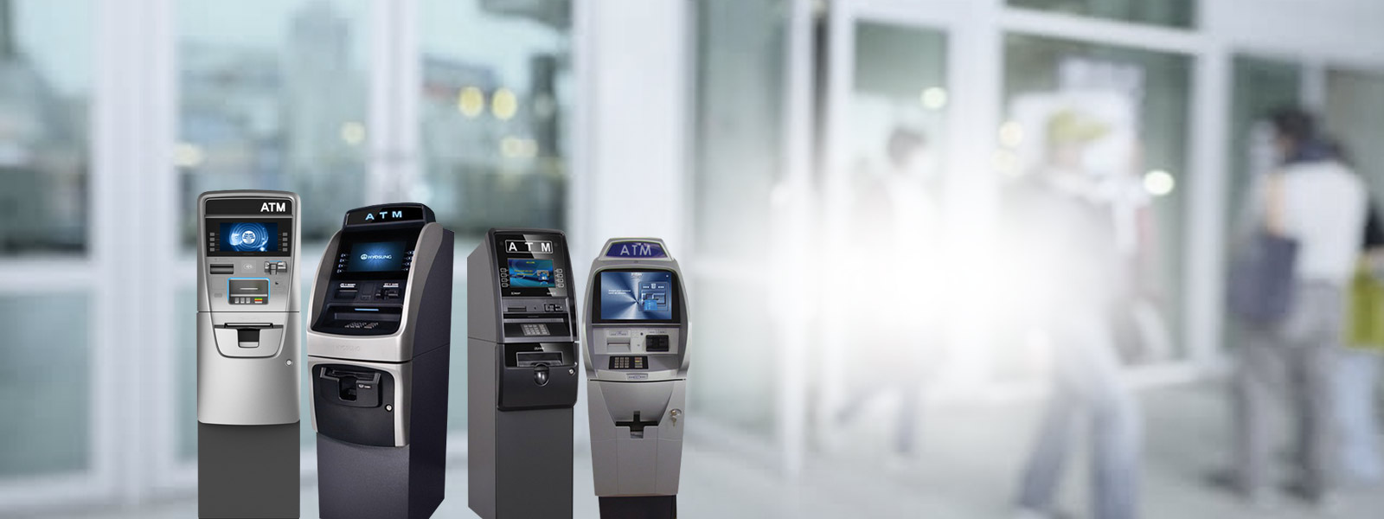
Address - 2000 North Racine, Suite 2000, Chicago IL 60614 USA
Call - 888.950.VISA (8472), 773 416 8526
Mail - info@goldcoastatm.com
Website - https://www.goldcoastatm.com/buy-or-lease-to-own.php

Slide 4

Thank You
Visit -https://www.goldcoastatm.com/buy-or-lease-to-own.php

