Slide 1


Best B.B.A.College in Lucknow
Shri Ramswaroop Memorial University in Lucknow offers a three-year Bachelor of Business Administration (BBA) program designed to launch students into business management careers with a blend of foundational and specialized courses in marketing, finance, HR, and international business
Visit - https://srmu.ac.in/program/bba-bachelor-of-business-administration

Slide 2
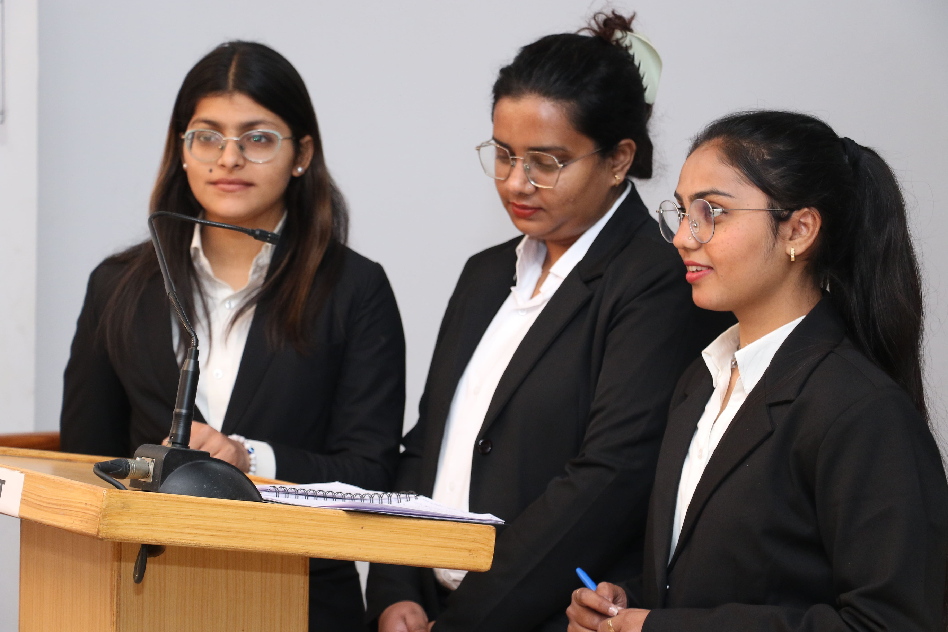
The program emphasizes practical learning through summer internships, live projects, case studies, presentations, and fieldwork to develop real-world managerial skills. Eligible candidates must have completed 10+2 with a minimum of 45% aggregate (40% for SC/ST), and students can choose from specializations like Business Analytics, Banking & Fintech, Aviation, and Retail Management

Slide 3
Contact Us
Shri Ramswaroop Memorial University
Village - Hadauri, Post - Tindola, Lucknow-Deva Road
Pin: 225003
Phone: 18001026004, +91-9120007948
Email: examination.cell@srmu.ac.in, admissions@srmu.ac.in
To know more details about the B.B.A. program, visit - https://srmu.ac.in/program/bba-bachelor-of-business-administration

Slide 4

Advance Your Career with SRMU’s Transformative Education
Thank You
Visit- https://srmu.ac.in/program/bba-bachelor-of-business-administration

