Slide 1
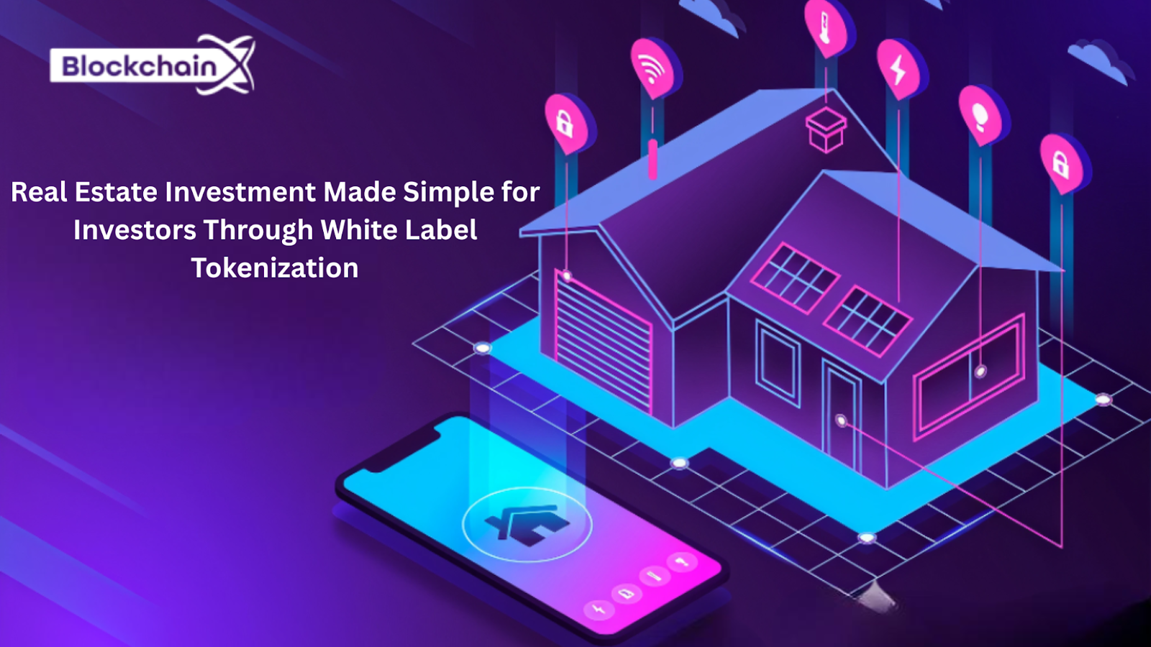

Slide 2

INTRODUCTION
Real estate has long then been considered to be the cornerstone of money-making-installation, capital appreciation and passive income. . Nevertheless, for many investors, especially for retail or international participants, reaching high quality real estate opportunities means traditionally dealing with complex legal structures, high capital requirements and limited liquidity.

Slide 3
WHAT IS WHITE LABEL REAL ESTATE TOKENIZATION?
White label is the process of converting assets in digital tokens using real estate tokenization blockchain technology. Each token represents a partial part of a real -world property, which enables easy, more accessible investment. A white label real estate tokenization platform development services provides prepared, adaptable infrastructure for businesses so that they launch their own branded tokenization solutions.

Slide 4
HOW WHITE LABEL TOKENIZATION SIMPLIFIES REAL ESTATE INVESTMENT
Traditional real estate investment often involves high entry barriers, long legal processes and significant upfront capital - which makes it inaccessible to many potential investors. White labeled tokenmail platforms are changing this scenario by taking advantage of blockchain technology for streamlined, automated and democratization of real estate investment.
Fractional Ownership
One of the most revolutionary aspects of tokens is the ability to divide a high value property into small digital shares, or tokens.
Real-Time Settlement
Through the use of smart contracts, transactions that used to take even weeks or months - such as ownership transfer, dividend payments, or distribution of rent - can now be executed automatically and in real time.

Slide 5

CROSS-BORDER ACCESSIBILITY
Tokenized are global by real estate platform design. With compliance and identification check (KYC/AML) manufactured in the onboarding process, investors in any part of the world can easily and legally reach out to invest in international markets. It opens new capital channels for property owners and provides investors access to global real estate portfolio, often with a few clicks
KEY BENEFITS FOR INVESTORS
Investing in real estate using white labeled tokenization platforms only brings more than innovation - it provides transparency, flexibility and belief. These platforms are designed to address the main concerns of modern investors, offering more efficient and safe ways to participate in real estate markets. Here are the major benefits:

Slide 6
Secure Transactions
One of the most valuable advances of the real estate of the token is its underlying transaction protection. Using blockchain and cryptographic protocols, every token transfer is digitally signed, verified and timled-protect against fraud, double expenses and unauthorized access.
Additionally, the white label platforms often integrate safe wallets, multi-comprehensive approval and detention solutions to protect investors funds during every transaction.
Liquidity Through Secondary Markets
Real estate has traditionally been a slow process and liquid asset class Tokenization introduces dynamic liquidity by enabling investors to trade their tokens on secondary markets, often with instantaneous disposal.
This gives more control over their exit strategy and capital allocation without delay in selling traditional property to investors.

Slide 7
WHY INVESTORS PREFER WHITE LABEL PLATFORMS
White Label Tokenization platforms do not simply simplify backend operations - they increase investor experience in powerful ways:
BRANDED EXPERIENCE:
Customizable portal gives investors an easy, professional interface under a reliable brand, creating long -term loyalty and confidence.
FASTER ONBOARDING:
Integrated Digital KYC/AML verification and instant wallet creation enables investors to start in minutes, not the day.
SECURE ASSET MANAGEMENT
blockchain infrastructure and safe detention solution investors protect property, reduce fraud and opposition risk.

Slide 8
SPOTLIGHT: BLOCKCHAINX – POWERING THE FUTURE OF REAL ESTATE TOKENIZATION
Smart contract automation
Blockchainx enables safe and automatic execution of transactions using smart contracts, ensures transparency, speed and eliminates manual errors.
Built KYC/AML Equipment
The platform includes integrated compliance checks, allowing spontaneous investor onboarding, following the global KYC/AML rules.
Token Creation and asset registry
Easily convert the property of real estate into a digital token and maintain an irreversible, blockchain-based registry of ownership and transactions.
Investor dashboard and wallet
Investors can track holdings, get updates, and manage their portfolio through a dashboard with integrated digital wallets.
Secondary market integration
Blockchainx connects to regulated secondary markets, allowing investors to trade tokens and reach liquidity when needed.

Slide 9
CONCLUSION
Integration of blockchain with real estate through white label token platforms is not a trend - this is a change. For investors, this means easy access, low obstructions, increased liquidity and global access. For platform owners, it means rapid deployment, regulatory readiness and scalability.In a world where access and automation are re -defined the financial markets, real estate investment has finally caught on.

Slide 10



Contact Us
BlockchainX offers secure, scalable data tokenization services powered by blockchain, enabling privacy, compliance, and seamless data sharing across platforms and industries.
https://www.linkedin.com/company/blockchainxtech/
https://www.blockchainx.tech/
contact@blockchainx.tech

