Slide 1
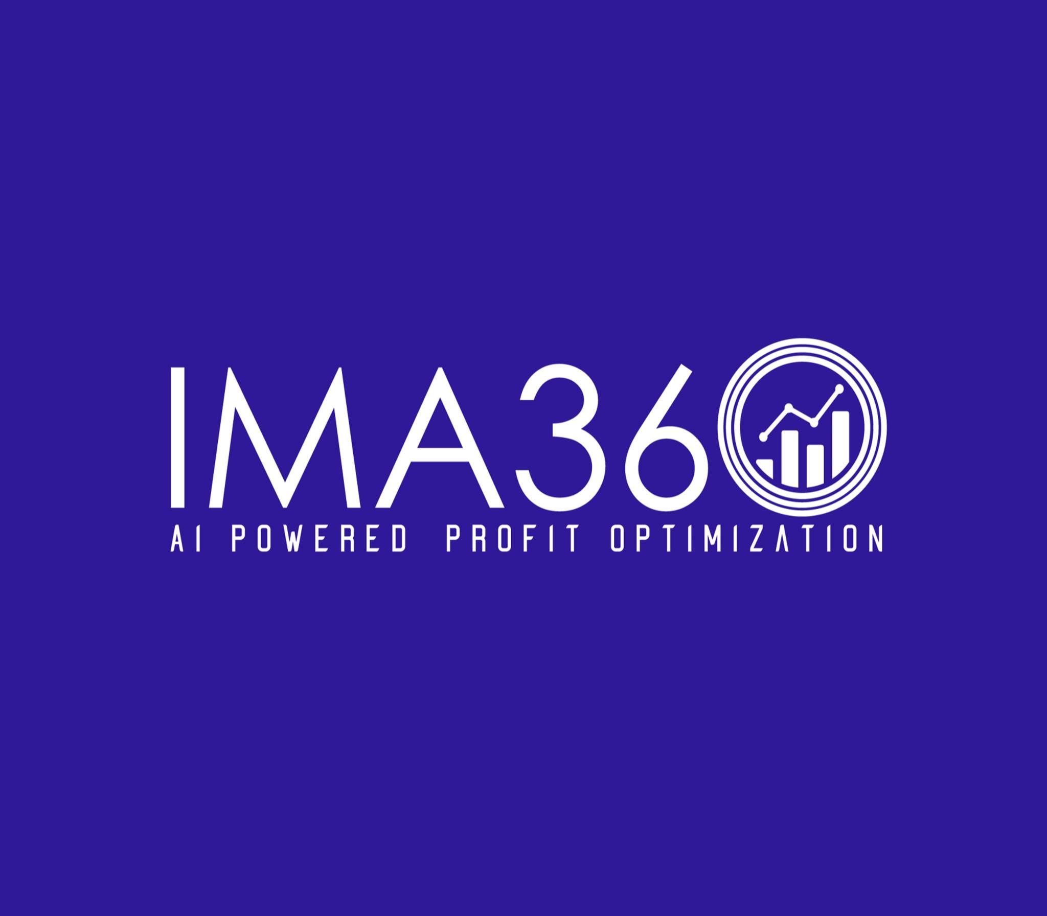
Driving Profitable Growth with Smart Pricing and Rebate Tools
https://ima360.com/

Slide 2
In the current challenging business environment where competition is high; organizations have no option but to use special tools to remain on their feet and make profits. Be it precise quoting or the smart price and rebates handling, companies are resorting to specialized software tools to capture the efficiency. Customer rebate Tracking software, pricing optimization software, and services of leading CPQ software vendors are important tools in enhancing operation efficiency and profitability by means of price and promotion optimization.
The necessity of the Customer rebate tracking software
Incentive value and rebates are very strong in inducing customer retention and boosting sales. Nevertheless, handling such programs manually may result in unpaid payment, conflict, and loss of money. There is the customer rebate tracking software that comes in.
The software will automatically monitor the rebate arrangements, audits, and checks on the rebates-- in a transparent way. Businesses are able to control accruals, spot overpayments and be compliant with the help of built in audit trails and real time reporting. Cutting on errors and manual involvement in the rebate programs, companies can make their rebate programs a strategic profit machine.

Slide 3
It looks at Pricing Optimization Software to unlock value
It is no longer price which is the fixed and constant position: it has to change according to the market conditions, according to the type of the customers, and according to the kind of competition. Pricing optimization software enables companies to charge data-based prices that generate the most revenues and profits.
It is a software which applies AI and predictive analytics to customer behaviour, competitor pricing and demand trends. Businesses are able to predict pricing situations, identify gaps in their pricing and adjust to changes in the market with pricing optimization software. It does not only facilitate profitability but also adds to your value as a customer would see it.
Giving Sales the Best CPQ Solution Providers
When the products or pricing structures are complex, the quoting exercise can be quite tedious and subject to error. The cpq software providers offer product configuration automation, pricing and quoting.
The best CPQ software suppliers facilitate sales representatives to close deals quicker by making sure that each quote is precise, timely and compliant with the business rules. These tools can easily connect to CRM and ERP systems, enhance workflows, and the customer experience.

Slide 4
Live Excellence in Price and Promotion Optimization
In the present day market environment, business requires accurate price and promotion control in order to be successful. Optimization software comes to rescue in decision-making as by evaluating the performance of the previous promotions, the data of the customers, and the practice of past-decisions, price and promotion optimization software helps to achieve clarity in decision-making.
Such intelligence helps the businesses to finalize the promotional offers, prevent marginal deterioration, and provide well-honed prize appeals, which can convert. There is no better way to undertake strategic and profitable campaigns.
Conclusion
With a combination of modern tools and accessories such as customer rebate tracking and pricing optimization software and platforms of proven CPQ software suppliers, companies stand a higher chance of gaining competitive advantages in terms of price and promotion optimization. The result? Improved margins, better customer satisfaction and faster growth.

Slide 5
Contact Us
Feel free to contact us for any questions and doubts​ on
https://ima360.com/
Phone No:
+1 214-584-6660
Email Address:
info@ima360.com
Head Office:
6600 Chase Oaks Blvd. Ste. 150, Plano, TX 75023

