Slide 1
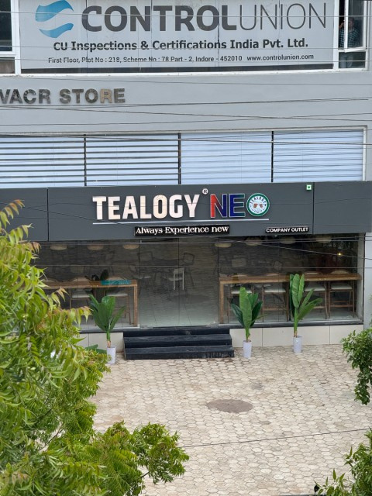

Best Tea Shop in Indore

Slide 2
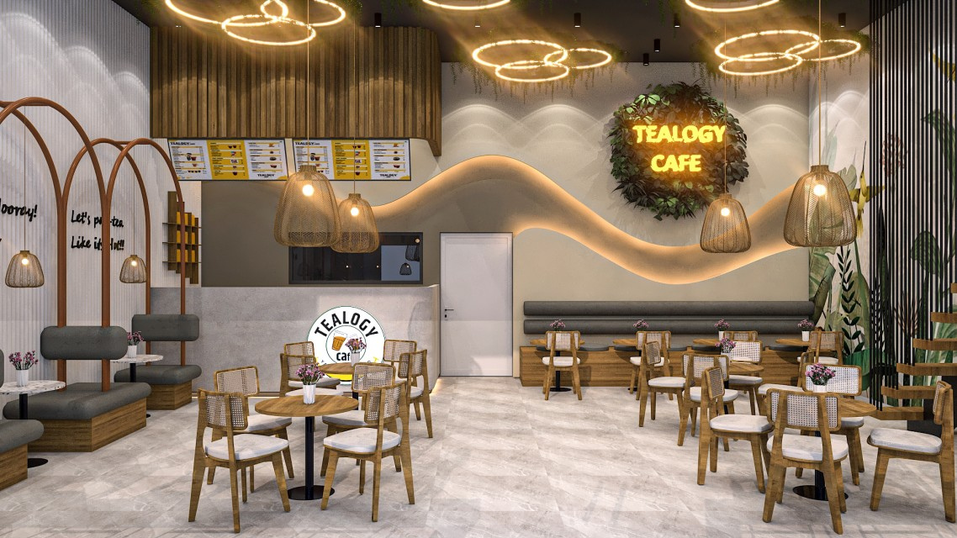
Tealogy Neo in Vijay Nagar is a vibrant tea café offering over 150 handcrafted beverages—from aromatic kulhad chai to iced drinks—and delectable snacks like garlic bread, mocktails, pizza, and shakes . Loved for its cheerful ambiance, free Wi‑Fi, live music and proactive service, it’s perfect for casual catch‑ups, work breaks, or solo time . With its fusion of traditional flavors and modern café vibe, Tealogy is an affordable, top‑rated destination for tea enthusiasts in Indore

Slide 3
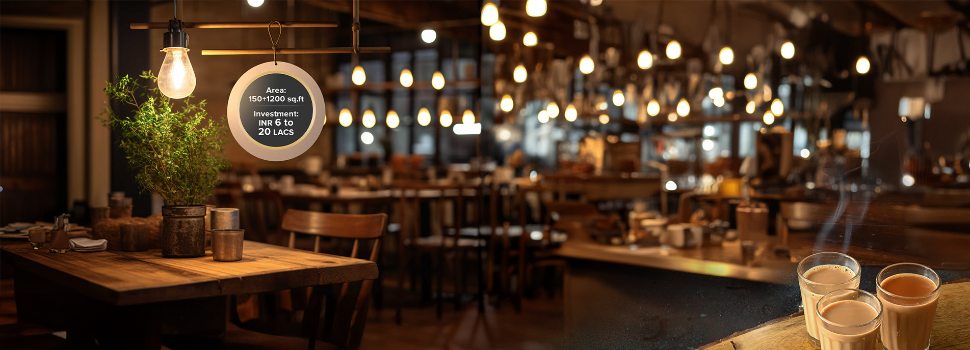
Contact Us
Address - Ground Floor, Plot No. 218, Scheme No 78 - III, Scheme Number 78, Vijay Nagar, Part II, Scheme 78, Vijay Nagar, Indore, Madhya Pradesh 452010
Visit - https://tealogy.in/store/tealogy-cafe-vijay-nagar-indore

Slide 4
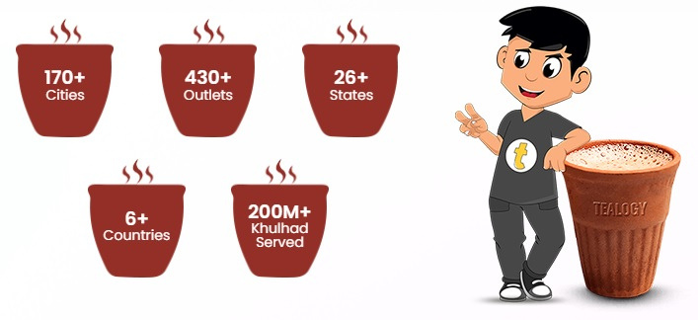
Thank You
Visit - https://tealogy.in/store/tealogy-cafe-vijay-nagar-indore

