Slide 1




Where Sustainability Meets Style
DEDICATED TO CRAFTING HIGH-QUALITY
© 2 02 5 , Re e p e a t Po w e r e d b y S h o p i f y

Slide 2
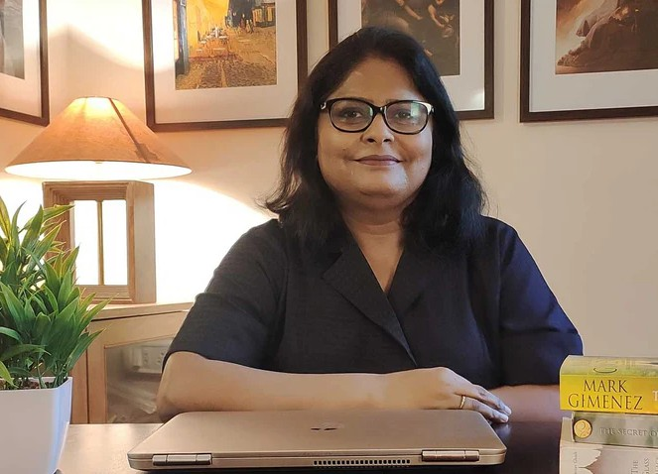
About Us
Reepeat is named after Ree which means Soul Free Design, is the brainchild of Reena Pavithran Krishnan, a passionate textile designer and fashion entrepreneur based in Bangalore.
She began with a simple yet profound belief that fashion should be kind to the planet and people. With a heart filled with love for artistry and a commitment to eco-friendly practices, she has successfully carved a niche in the fashion industry, setting new standards for sustainable fashion.
© 2 02 5 , Re e p e a t Po w e r e d b y S h o p i f y

Slide 3

Mission and Vision
We're dedicated to crafting high-quality, sustainable clothing that makes you feel confident and connected to the environment. Our organic cotton reduces water usage and carbon emissions, aligning with our goal of minimizing our ecological footprint. We strive to inspire a community that values both style and sustainability.
Why Choose Reepeat:
Quality & Durability: Our Azo-free dyes ensure that your clothes stay vibrant and fresh for longer.
Sustainability: We use organic cotton, which is better for the planet and your skin.
Comfort: Our clothing is designed to be soft, breathable, and comfortable for everyday wear
© 2 02 5 , Re e p e a t Po w e r e d b y S h o p i f y

Slide 4

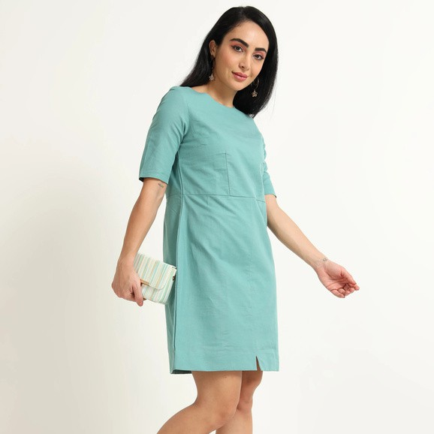

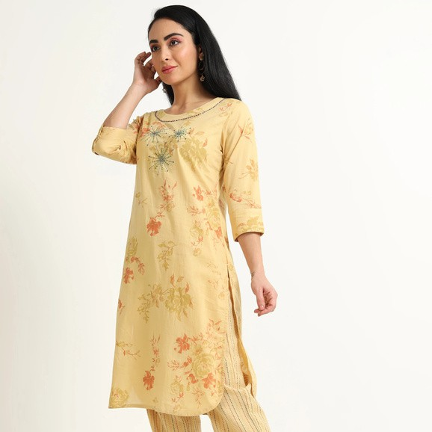
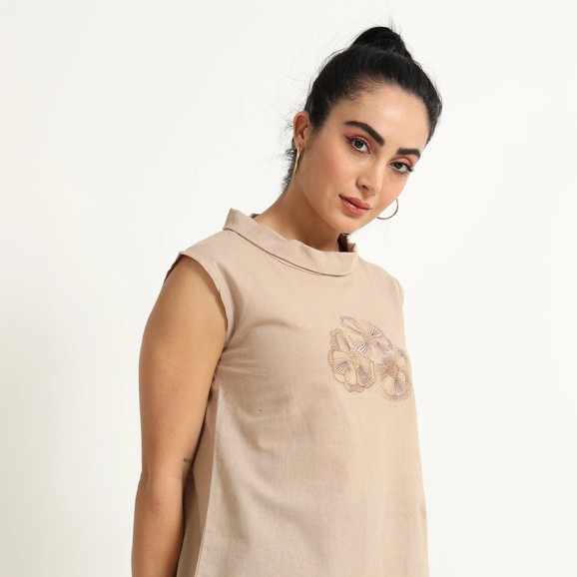



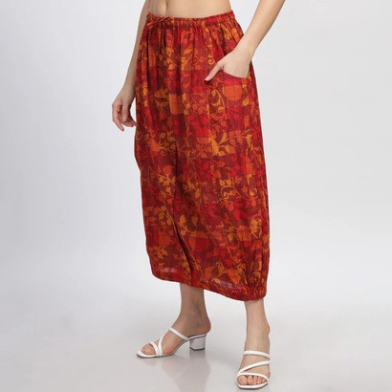
Collection
Dresses
Kurta
Tops
Shirts
Trousers
Jumpsuits
Skirts
© 2 02 5 , Re e p e a t Po w e r e d b y S h o p i f y

Slide 5




FOUNDED BY
Reena Pavithran Krishnan,
Reepeat is not just a brand
it's a movement towards a more sustainable and stylish future.
At Reepeat, we believe that fashion should not come at the expense of our planet. We are committed to eco- friendly practices and our passion for artistry drives us to create natural & organic, non-polluting garments that are as beautiful as they are sustainable. From everyday essentials to statement pieces, find everyday here they will complement your style while preserving the planet.
Explore our new collection and discover how you can make a difference with every purchase. Together, let's redefine fashion for a greener future.
CONTACT US:
+91-90082 00995
krishnan.reena@gmail.com
© 2 02 5 , Re e p e a t Po w e r e d b y S h o p i f y

