Slide 1
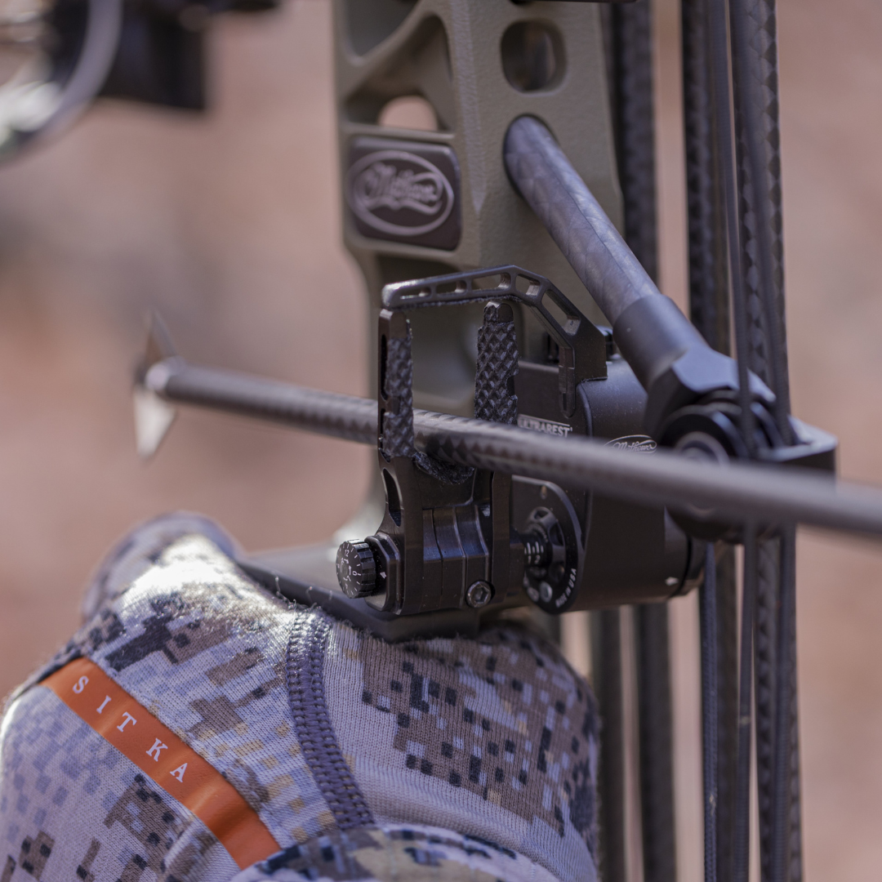

ARCHERY PEEP SIGHTS
Clarifiers & Verifiers for Hunting
www.jamesriverarchery.com

Slide 2
INTRODUCTION
Upgrade your accuracy with our top-quality peep sights, clarifiers, and verifiers—designed for bowhunters and target archers who demand precision. Whether you're battling low-light conditions or striving for a crystal-clear sight picture, James River Archery offers trusted options from leading brands. Shop now to find the perfect peep sight setup that enhances visibility, sharpens focus, and improves your overall shooting performance.
www.jamesriverarchery.com

Slide 3
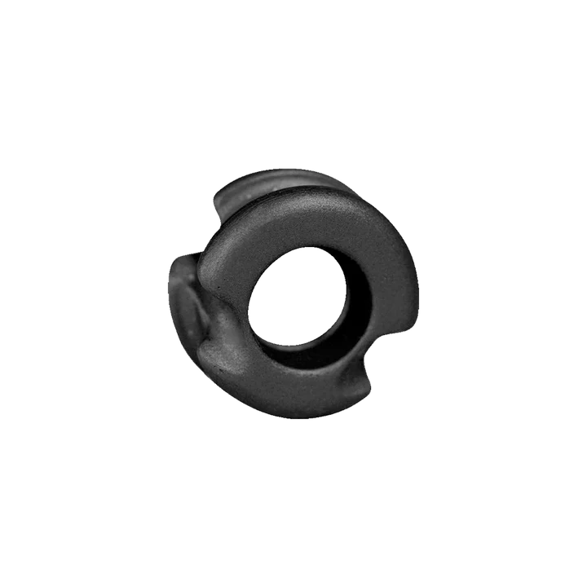
SUPER DEUCE 38 PEEP SIGHTS
The Super Deuce 38 is a premium, anodized aluminum peep sight designed for ultimate accuracy and safety. Its 38-degree angle mount ensures a perfectly round aperture at full draw, ideal for compound archers. Featuring exclusive Dual Radius Slotting, this peep minimizes string wear and eliminates sharp burrs. The outer groove accepts a safety serving, offering extra protection against peep loss during dry fires and reducing accidental movement. Whether you're hunting or target shooting, the Super Deuce 38 delivers reliable performance and durability shot after shot.
www.jamesriverarchery.com

Slide 4
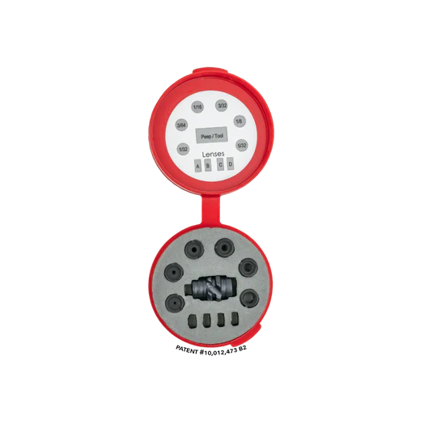
BENEFITS
  Increased Accuracy
  Enhanced Target Acquisition
  Improved Confidence
  Better Performance in Challenging Conditions
  Consistency in Shooting
  Reduced Eye Strain
  Customization Options
  Enhanced Hunting Experience
www.jamesriverarchery.com

Slide 5
CONCLUSION
Peep sights, clarifiers, and verifiers are essential accessories for archers looking to enhance their precision aiming skills. By choosing the right equipment and practicing regularly, archers can improve their accuracy and enjoy a more rewarding hunting experience. James River Archery offers a wide selection of high-quality accessories to help archers achieve their goals and maximize their potential in the field.
www.jamesriverarchery.com

Slide 6
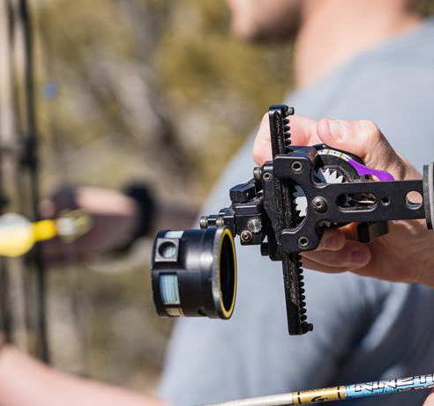


CONTACT US
2734 South Campbell Ave Springfield, Mo. 65807
Tues - Sat,
10:00am - 7:00pm

