Slide 1
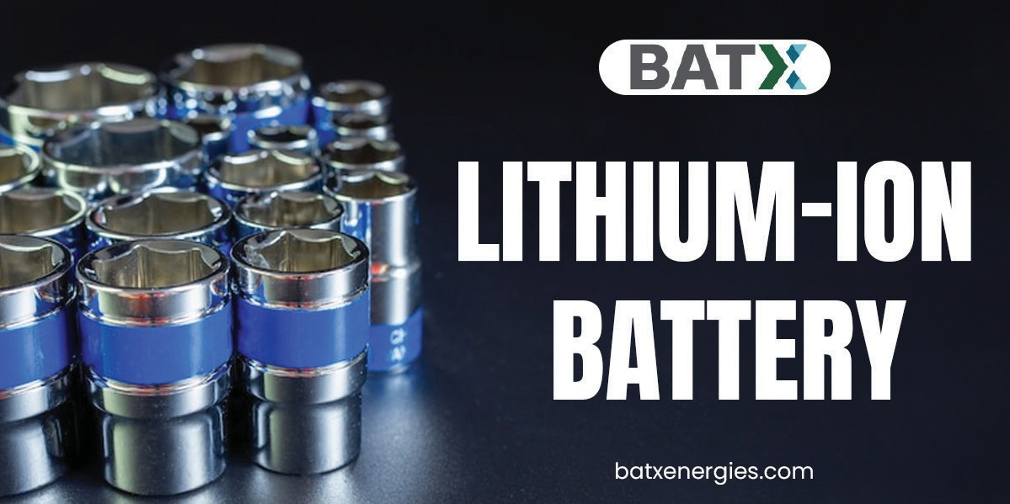

Slide 2

This is not just about us. This is about everybody. We, at BatX Energies Pvt. Ltd., are just the agents of change whose mission it is to create a truly Circular Economy. We’re doing our part by extracting Rare Earth metals such as Lithium, Cobalt, Nickel and Manganese from used Lithium-ion cells. The result of this is that these precious Rare Earth metals can go back into manufacturing Lithium-ion batteries.
batxenergies.com

Slide 3
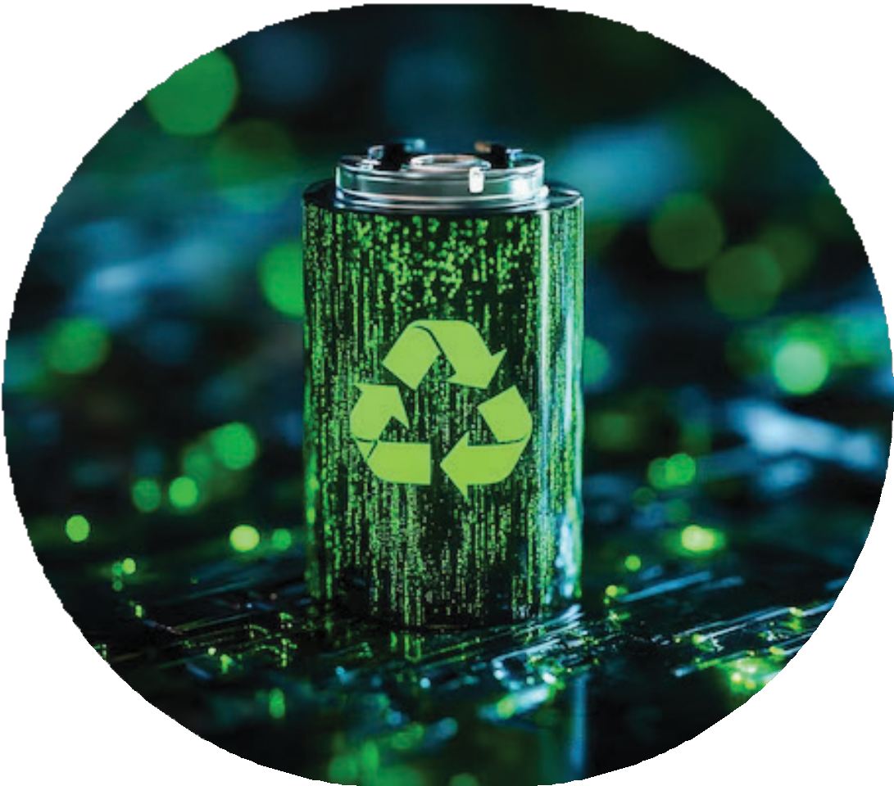
Improper disposal of lithium-ion batteries increases the risk of health, water, and land degradation. Overall it harms human health and the ecosystem. Many people are still unaware of the negative impact of the unsafe disposal of Lithium-ion batteries. They dispose of it as ordinary garbage. This unintentionally harms them and raises health hazards due to improper lithium-ion battery disposal. Stay with us, this blog will ex- plore the health hazards of improper lithium-ion battery disposal.
Health Hazards of Improper Lithium-Ion Battery Disposal
Let’s dive into the health hazards of improper lithium-ion battery disposal.
Chemical Exposure
Improper disposal of lithium-ion batteries results in the leakage of harmful chemicals such as nickel, cobalt, manganese, etc. into landfills and waterfalls. Human exposure to these chemicals through drinking, eating, or touching, either accidentally or inten- tionally, has adverse effects on their health.
Fire and Explosions
Improper disposal of lithium-ion batteries can result in crushing or penetration. This causes moisture and oxygen to enter the battery, further oxidizing the lithium compo- nents resulting in the heat reaction, called a thermal runway. As a result, it can lead to fire and explosions. This fire and explosion generate toxic gases that harm human health such as burns and unconsciousness.
Air Pollution
Lithium-ion batteries are volatile. It is prone to landfill fires that can smolder for many years. Hence, the improper disposal of batteries contributes to air pollution by releas- ing toxic chemicals into the air. It has many risks to human health. This lowers the human quality of life, increasing the risk of pulmonary diseases, lung cancers, asthma, and cardiovascular diseases. Additionally, air pollution plays a crucial role in global warming. It increases the risk of illness and premature death.
batxenergies.com

Slide 4
info@batx.in
+91-9667723923
batxenergies.com

Slide 5
batxenergies.com

