Slide 1
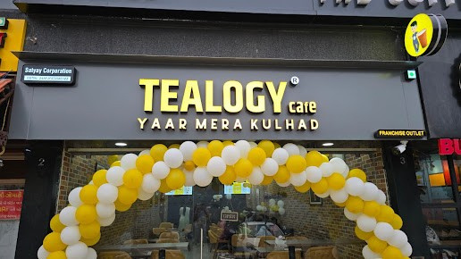

Tea Franchise in Ahmedabad

Slide 2
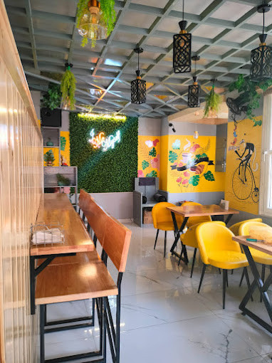

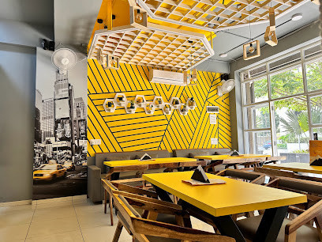
Tealogy offers a premier tea café franchise model in Ahmedabad, combining traditional kulhad chai with a contemporary café experience. Ideal for entrepreneurs, their support includes site selection, comprehensive training, marketing strategies, and streamlined operations . With multiple city outlets in neighborhoods like Nikol and Bapunagar, Tealogy’s proven brand and quality-focused approach make it a top choice for entering Ahmedabad’s thriving tea café scene

Slide 3

Address Details - Shop no. 10, Shiv Business Hub, Sardar Patel Ring Rd, opp. Torrent power sub Station, Nikol, Ahmedabad, Gujarat 382350
Contact Details - 98210 10782
Visit - https://tealogy.in/city/tea-cafe-franchise-ahmedabad

Slide 4

Thank You
Visit - https://tealogy.in/city/tea-cafe-franchise-ahmedabad

