Slide 1
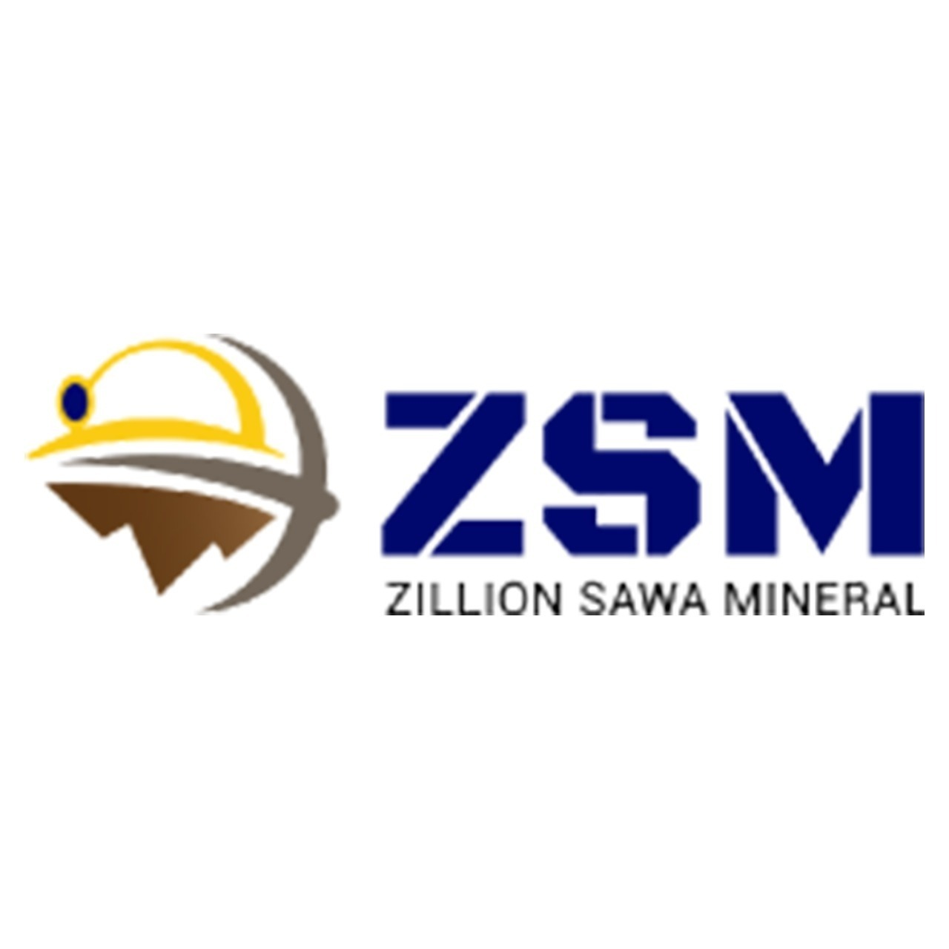
Premium Crushed Limestone Supplier
By Zillion Sawa Minerals Pvt. Ltd.

Slide 2
About Zillion Sawa Minerals Pvt. Ltd.
Established name in the Indian minerals industry
Known for quality, reliability, and ethical business practices
Specializing in limestone, quartz, kaolin, and other minerals

Slide 3
What is Crushed Limestone?
Crushed limestone is a versatile material derived from sedimentary rock
Commonly used in construction, agriculture, and industrial applications
Sizes range from fine particles to larger aggregates

Slide 4
Applications of Crushed Limestone
Construction: Roads, concrete mix, base material
Agriculture: Soil pH control (aglime)
Industry: Glass, cement, iron smelting
Landscaping: Pathways, driveways, decorative uses

Slide 5
Limestone variation of sizes
Type | Limestone | Size
Type 1 | Limestone lump | particle size is <150
Type 1 | Limestone Gitti | particle size is <20mm.
Type 1 | Limestone concrete | particle size is 60 mm, 50 mm, 40mm

Slide 6
Product Specifications
Purity: High Calcium content
Size range: Customized per client need
Color: White to off-white
Packaging: Loose, bulk, or custom

Slide 7
Quality Control & Certifications
Rigorous quality checks at every stage
In-house testing facilities
Adheres to international standards

Slide 8
Why Choose Zillion Sawa Minerals?
Premium quality crushed limestone with consistent sizing
Timely delivery and flexible bulk orders
Committed to sustainable and eco-friendly mining practices
Competitive pricing with excellent customer support

Slide 9
Clientele & Industries Served
Serving cement, construction, chemical, and agricultural industries
Serving cement, construction, chemical, and agricultural industries
Long-term supply contracts available

Slide 10
Contact & Call to Action
Phone: 91 8302184095
Email: info@zillionsawaminerals.com
Visit: https://zillionsawaminerals.com/limestone.php

