Slide 1
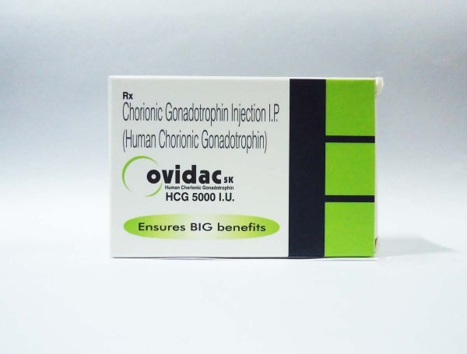

Buy Ovidac hcg 5000 iu Injection
Visit - https://www.safemeds4all.com/product-details/ovidac-5000-iu-ml-freeze-dried-powdered-hcg-injection/442.html

Slide 2
Primary uses of Ovidac 5000 IU (hCG)
  Stimulates ovulation in women to treat infertility and support assisted reproductive cycles.
  Increases testosterone production and sperm count in males with hypogonadotropic hypogonadism.
  Treats delayed puberty in boys due to insufficient gonadotropin pituitary function.
  Manages cryptorchidism (undescended testes) in prepubertal boys not anatomically obstructed.
  Supports corpus luteum function by increasing progesterone during fertility treatments.
https://www.safemeds4all.com/product-details/ovidac-5000-iu-ml-freeze-dried-powdered-hcg-injection/442.html

Slide 3


+1-800-897-1053
Safemeds4all
Trustworthy Source for Generic Drugs
https://www.safemeds4all.com/product-details/ovidac-5000-iu-ml-freeze-dried-powdered-hcg-injection/442.html

Slide 4




+1-800-897-1053
+1-800-897-1053
www.safemeds4all.com
orders@safemeds4all.com
https://www.safemeds4all.com/product-details/ovidac-5000-iu-ml-freeze-dried-powdered-hcg-injection/442.html

Slide 5



+1-800-897-1053
Thank You
https://www.safemeds4all.com/product-details/ovidac-5000-iu-ml-freeze-dried-powdered-hcg-injection/442.html

