Slide 1


Corporate Transfer in Sydney

Slide 2
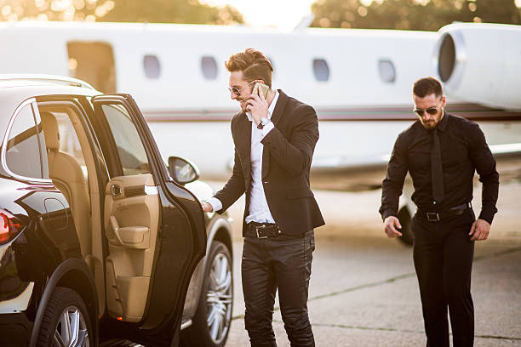
Reliable Corporate Transfers in Sydney
Premium Corporate Transfers in Sydney offers luxury chauffeur‑driven transport tailored for business professionals, combining punctuality, discreet service, and comfort. Executive vehicles feature Wi‑Fi, bottled water, climate control, and flexible multi‑stop scheduling.

Slide 3

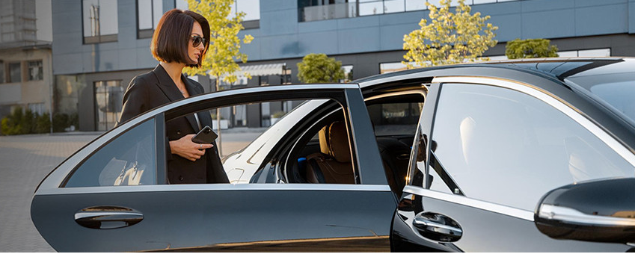
THANK YOU
Address - 12 Brahman Rd, Box Hill NSW 2765
Call - +61 451139131
Visit - https://www.chauffeurhire.com.au/our-services/corporate-transfer-in-sydney

