Slide 1

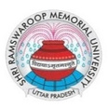
BSc. (Hons.) OTT College in Lucknow

Slide 2

Kickstart Your Healthcare Career with B.Sc. in OT & Anaesthesia Technology
at SRMU
Shri Ramswaroop Memorial University offers a four-year B.Sc. in Operation Theatre & Anaesthesia Technology, blending theory and hands‑on clinical training. The curriculum covers surgical procedures, anesthesia management, infection control, and patient monitoring. With state-of‑the‑art labs, hospital internships and industry tie-ups, it equips graduates for roles like OT technologist, anesthesia technician, and more

Slide 3
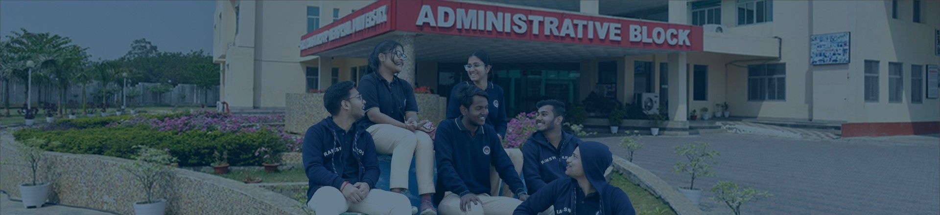
ADDRESS
Shri Ramswaroop Memorial University
Village - Hadauri, Post - Tindola, Lucknow-Deva Road
Phone: 18001026004, +91-9120007948
Email: examination.cell@srmu.ac.in, admissions@srmu.ac.in

Slide 4

Thank You
Visit - https://srmu.ac.in/program/b-sc-in-operation-theatre-anaesthesia-technology

