Slide 1
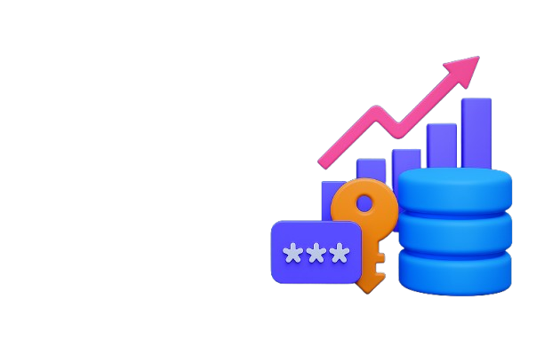

How Data Tokenization Technology is Powering Industry Growth

Slide 2

Introduction
At the age of digital transformation, industries generate and control the entire line and control huge amounts of sensitive data - customer posts, economic details, health information and more. But with this wave in data comes increased risk. Threats for cybersecurity privacy regulations and challenges with consumers are pushing companies to rethink how they handle and secure data.
Data tokenization has proven to be a powerful solution not only to protect data also to enable safe scalable business growth. More than a safety tool, tokenization becomes a strategic technology that promotes innovation across sectors.

Slide 3
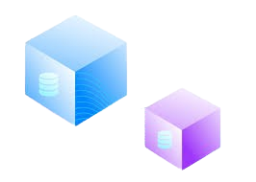
What is Data Tokenization?
Data tokenization is a process that replaces sensitive information with the non-sensitive format-preserving tokens. These symbols have no intrinsic value and cannot reverse constructed without access to a safe token vault.
Unlike encryption, which relies on mathematical algorithms and keys, tokenization ensures that even if tokens are exposed, no meaningful data is revealed. This approach allows businesses to store, transmit, and analyze data securely without compromising functionality or compliance requirements.

Slide 4

Why Tokenization Fuels Growth
Data tokenization is a process to replaces sensitive data and information with non sensitive format-preserving tokens. These token have no essential value not to be constructed without access to a safe token to a vault.
Unlike encryption, which depends on mathematical algorithms and keys tokenization ensures that even if tokens are exposed, no meaningful data is revealed. This approach allows companies to store transmit and analyze data safely - without compromising functionality or compliance requirements

Slide 5

Industry-Specific Use Cases
Finance:
Banks and fintechs use tokenization to protect cardholder data, customer identity and transaction records, enabling compliance with PCI-DSS and reducing fraud.
Healthcare:
Hospitals and medical platforms tokenize patient health information (PHI) to ensure HIPAA compliance and to safely share data for research and diagnostics.
Data tokenization for regulatory compliance in healthcare industry

Slide 6

Retail & E-commerce:
Tokenization helps protect customer PII and payment data while enabling personalization and secure omnichannel experiences.
Supply Chain & Manufacturing:
Sensitive shipment, vendor, and product data are tokenized to maintain confidentiality and support traceability.
Blockchain & Web3:
Tokenization is essential in privacy-preserving identity the asset representation and compliant decentralized applications.

Slide 7
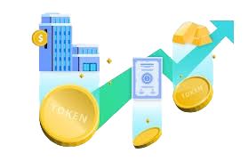
Business Benefits of Tokenization
Implementation of tokenization provides several business benefits. It minimizes the risk of data breaches and insider threats, reduces the costs and complexity of compliance audits and supports secure integration with third -party platforms. Furthermore, it provides the possibility of secure data analysis, which enables insight and innovation without exposing sensitive data. Companies can modernize their infrastructure with confidence, and know that customer and business data remains protected.

Slide 8
Conclusion
Data tokenization is no longer just a security measure - it is a core activation of digital growth and innovation. When industries continue to embrace Cloud Computing, Blockchain, AI and real -time analysis, the need to secure sensitive data without sacrificing ease of use becomes critical.
Tokenization provides a practical, scalable and compatible way of meeting this challenge. By protecting data at the core while allowing them to flow safely through modern systems, companies can safely innovate, expand and build lasting trust with their customers. In the digital age, tokenization is not just a trend - it is a basic strategy for sustainable success.

Slide 9





CONTACT US
BlockchainX offers secure, scalable data tokenization services powered by blockchain, enabling privacy, compliance, and seamless data sharing across platforms and industries.
https://www.linkedin.com/company/blockchainxtech/
https://www.blockchainx.tech/
contact@blockchainx.tech

