Slide 1


MBA in Finance College in Lucknow
at Shri Ramswaroop Memorial University

Slide 2
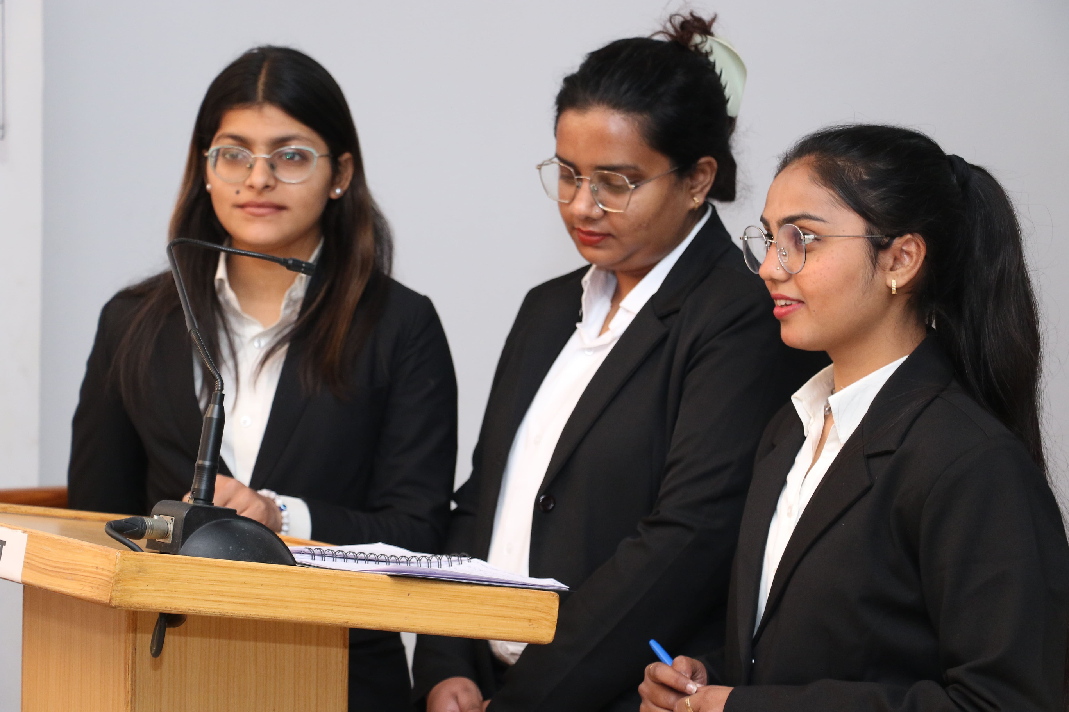
SRMU’s MBA is a dynamic two-year program with CBCS flexibility, industry-certified curriculum, practical internships, and specializations in Finance, HR, Marketing, International Business, Operations, and Entrepreneurship.

Slide 3

Shape your future with SRMU's industry-focused MBA program today!
Shri Ramswaroop Memorial University
Village - Hadauri, Post - Tindola, Lucknow-Deva Road
Phone: 18001026004, +91-9120007948
Email: examination.cell@srmu.ac.in, admissions@srmu.ac.in

Slide 4

Thank You
Visit - https://srmu.ac.in/program/mba-master-of-business-administration

