Slide 1
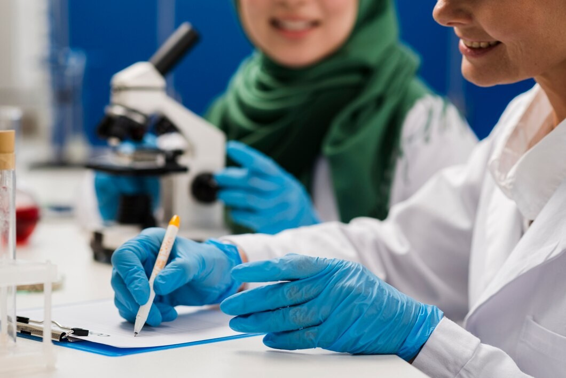

Paramedical College in Lucknow
Visit - https://srmu.ac.in/allied-health-sciences/undergraduate

Slide 2

Shri Ramswaroop Memorial University (SRMU) in Lucknow offers a dynamic Faculty of Allied Health Sciences established in 2023. Undergraduate programs include Medical Laboratory Sciences, Operation Theatre & Anaesthesia Technology, Medical Radiology & Imaging, Optometry, and Physiotherapy, integrating modern labs, expert faculty, research, and robust industry partnerships

Slide 3

Shri Ramswaroop Memorial University
Village - Hadauri, Post - Tindola, Lucknow-Deva Road
Phone: 18001026004, +91-9120007948
Email: examination.cell@srmu.ac.in, admissions@srmu.ac.in
Visit - https://srmu.ac.in/allied-health-sciences/undergraduate

Slide 4

Thank You For Watching
Visit - https://srmu.ac.in/allied-health-sciences/undergraduate

