Slide 1

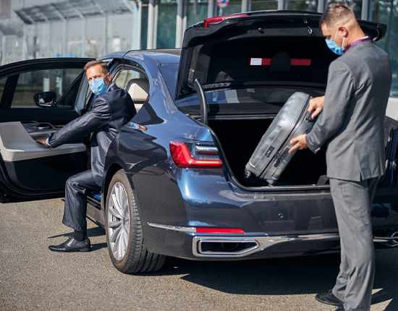
Luxury Chauffeured Cars Sydney

Slide 2
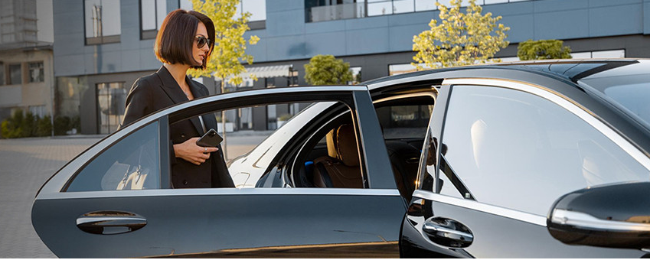
Chauffeur Hire’s Luxury Chauffeured Cars in Sydney
Premium vehicle travel in Sydney: professional trained chauffeurs, high‑end cars, reliable 24/7 service, seamless experiences at affordable rates.

Slide 3
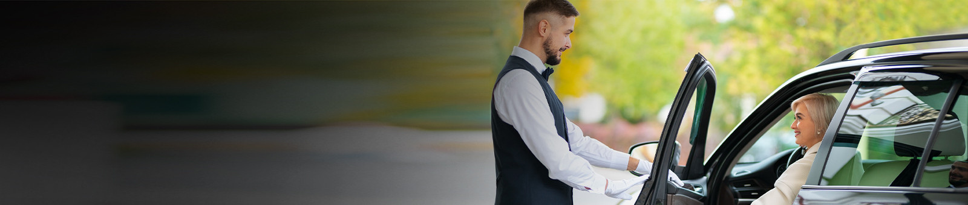

THANK YOU
Address - 12 Brahman Rd, Box Hill NSW 2765
Call - +61 451139131
Visit - https://www.chauffeurhire.com.au/about-us

