Slide 1
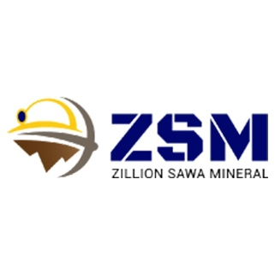
Quartz Lumps Suppliers
Premium Quality Quartz from Zillion Sawa Minerals Pvt. Ltd.
Website: https://zillionsawaminerals.com/quartz.php

Slide 2
About Us
Zillion Sawa Minerals Pvt. Ltd. is a leading name in the mining and mineral industry.
Specializing in high-purity quartz lumps for industrial applications.
Based in India, serving clients globally.

Slide 3
What Are Quartz Lumps?
Naturally occurring crystalline mineral.
Composed mainly of silica (SiO₂).
Used in glass, ceramics, electronics, and construction industries.

Slide 4
Why Choose Our Quartz Lumps?
High purity and consistency
Low iron content
Optimal particle size
Eco-friendly and ethically sourced

Slide 5
Applications of Quartz Lumps
Glass Manufacturing
Ceramics & Sanitaryware
Foundry Sand
Paints & Coatings
Semiconductor Industry

Slide 6
Our Product Range
White Quartz Lumps
Snow White Quartz
Industrial Grade Quartz
Custom size & specifications available

Slide 7
Quality Assurance
Strict quality control processes
Laboratory testing for purity and size
ISO-certified production standards
Reliable and consistent supply

Slide 8
Logistics & Delivery
Global shipping capabilities
Safe and secure packaging
Timely deliveries
Customizable logistics support

Slide 9
Clientele & Markets Served
Domestic & international clients
Trusted by manufacturers across industries
Export presence in Asia, Europe, Middle East & more

Slide 10
Contact Us
Website: https://zillionsawaminerals.com/quartz.php
Email: info@zillionsawaminerals.com
Phone: +91 8302184095
Let’s partner for quality and reliability in quartz supply!

