Slide 1

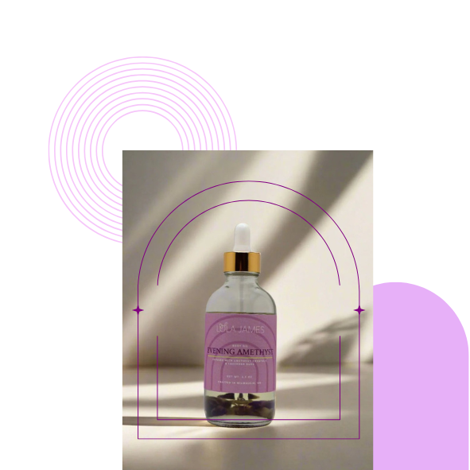

Natural Body Oils for Healthy Skin
LOLA JAMES

Slide 2
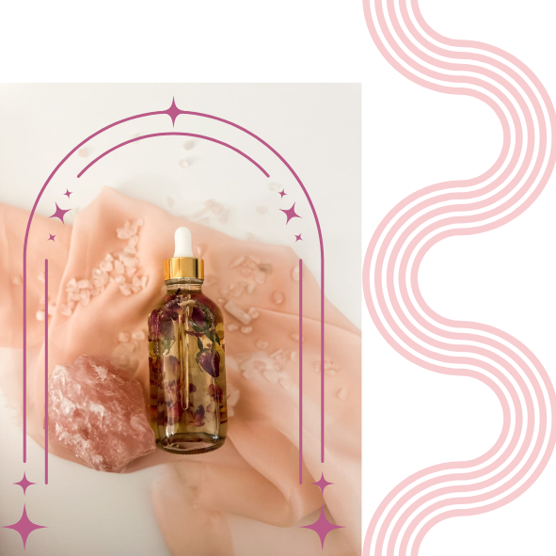
Natural Oils
Benefits of Natural Oils
Natural body oils offer a wealth of benefits for skin health. They are rich in vitamins and antioxidants, providing essential nutrients that nourish and hydrate the skin. Through regular application, these oils can improve skin elasticity and reduce the appearance of fine lines.

Slide 3

Natural oils provide deep hydration to the skin, ensuring it remains supple and moisturized, preventing dryness and enhancing overall skin texture.
Objectives
They also offer essential nourishment, supplying the skin with vital nutrients and fatty acids that promote healthy cell regeneration and improve skin elasticity.
Benefits of Using Natural Oils
Finally, natural oils serve as a barrier, providing protection against environmental stressors while supporting the skin's natural healing processes and reducing inflammation.

Slide 4

Top Natural Oils and Their Benefits
Clear Quartz Body Oil
Amethyst Body Oil
Rose Quartz Body Oil
Quartz crystals combined with lightweight natural body oils such as jojoba, apricot kernel oil, and Kalahari melon oil to encourage clarity; both of your skin and your energy.
Oils charged with amethyst crystals are ideal for moisturizing and calming stressed-out skin and relaxing your mind.
When your skin routine is full of self-love, rose quartz body oil should be a part of it. Along with your skin, you may even see improvement in your mood after using crystal rose quartz-charged oils.

Slide 5
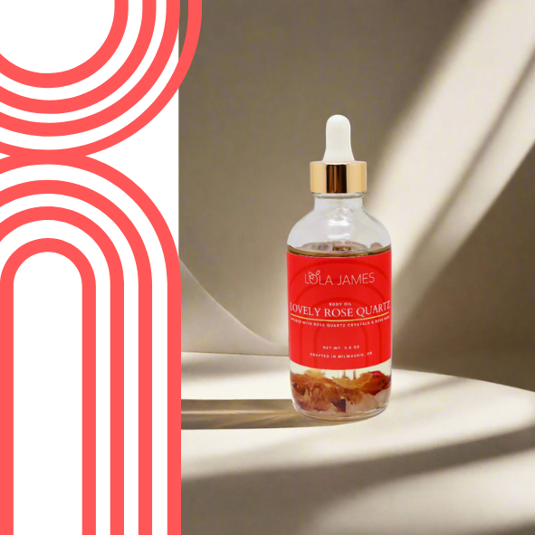
Incorporating Natural Oils Daily
Natural oils can be a game changer in your skincare routine. Start by applying a few drops for enhanced hydration. Natural oils provide a perfect base for a customized skincare experience.

Slide 6


Thank You for Connecting!
Reach out Lola James for more information
Website
WWW.LOLAJAMES.COM
Phone Number
971-236-4703
Location
MILWAUKIE, OR

