Slide 1


Best MBA Colleges in Uttar Pradesh

Slide 2
Highlights of the MBA program at Shri Ramswaroop Memorial University
  Comprehensive Curriculum with Specializations
Offers diverse specializations including HR, Marketing, Finance, International Business, Operations, and Entrepreneurship.
  Industry-Aligned Learning Approach
Emphasizes application-based learning through internships, case studies, and projects to prepare students for real-world challenges.
  Flexible Choice-Based Credit System (CBCS)
Allows students to select courses of their choice, take additional courses, and adopt an interdisciplinary approach to learning.
  Experienced Faculty with Industry Expertise
Faculty members bring a blend of academic excellence and industry experience, ensuring quality education.
  Strong Placement Support and Career Opportunities
Collaborations with premier corporate houses for internships, training, and placements, leading to diverse career avenues.

Slide 3

ADDRESS
Shri Ramswaroop Memorial University
Village - Hadauri, Post - Tindola, Lucknow-Deva Road
Phone: 18001026004, +91-9120007948
Email: examination.cell@srmu.ac.in, admissions@srmu.ac.in

Slide 4
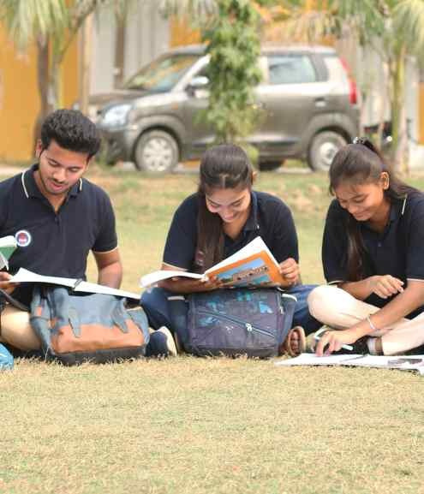
Thank You
Visit - https://srmu.ac.in/program/mba-master-of-business-administration

