Slide 1


Chauffeur Services Wollongong
By Chauffeur Hire

Slide 2
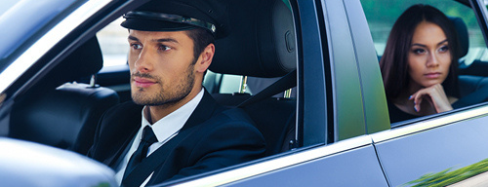
Experience Wollongong in refined elegance with Chauffeur Hire’s luxury chauffeur service. Their professional drivers deliver seamless comfort for airport transfers, corporate events, scenic tours or special occasions. Choose from a premium fleet of executive sedans, SUVs and vans. Enjoy tailored itineraries, local expertise, and hassle‑free travel across this stunning coastal city.

Slide 3

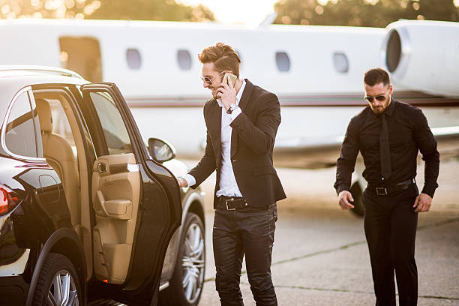
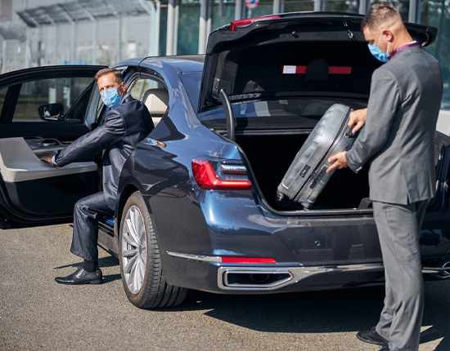
THANK YOU
Address - 12 Brahman Rd, Box Hill NSW 2765
Call - +61 451139131
Visit - https://www.chauffeurhire.com.au/our-services/wollongong-chauffeur-service

