Slide 1

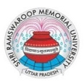
M.A. in Journalism & Mass Communication in Uttar Pradesh

Slide 2

M.A. in Journalism & Mass Communication Program at SRMU
Shri Ramswaroop Memorial University (SRMU) offers a comprehensive M.A. in Journalism & Mass Communication, focusing on practical training across print, broadcast, and digital media. The program emphasizes ethical storytelling, critical thinking, and real-world applications, preparing students for dynamic media careers. With state-of-the-art facilities and industry collaborations, SRMU ensures hands-on experience through workshops, internships, and guest lectures. The curriculum aligns with the New Education Policy (NEP-2020), fostering holistic development and ethical journalism practices. Graduates are well-equipped to excel in various media sectors, including journalism, public relations, and digital communication.

Slide 3

ADDRESS
Shri Ramswaroop Memorial University
Village - Hadauri, Post - Tindola, Lucknow-Deva Road
Phone: 18001026004, +91-9120007948
Email: examination.cell@srmu.ac.in, admissions@srmu.ac.in

Slide 4
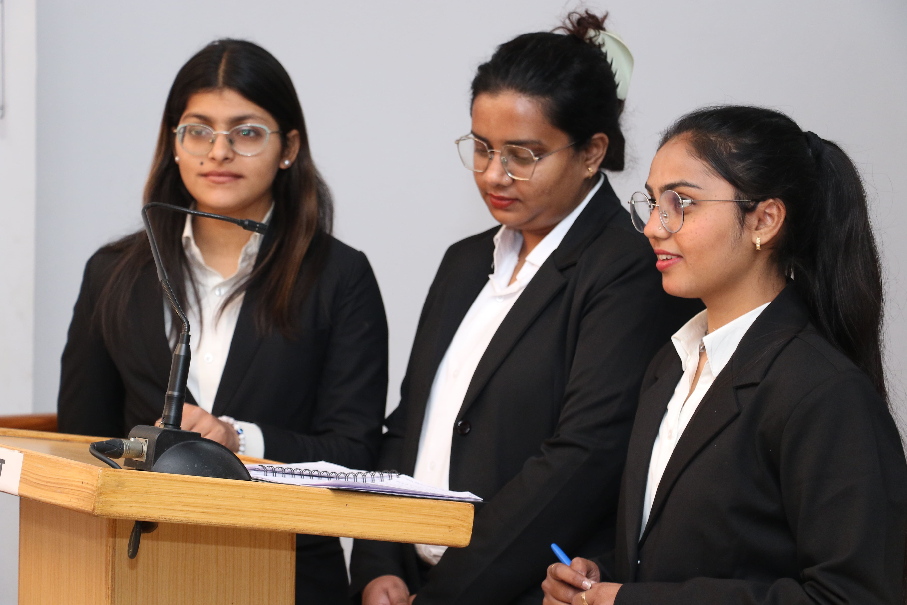
Thank You
Visit - https://srmu.ac.in/program/m-a-journalism-mass-communication

