Slide 1


Shri Ramswaroop Memorial University(SRMU)
M.Sc. in Physics College in Lucknow

Slide 2

M.Sc Course in Physics at Shri Ramswaroop Memorial University (SRMU) offers -
  Two-year postgraduate program in Physics
  Focus on classical and quantum mechanics
  Hands-on experience in specialized physics labs
  Curriculum aligned with NEP-2020 standards
  100% placement assistance and internships

Slide 3
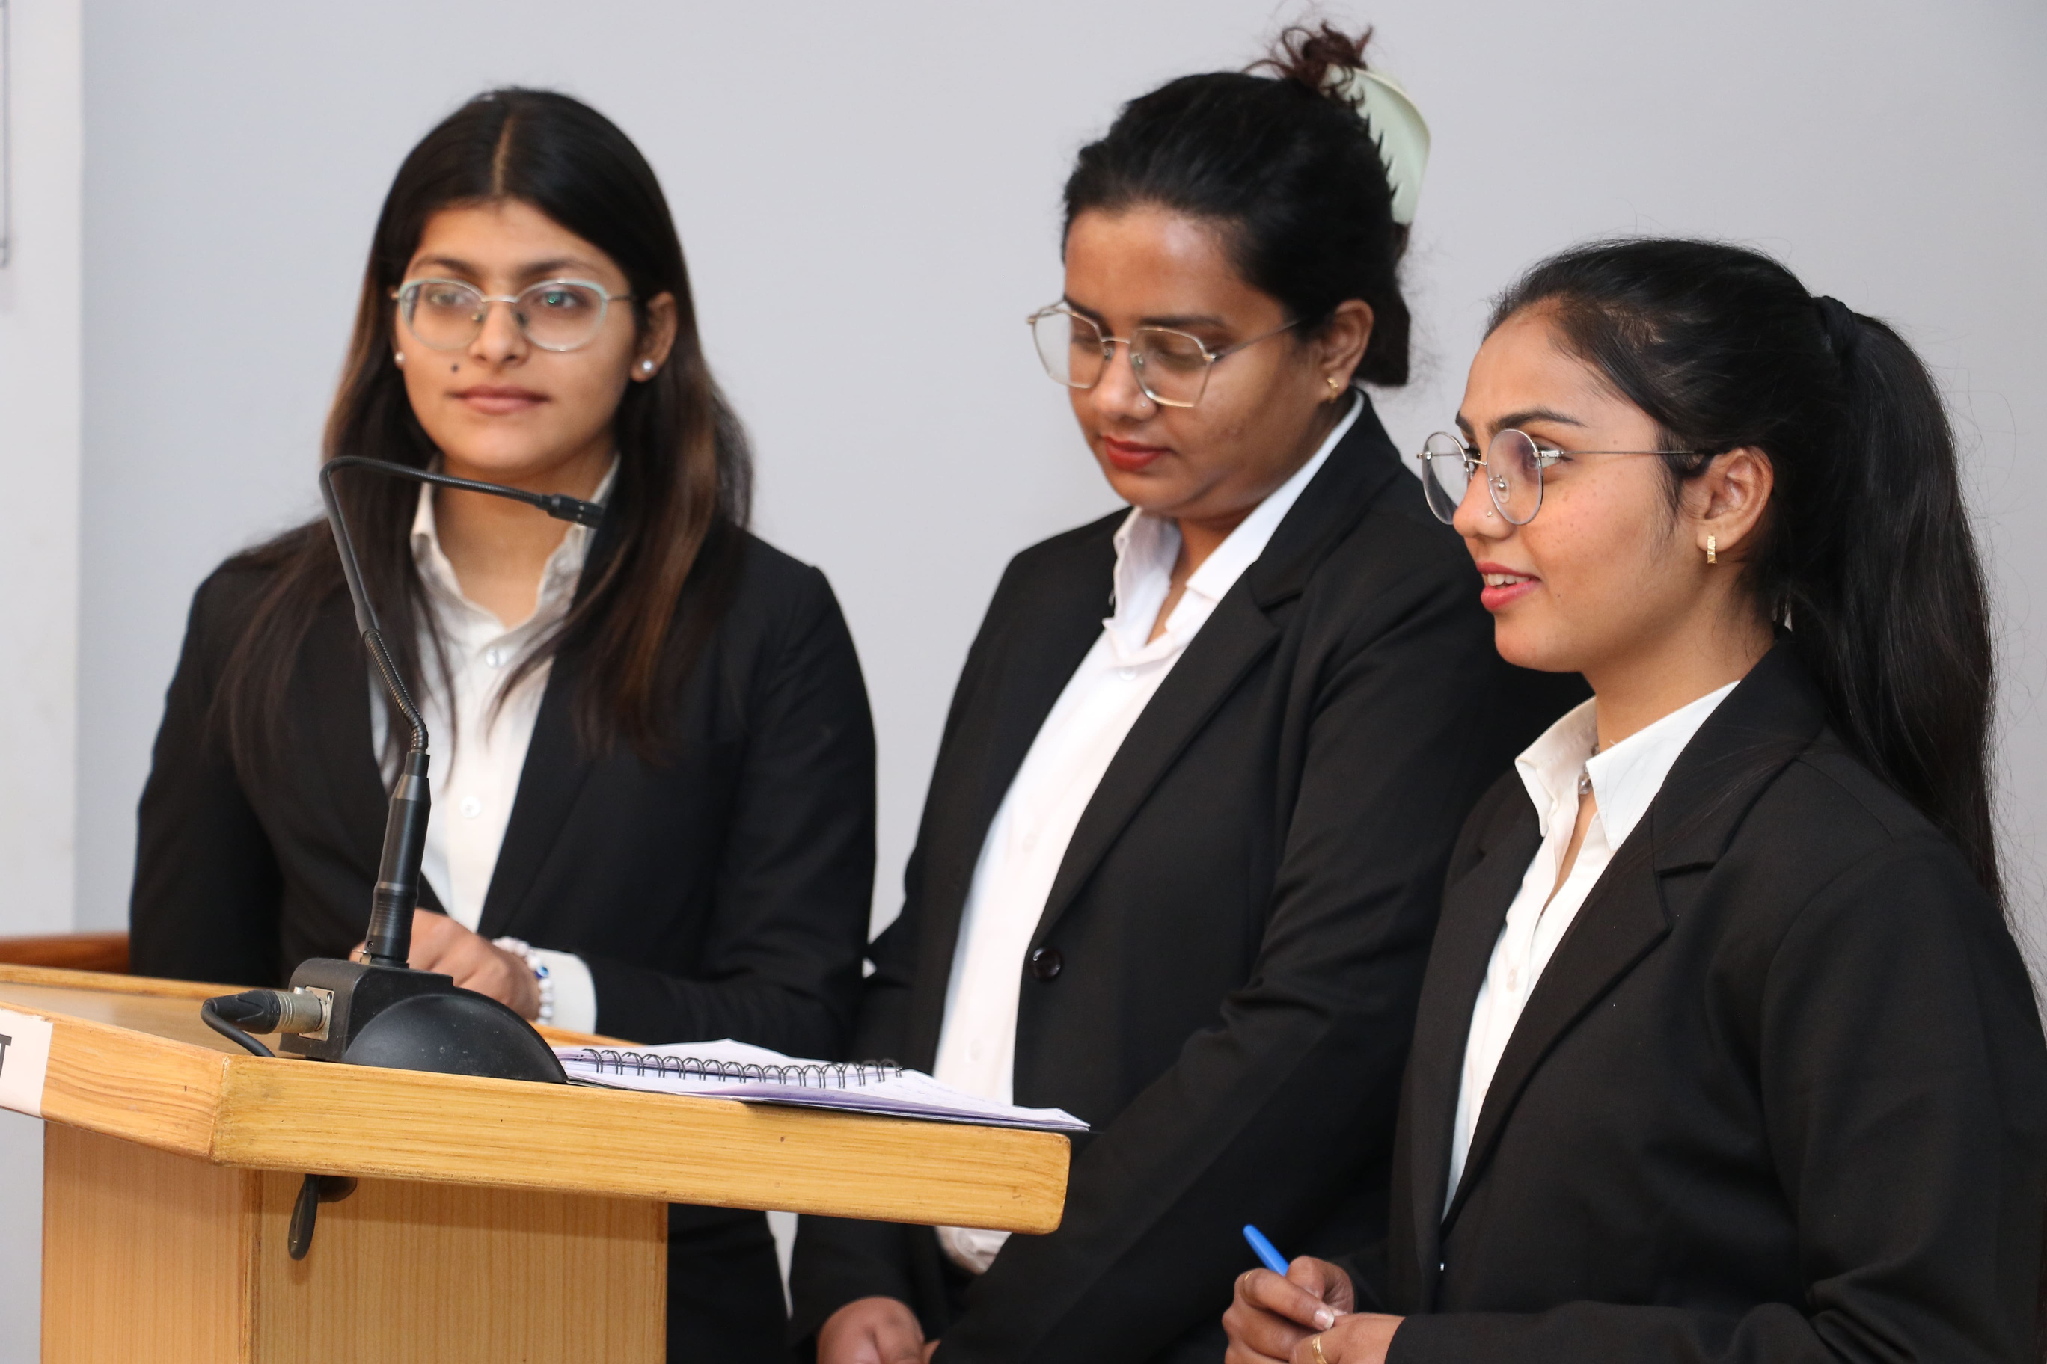
ADDRESS
Shri Ramswaroop Memorial University
Village - Hadauri, Post - Tindola, Lucknow-Deva Road
Phone: 18001026004, +91-9120007948
Email: examination.cell@srmu.ac.in, admissions@srmu.ac.in

Slide 4

Thank You
Visit - https://srmu.ac.in/program/m-sc-physics

