Slide 1

SPICES INDIA
Chilli Export from India
Visit - https://www.spicesindia.net/

Slide 2
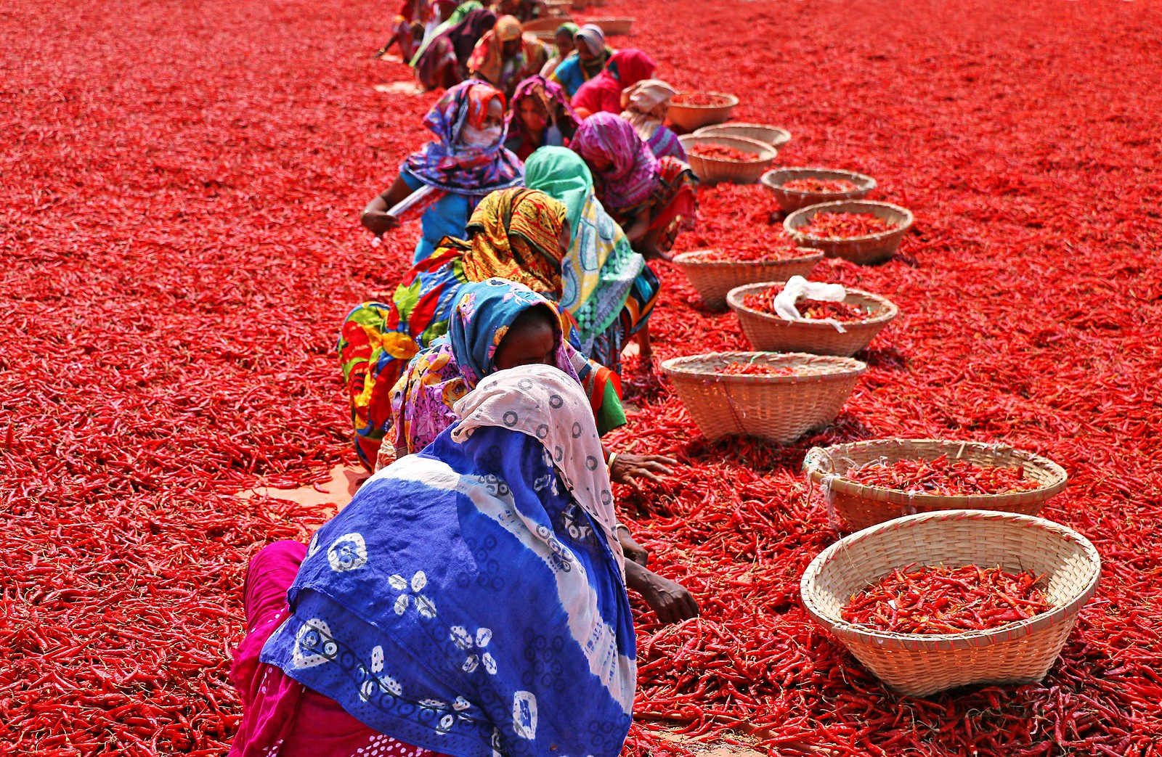
SPICES INDIA
Why Choose Spices India for Premium Dry Red Chillies?
  Leading exporter of premium quality Indian dry red chillies.
  Wide range of chilli varieties sourced from trusted farmers.
  Specializes in Guntur, Byadgi, and Teja dry red chillies.
  Committed to quality, hygiene, and global export standards.
  Supplying spices to USA, UK, Middle East, and more.

Slide 3
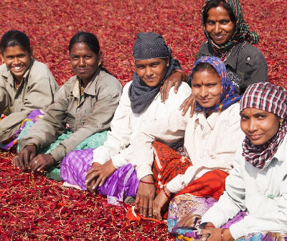
SPICES INDIA
Address- D.No 25-16-180, 181, Mirichi Yard Road, Guntur, Andhra Pradesh, 522005
Phone Number: +91 9701363424
Mail: samsu@agrocrops.com
Website - https://www.spicesindia.net/

Slide 4
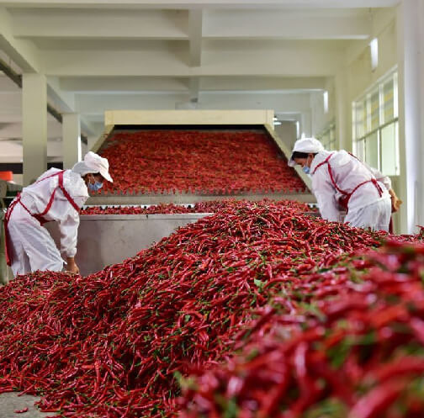
SPICES INDIA
Thank You
Visit - https://www.spicesindia.net/

