Slide 1

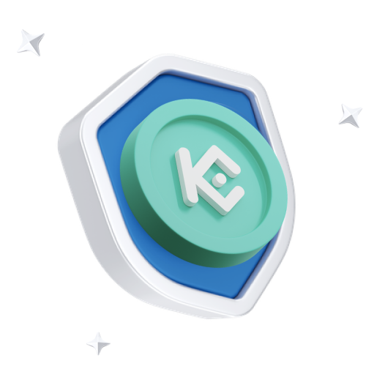

How Customizable Is a KuCoin Clone Script for Business Needs?

Slide 2
What Is a KuCoin Clone Script?
A KuCoin clone script is a pre-made software designed to duplicate core functionalities and features of the KuCoin cryptocurrency exchange. It consists of every component required for running a fully functioning exchange, including trading engines, crypto wallets, order matching systems, KYC/AML integration, and an admin dashboard.
Such scripts are typically designed around popular incidences of Node.js, React, Angular, and MongoDB for their development. They are meant to be white-labeled so a business can rebrand and customize it forthwith to come up with its own crypto trading platform with far less effort as compared to building from scratch.

Slide 3
Why KuCoin Clone Script Is Needed for Business
01
02
03
Time Efficiency
Affordability
Tested & Established Model
04
05
Compliance & Security
Ease of Scaling

Slide 4

Security Enhancements
Advanced Customized Features of KuCoin Clone Script
Multiple Languages and Currencies Supported
DeFi and NFT Integrations
Modern KuCoin clone scripts are highly modular and extensible with a plethoric dearth of advanced customization possibilities:
Advanced Types of Orders and Trading Pairs
Liquidity API and Third-Party Integrations

Slide 5

Why Customization Matters in Crypto Exchanges
While a cryptocurrency exchange clone script provides the initial foundation, suitable customization will truly differentiate a platform in this highly competitive environment. The business has to customize the platform with its clientele in mind, along with regional stipulations and brand identity.
Unique Brand Identity
User Experience
Business Model Alignment
Revenue Strategy
Legal Compliance

Slide 6

Conclusion
In reality, a solid KuCoin clone script sets up the base for one to launch a crypto exchange. But it is in customization where true power exists. The possibilities abound from branding, user experience, integrating advanced financial tools, and conforming to regulations.
If you are an entrepreneur or an enterprise getting into crypto trading, then such a KuCoin clone script can drastically lower your entry barrier with the opportunity to mold the platform as per your vision.
With an ever-growing crypto space, with timely customization your exchange can stand out in such a saturated market, deliver value to its users, and make it big over time.

Slide 7



Thank's For Watching
Connect with us.
7708889555
contact@blockchainx.tech

