Slide 1

KBSPets
7 Best Cat Trees for Large Cats in 2025
Comfort, Climbing & Play — All in One Spot

Slide 2
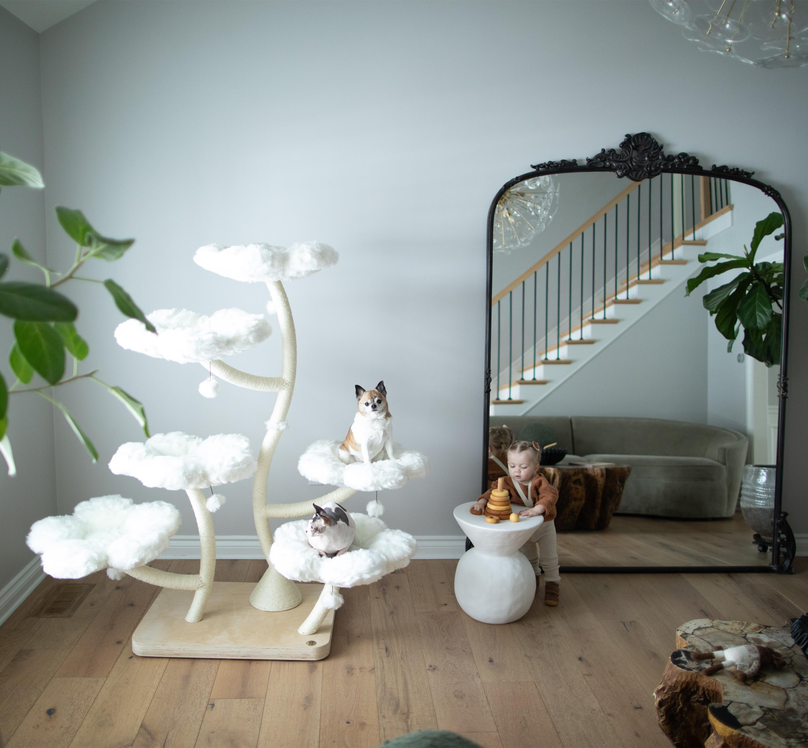
KBSPets
Why Cat Trees Matter
Cats love to climb, perch, and explore.
Large cats need space and sturdy builds.
A good cat tree reduces furniture scratching.

Slide 3
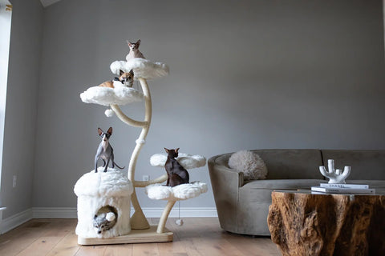
KBSPets
Teddy Blanc Eden
4 oversized flower beds — the largest available.
Strong, curved sisal-wrapped trunk
Mushroom house + 5 pom-pom toys
Great for cats of all ages

Slide 4
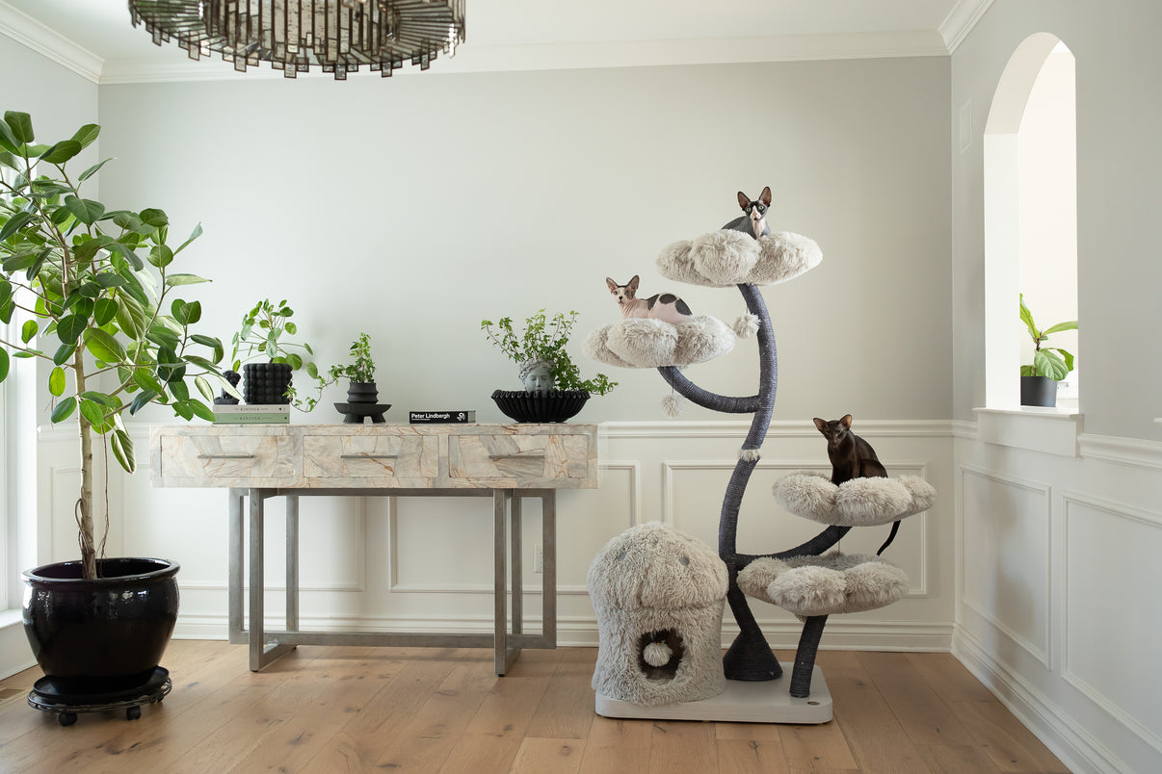
KBSPets
Graphite Grey Eden
Monochrome style from our modern collection
4 large beds + cozy mushroom hideaway
Scratch-friendly sisal rope

Slide 5
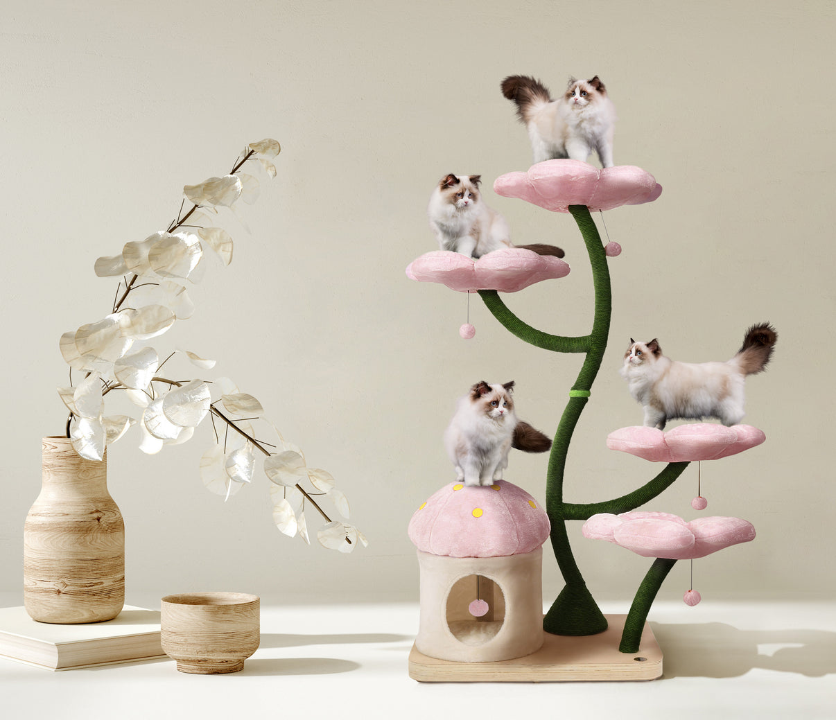
KBSPets
Cherry Blossom Eden
Three pastel shades
4 tiered beds (20.5") + mushroom house
Holds cats up to 25 lbs.

Slide 6
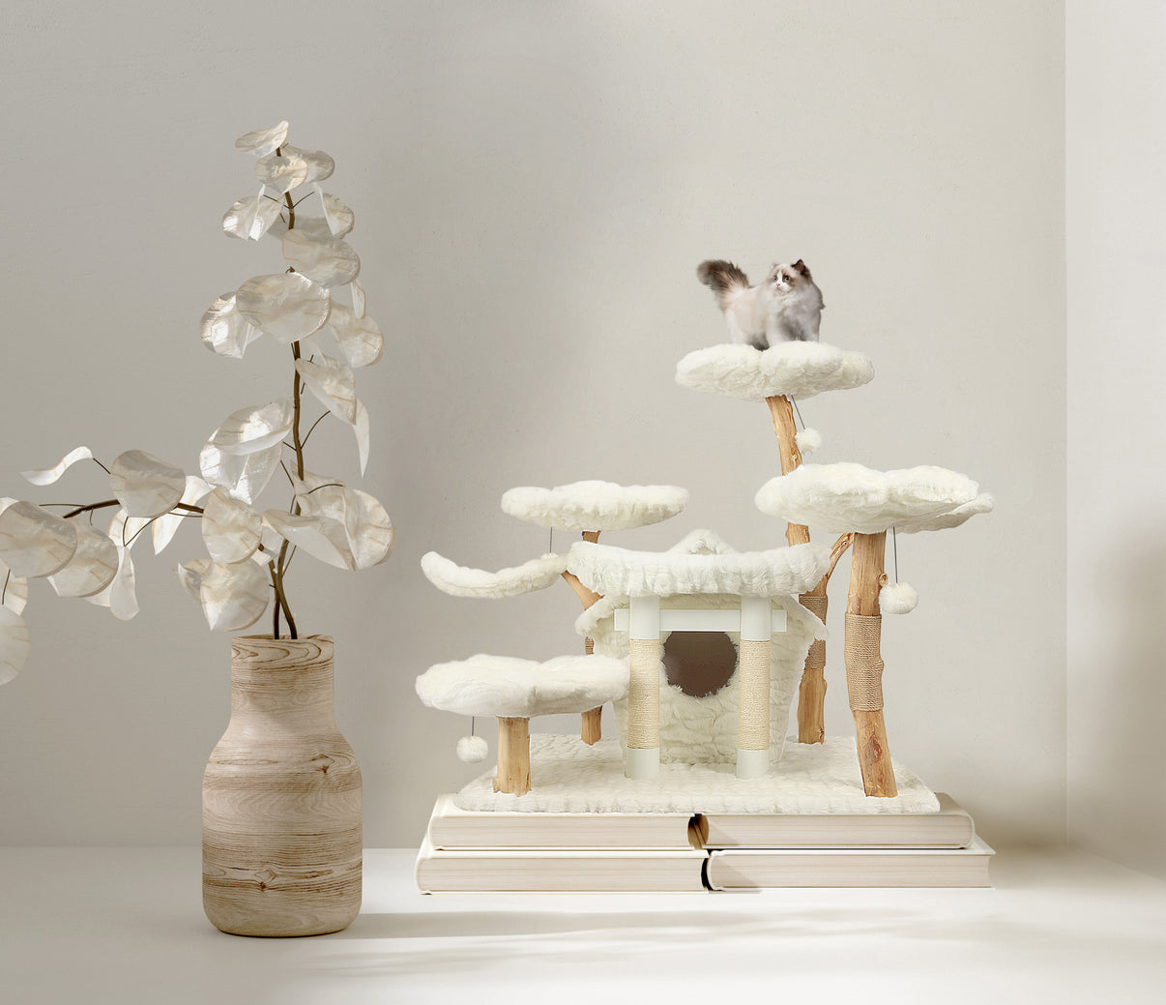
KBSPets
Teddy Blanc Secret Garden
4 blossom beds, 2 leaf perches, 5 posts
Private condo + plush bell toys
Natural wood branches, sisal wrapped

Slide 7
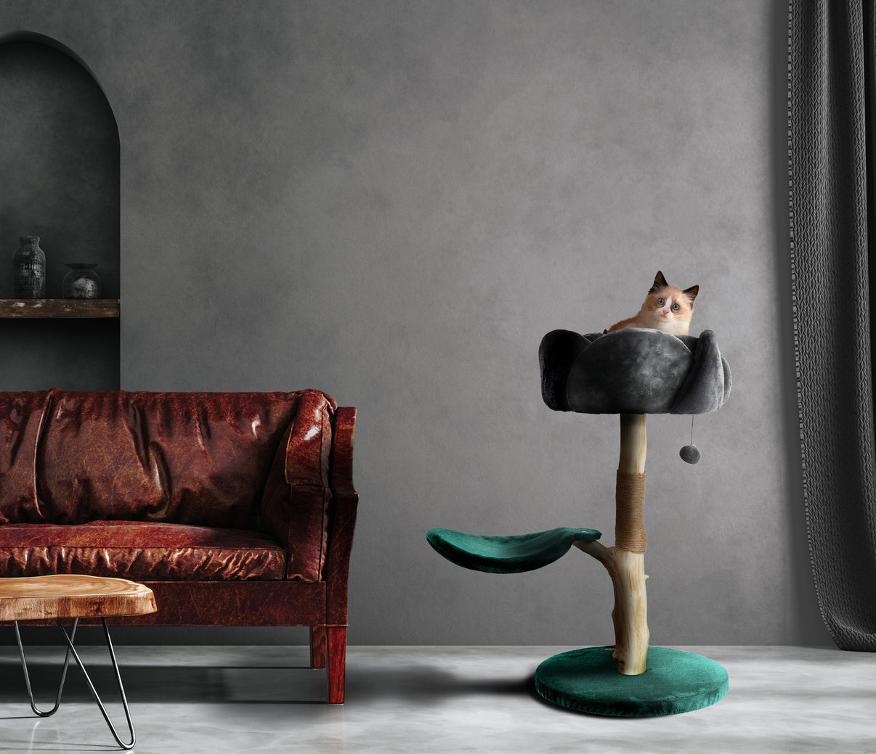
KBSPets
Black Rose
Handmade artisan design
Rose-shaped bed + leaf perch
Soft velvet-style bed, dangling toy

Slide 8
KBSPets
Lavender Cat Tree
Lavender flower bed + leaf perch
Crafted from real tree branches
Unique and cozy lounging space

Slide 9
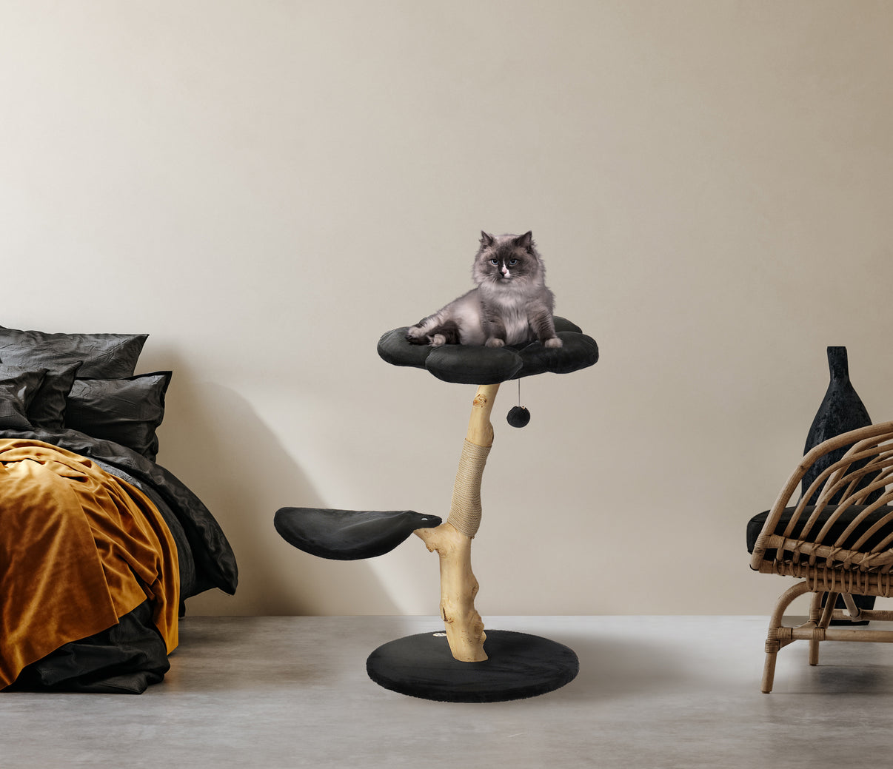
KBSPets
Graphite Grey Eden
Minimalist compact design
Hemp rope scratching post
Easy to move, perfect for 1-cat homes

Slide 10

Final Thoughts
Enrich your cat's life with the right furniture
Stylish, functional, and built for large cats
From playtime to nap time — all covered
KBSPets
Every cat deserves a furrever home

Slide 11
Ready to Treat Your Cat?
Browse the full floral Cat Tree collection
Choose the perfect match for your kitty
Designed for both you and your cat to love
Visit: kbspets.com

Slide 12

CONTACT US
ONLINE SHOP: KBSPets
EMAIL: info@kbspets.com
WEBSITE: www.kbspets.com
SERVED AT: Los Angeles, California
Every cat deserves a furrever home

