Slide 1
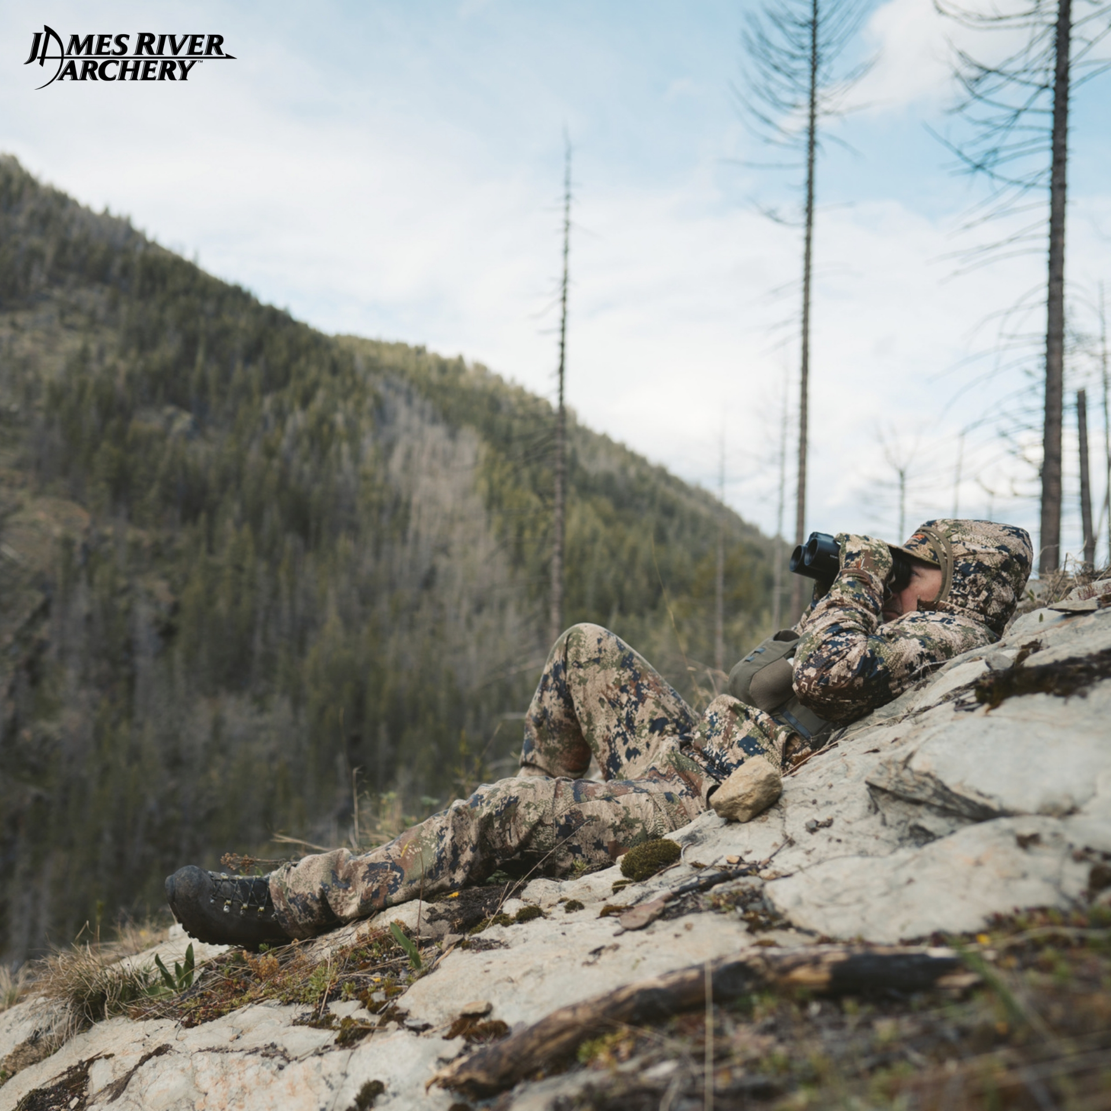

SITKA GEAR
Sitka hunting apparel is now on sale
www.jamesriverarchery.com

Slide 2
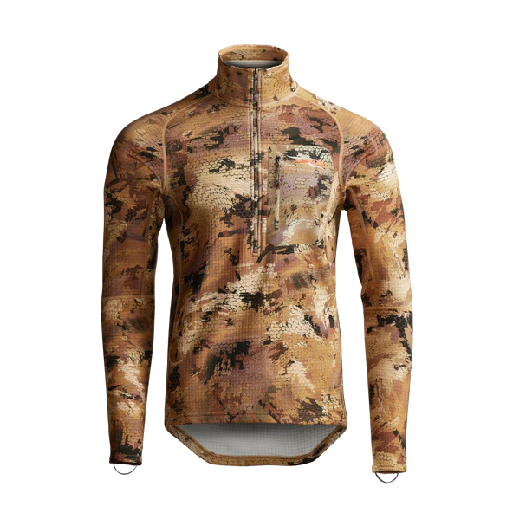
SITKA has maintained its position as a premier provider of outdoor gear, recognized for its excellence, innovation, and top-notch performance. As we enter 2024, the incentives to invest in superior Sitka hunting gear are stronger than before. Renowned for its dedication to producing high-quality hunting and outdoor apparel, SITKA consistently pushes technological and design boundaries, providing enthusiasts with unmatched comfort, durability, and functionality.
www.jamesriverarchery.com

Slide 3
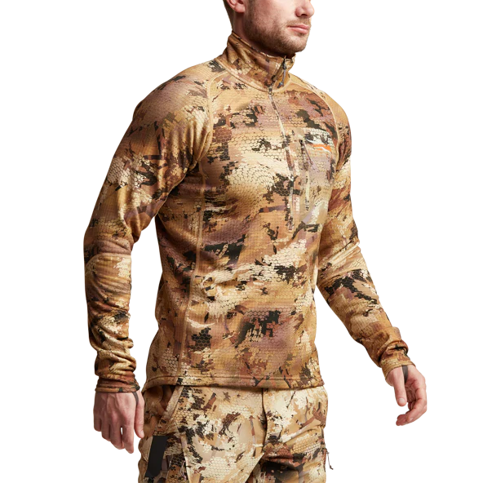
REASONS TO BUY THE BEST SITKA GEAR
  Sitka Gear Camo Technology
  Sitka Gear Stratus Vest
  Sitka Gear Equinox Turkey Vest
  Sitka Gear Merino Core Lightweight Bottom
  Sitka Gear Product Line and Layers
  Sitka Gear Sitka Face Mask
  Sitka Gear Delta Creek GTX Glove
  Sitka Gear Traverse Rib

Slide 4
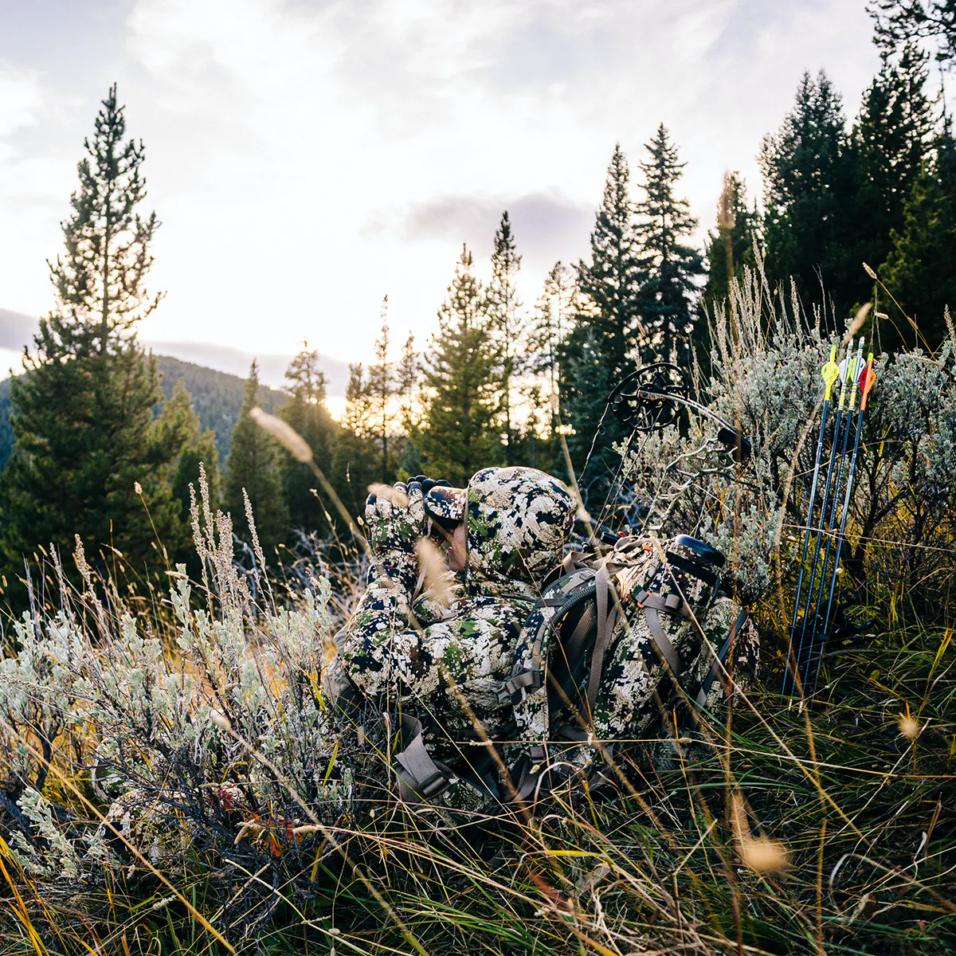
SITKA GEAR CAMO TECHNOLOGY
In our perception, camouflage often features jackets decorated with bark, branches, and leaves. However, SITKA challenges this conventional belief, suggesting that such camouflage primarily appeals to human vision rather than the discerning eyes of the animals we pursue while hunting. Through its camouflage philosophy, SITKA strives to make you truly imperceptible to your prey, rather than simply merging into the background. The objective is to effectively obscure your outline.
www.jamesriverarchery.com

Slide 5
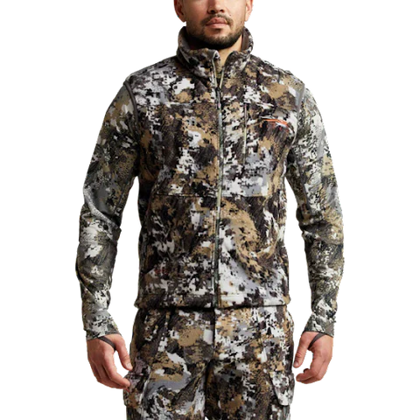
SITKA GEAR STRATUS VEST
Sitka Gear Stratus Vest – a game-changer for whitetail hunters seeking the epitome of versatility in their outerwear. And for your essentials, rely on the YKK zippered chest and hand pockets, all fortified with a Durable Water Repellent Finish. Elevate your Sitka hunting apparel experience with the Stratus Vest – where innovation meets unbeatable performance in the pursuit of the perfect whitetail adventure.

Slide 6
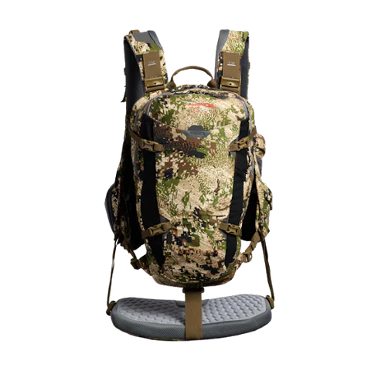
SITKA GEAR EQUINOX TURKEY VEST
Behold the Sitka Gear Equinox Turkey Vest – a revolution in turkey hunting gear that breaks free from tradition. Unleashing a pack-like design, this vest caters to the dynamic movements and organizational demands of run-and-gun turkey enthusiasts. Equinox Turkey Vest is your trusted companion for a successful and comfortable turkey hunt. Weighing in at just 44.5 oz, it's time to gear up and redefine your turkey hunting game with Sitka's Equinox Vest.

Slide 7
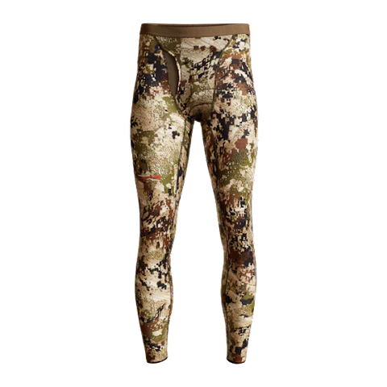
SITKA GEAR MERINO CORE LIGHTWEIGHT BOTTOM
Sitka Gear Merino Core Lightweight Bottom – where cutting-edge technology meets unbeatable comfort for the ultimate outdoor performance. And here's the cherry on top – gear up for success with the Sitka Gears Sale, where excellence meets affordability. It's time to redefine your outdoor game with the Merino Core Lightweight Bottom – because when performance meets style, adventure knows no limits.
www.jamesriverarchery.com

Slide 8
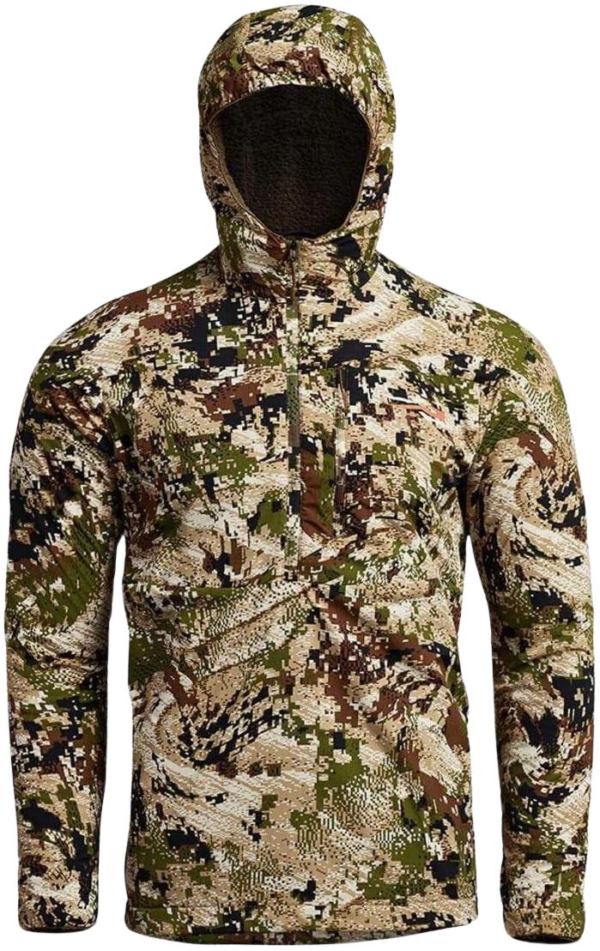
SITKA GEAR PRODUCT LINE AND LAYERS
SITKA Gear is like assembling the ultimate hunting toolkit tailored to your specific adventure. Whether you're pursuing big games in diverse landscapes or navigating challenging terrains, SITKA's product line has you covered. Your selection hinges on the type of game, your prime hunting locations, and the elements you'll face. SITKA Gear ensures you're equipped with the ideal ensemble for an unparalleled hunting experience.
www.jamesriverarchery.com

Slide 9
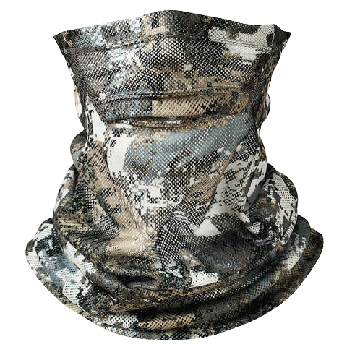
SITKA GEAR SITKA FACE MASK
When a bull elk is inches away or a curious whitetail locks eyes with you from below, your face is your last line of defense. Enter the Sitka Gear Face Mask – the ultimate concealment ace up your sleeve. Crafted from open mesh, this face mask ensures your identity stays a secret, maximizing your shot opportunities. Don't let a bare face blow your cover – let Sitka Gear be your silent partner in the art of stealthy encounters.
www.jamesriverarchery.com

Slide 10
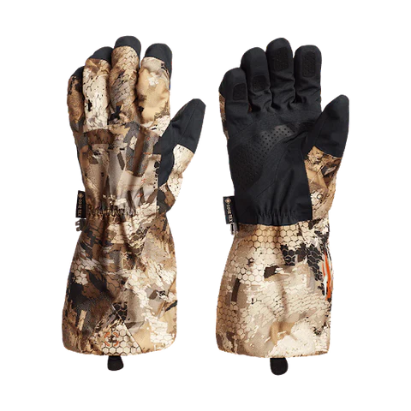
SITKA GEAR DELTA CREEK GTX GLOVE
The Delta Creek GTX Glove ensures unparalleled comfort and peak performance. Crafted with a waterproof 3-Layer GORE-TEX shell and featuring high-loft polyester fleece, this glove is your go-to gear for durability, lightweight functionality, and breathability. Elevate your outdoor game with Sitka Gear – where innovation meets unbeatable protection.
www.jamesriverarchery.com

Slide 11
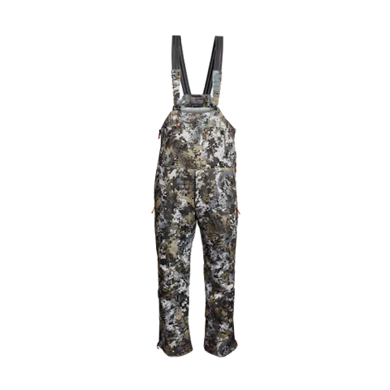
SITKA GEAR TRAVERSE RIB
Unleash the Sitka Gear Traverse Bib – where comfort, performance, and warmth unite to redefine your hunting experience. Featuring set-and-forget suspenders for hassle-free wear, full-length side zips for venting, and a high-loft Berber fleece hand warmer pocket, the Traverse Bib is your ultimate hunting companion, weighing in at just 33 oz. It's time to gear up and conquer the elements with Sitka's Traverse Bib – where comfort meets cutting-edge performance.

Slide 12
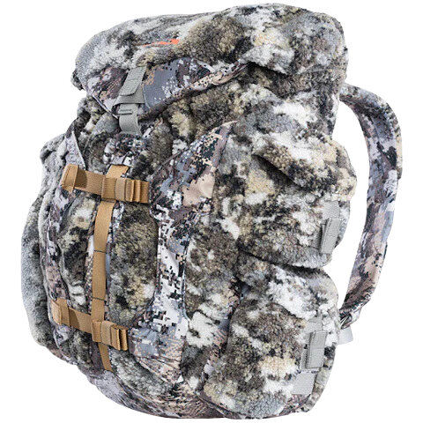
SITKA GEAR FANATIC PACK
Sitka Gear Fanatic Pack – the essential companion for late-season whitetail treestand hunting. This pack isn't just gear; it's a stealthy symphony of innovation. Stay balanced and secure with the stow-away bow/firearm stabilization strap. It's time to revolutionize your hunting experience with the ultimate utility storage system – the Sitka Gear Fanatic Pack. Because in the realm of late-season treestand hunts, silence is your best ally.
www.jamesriverarchery.com

Slide 13
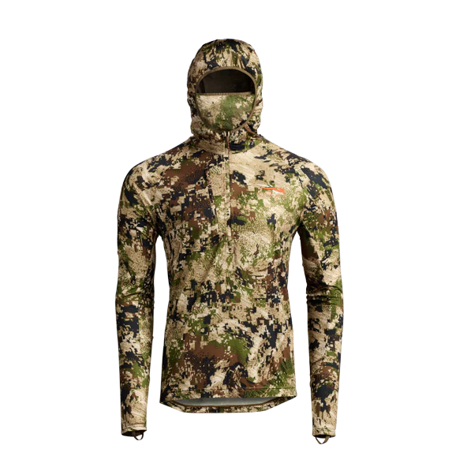

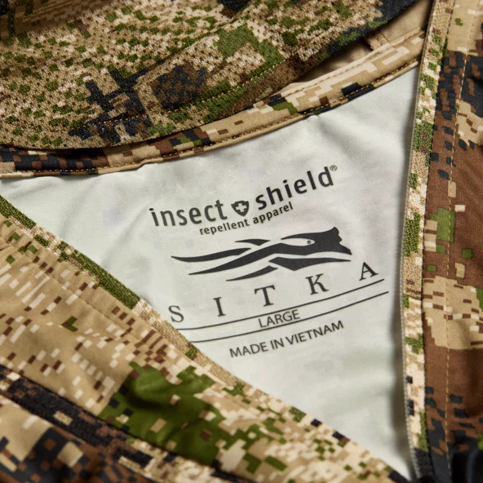


CONTACT US
2734 South Campbell Ave Springfield, Mo. 65807
Tues - Sat,
10:00am - 7:00pm
www.jamesriverarchery.com

