Slide 1



Everything You Need to Know About
DEX DEVELOPMENT IN 2025

Slide 2
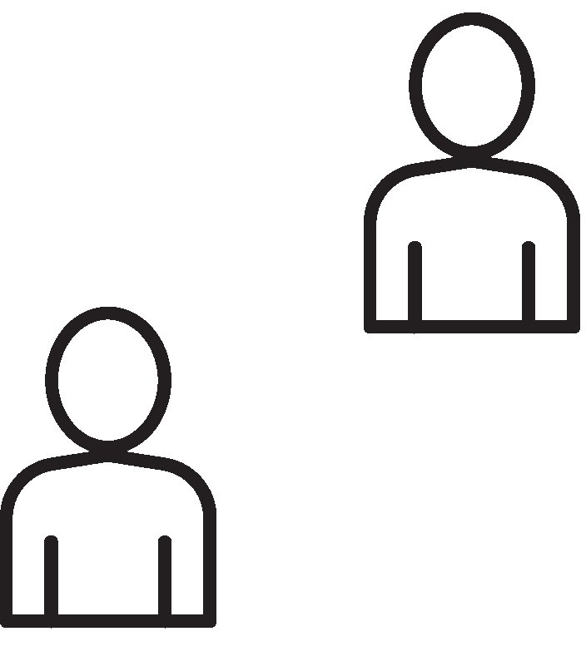
INTRODUCTION
The landscape of cryptocurrencies has been developing at a very rapid pace over the last decade, yet not many innovations have been as impactful as that of decentralized exchanges (DEXs). In 2025, DEXs are not a novelty and experimental area on the fringe of the DeFi ecosystem but the mainstream platforms that contribute to financial autonomy, transparency, and innovations. As interest continues to rise, many developers and entrepreneurs are looking to create your own decentralized exchange to take advantage of this shifting landscape. This blog covers all you should know about DEX development in 2025—its architecture, features, security, and other recent trends that will shape the future of decentralized finance.

Slide 3

THE EVOLVING LANDSCAPE OF DECENTRALIZED EXCHANGES IN 2025
In 2025, the decentralized exchange ecosystem has become more robust, user friendly and scalable than ever. Developments in multi-chain interoperability, zero-knowledge proofs, and blockchain infrastructure have changed the way DEXs operate. Uniswap, SushiSwap, and PancakeSwap were the first platforms, but newcomers have already increased the bar by supporting cross-chain bridges, built-in fiat onramps, and more sophisticated trading instruments.

Slide 4
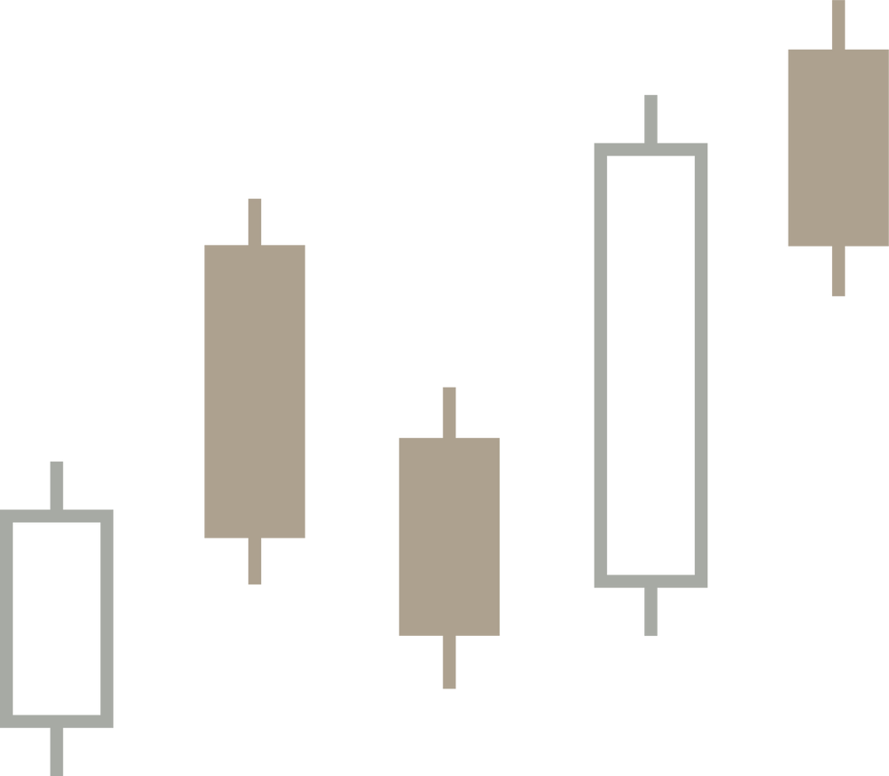
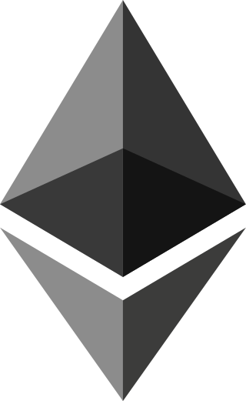
CORE COMPONENTS OF A MODERN DEX
A decentralized exchange does not usually have a central entity, and the smart contracts and blockchain networks are used to ensure that people trade with each other. Main elements of a contemporary DEX are the smart contract platform, automated market makers (AMM) or order book mechanism, liquidity pools, a frontend (web or mobile) and wallet integration.
The DEX functionality centres around smart contracts, which are used to perform trades, provide liquidity and governance. AMMs, such as Uniswap, rely on liquidity pools and constant product formulas to calculate prices algorithmically instead of relying on order books. Conversely, DEXs nowadays also follow hybrid models that combine the efficiency of AMM with the precision of order books in order to support advanced traders.

Slide 5

BUILDING BLOCKS OF A DEX
In 2025, to develop a DEX, it is necessary to have a good command of not only the mechanics of blockchain but also the experience of users. The most important step that developers take is selecting a proper blockchain to develop on Ethereum is dominant, but most build on faster, low- fee networks such as Arbitrum, Polygon, Avalanche, and Solana. Interoperability is done on some platforms even using layer-0 protocols such as Cosmos or Polkadot.
After establishing the basis, it is important to choose the appropriate development tools. Smart contracts are most often compiled in Solidity (in chains compatible with EVM) or Rust (on Solana).

Slide 6
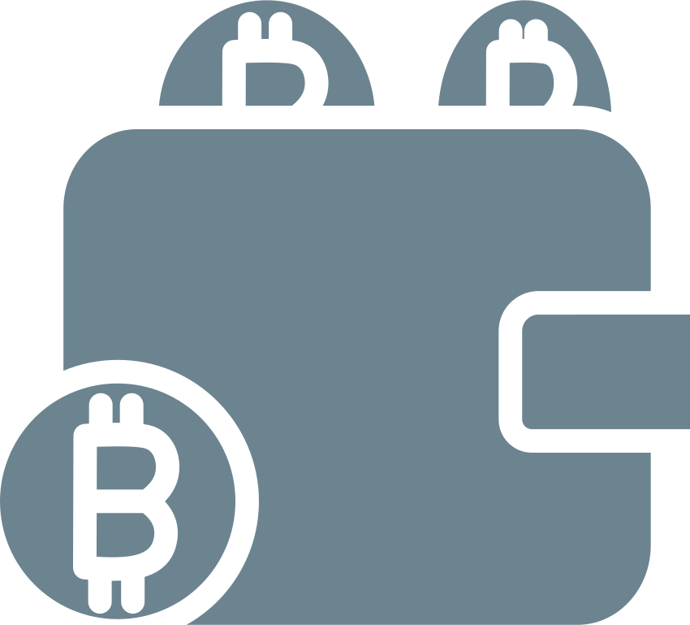
SECURITY AND COMPLIANCE
One of the priorities in the development of DEX is security, naturally, following the series of hacks and exploits that have become more common in recent years. The vulnerabilities of smart contracts may result in the loss that can be catastrophic, that is why it is necessary to perform extensive testing, audits, and bug bounties. Development environments such as Hardhat, Truffle or Foundry allow developers to write, test and simulate smart contracts exhaustively prior to deployment.

Slide 7

ADVANCED FEATURES AND INNOVATIONS
In 2025 DEXs are not simply swap platforms but versatile DeFi ecosystems. Such functions as staking, yield farming, lending, and governance by DAO have become widespread. To compete with centralized exchanges, many platforms introduce limit orders, margin trading, and perpetual contracts.
One of these features is cross-chain functionality. Swaps between blockchains Such as Thorchain, LayerZero, and Axelar allow protocols to climb liquidity and userbase on other blockchains, seamlessly. The bridge technology is no longer new and allows quicker and safer transfer of assets.

Slide 8
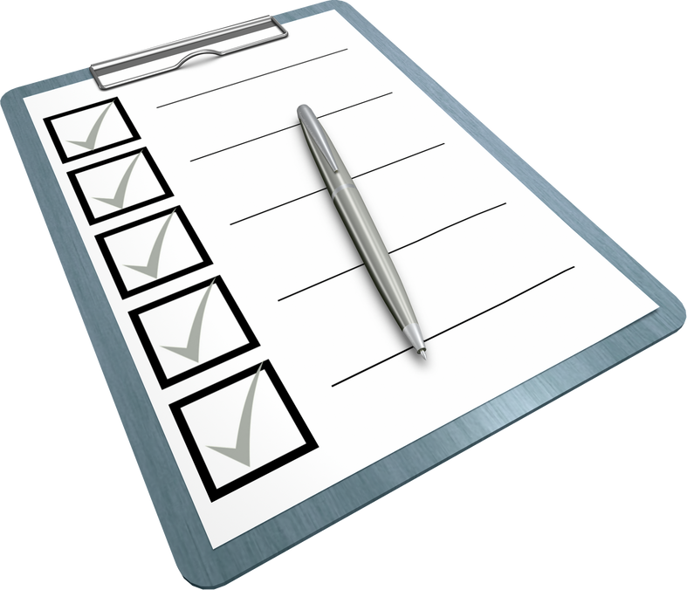
TESTING, DEPLOYMENT & OPTIMIZATION
Thorough testing is done before the contract is live to ensure integrity and reliability of the platform. Unit tests, integration tests, and simulations are used to test all functions of the DEX by developers. There are services such as Tenderly, MythX, and Foundry that provide real-time test environments and vulnerability scanning.
Testing is followed by deployment: after writing the scripts or using CLI tools, one verifies the contracts on the block explorers. Monitoring after deployment: Services such as Etherscan, Dune Analytics, and home-made dashboards can be used to monitor the activity and spot abnormal behavior in real time.

Slide 9

FUTURE OF DEX DEVELOPMENT
In the future, the future development of DEX is bound to the future development of Web3 infrastructure. Rollups Layer 2, ZK-proofs and AI inclusion will offer user-centric, smarter and faster platforms. Censorship resistance will be strengthened by decentralized frontends, which are driven by IPFS or Arweave.
The governance by the community will have a more significant role and the DAO structures will be changed to allow making decisions much quicker, upgrade the protocols and also distribute the rewards more fairly. In the meantime, the regulatory certainty will dictate the approach of DEXs to the regulatory compliance and user onboarding across various jurisdictions

Slide 10

CONCLUSION
Decentralized exchanges have long since outgrown their experimental origins and are taking the lead in marching towards a more open and independent financial system. In 2025, the development of DEX combines the technical intricacy with innovative ease of use, regulatory vision, and state-of-the-art security. You are a developer, entrepreneur or just a crypto enthusiast, you need to learn the dynamics of DEX development to be able to take part in the next wave of decentralized finance. The future of global finance will be formulated by people who are forward-looking, agile, and profoundly decentralization-respecting builders as the ecosystem continues to mature.

Slide 11

For your attention

