Slide 1
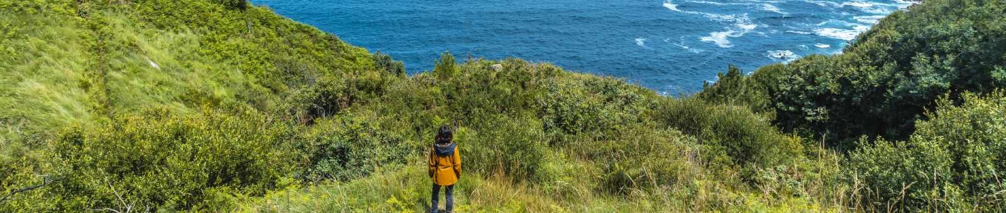

Chauffeur Hire Blue Mountains
By Chauffeur Hire

Slide 2
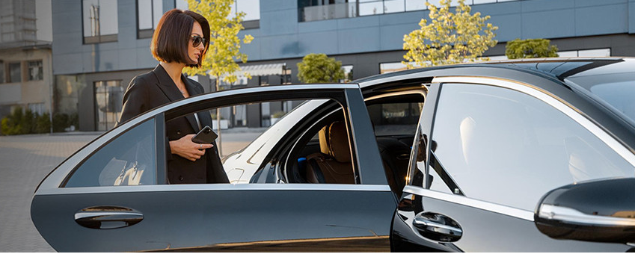
Chauffeur Hire Services in Blue Mountains
  Luxury chauffeur service to and from Blue Mountains.
  Professional drivers ensure safe, relaxed and timely travel.
  Ideal for tours, getaways, or special occasion transport.
  Fleet includes premium sedans, SUVs and luxury vans.
  Enjoy scenic rides with comfort and top-class service.

Slide 3

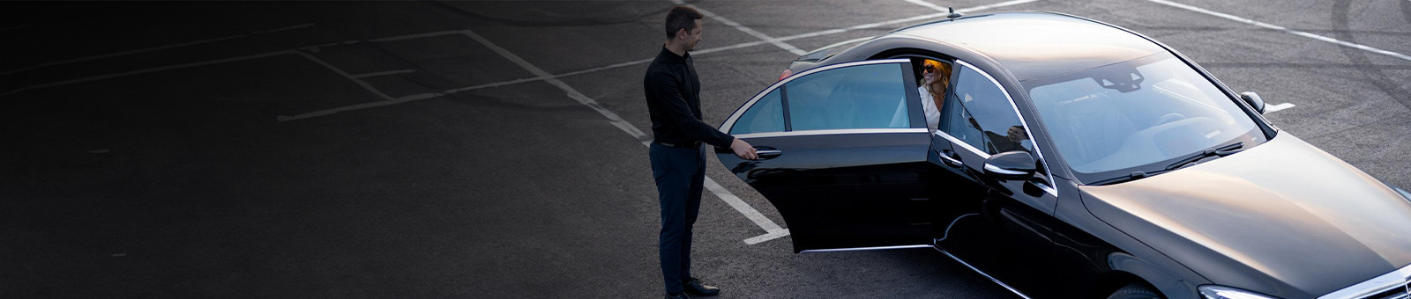
THANK YOU
Address - 12 Brahman Rd, Box Hill NSW 2765
Call - +61 451139131
Visit - https://www.chauffeurhire.com.au/our-services/blue-mountain-chauffeur-service

