Slide 1
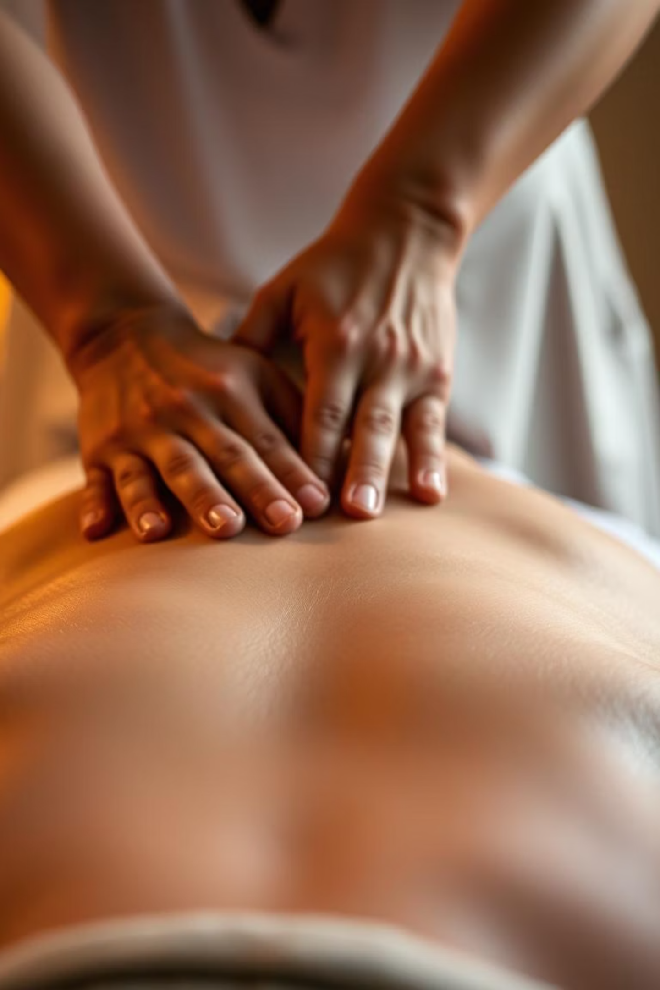
Revitalize Your Body with Deep Tissue Massage in Sammamish
For residents of Sammamish looking to ease chronic muscle pain and reclaim physical balance, a new wellness solution awaits. Calming Corner Spa now offers advanced deep tissue massage Sammamish services designed to target deep layers of muscle and connective tissue—ideal for those dealing with postural tension, repetitive strain, or stress-related discomfort.

Slide 2

A Holistic Approach to Recovery and Relaxation
We understand how physical tension can disrupt your entire sense of well-being. That’s why our skilled massage therapists go beyond traditional techniques. Every session focuses on reducing inflammation, improving mobility, and releasing tight knots using slow, firm pressure. Whether you're an athlete, desk-bound professional, or simply in need of physical release, this treatment is crafted with precision to restore both body and mind.

Slide 3
Customized Treatment in a Tranquil Setting
At our spa, we believe true healing begins in a peaceful environment. From the moment you walk in, you’ll be welcomed into a calming space where comfort and privacy are prioritized. We listen carefully to your needs, customizing the massage experience to align with your body’s condition and your personal goals. Our team uses refined techniques to address long-held tension patterns and support long-term physical wellness.

Slide 4
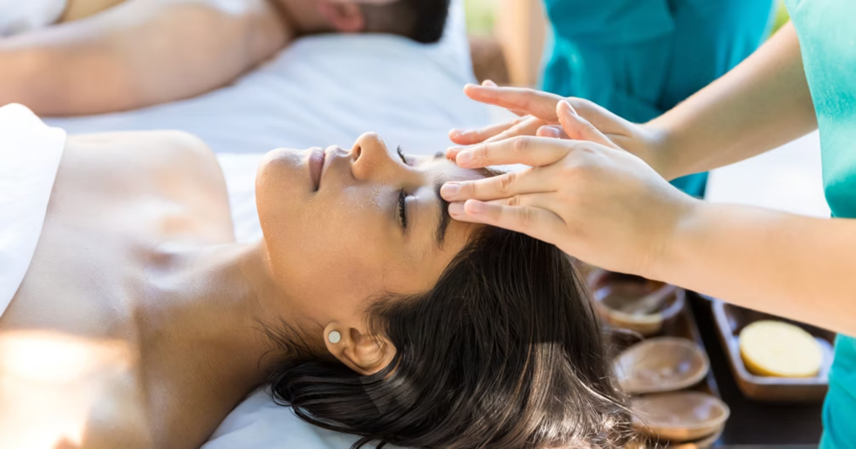
Why Choose Calming Corner Spa for Muscle Relief
We’re committed to more than just surface-level relaxation. Our therapists are trained in advanced modalities that deliver therapeutic results. Each deep tissue massage Sammamish session is backed by anatomical knowledge and thoughtful care—helping to alleviate stiffness, improve circulation, and enhance flexibility.

Slide 5
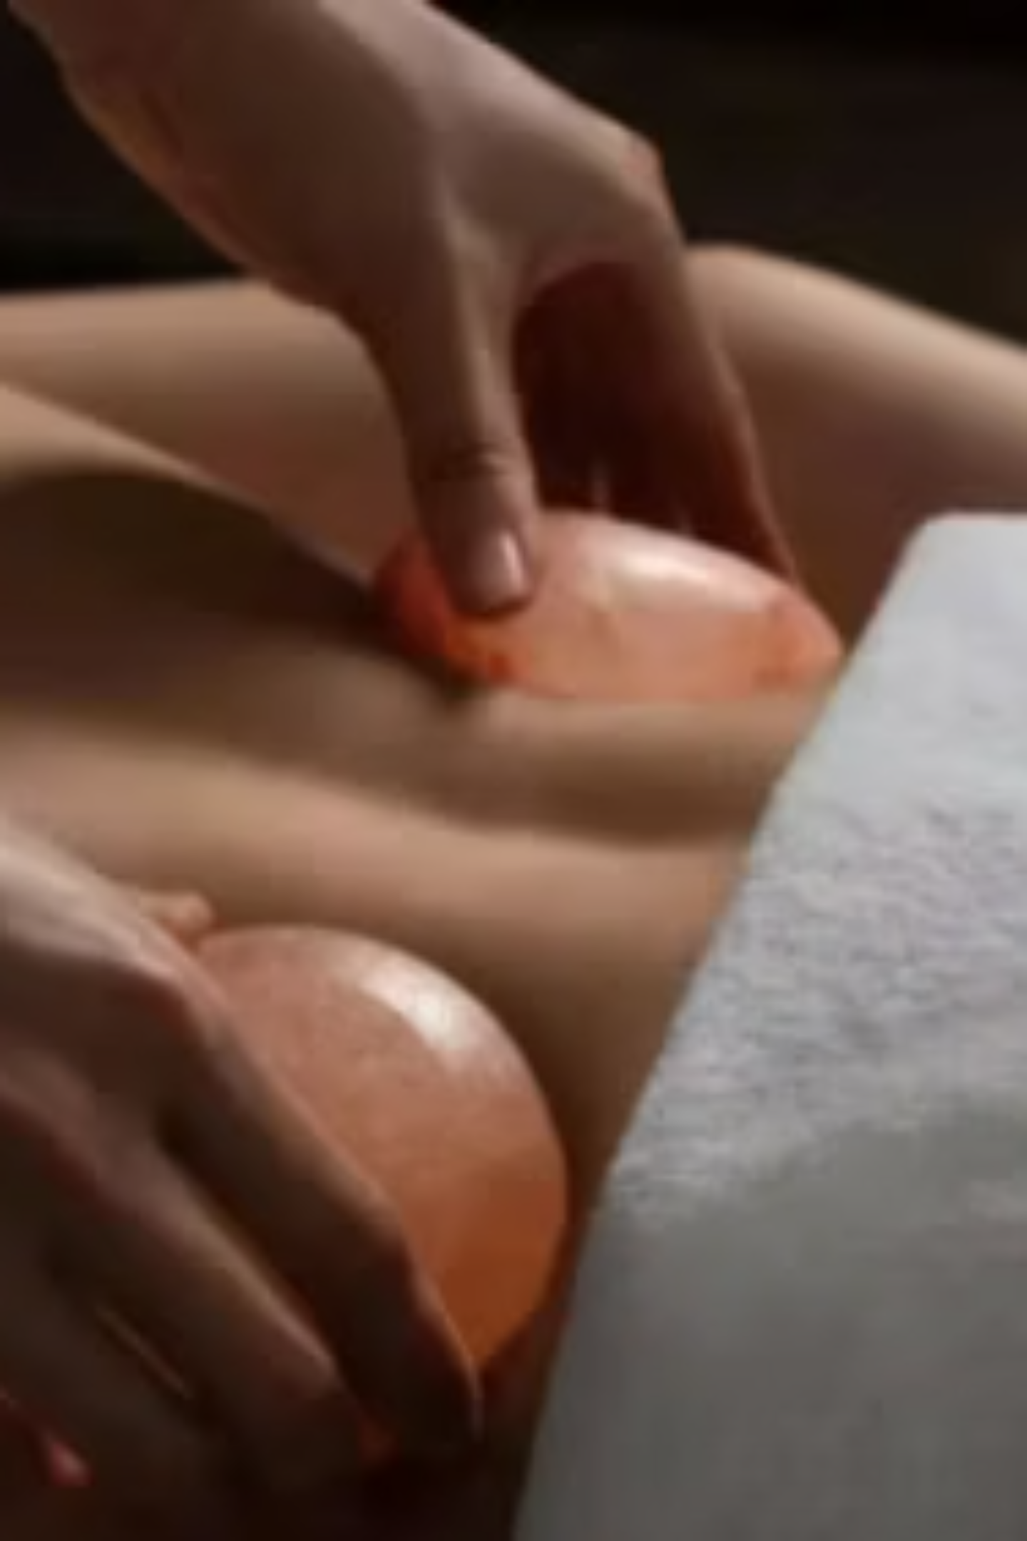
Restore Deep Comfort with Targeted Therapy
When everyday stress builds up or chronic aches start to interfere with your routine, a focused massage can make a world of difference. Our deep tissue massage service is designed to work beneath the surface—easing muscle tension, improving posture, and enhancing blood flow.

Slide 6

About Calming Corner Spa
Located in the heart of Sammamish, Calming Corner Spa is your local destination for body and mind restoration. We offer a curated selection of wellness treatments, including therapeutic massages, facials, and holistic care. Our goal is to help you feel renewed from the inside out. With a team of passionate professionals and a warm, welcoming atmosphere, we are here to support your journey toward balance and relaxation. Visit website our website: www.calmingcornerspa.com​

Slide 7



Media Contacts
8353 160th Ave NE, Redmond, WA 98052
Email Address: calmingcornerspa@gmail.com

