Slide 1


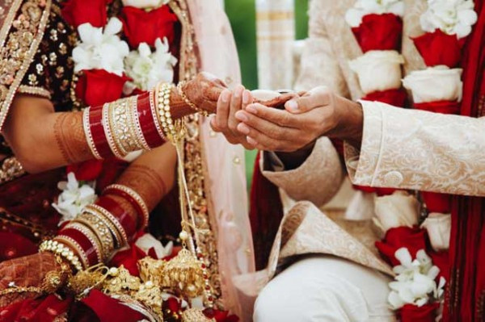
Imperial Wedding
Indian Marriage Bureau in UK
Visit - https://www.imperial.wedding/indian-marriage-bureau-in-uk

Slide 2
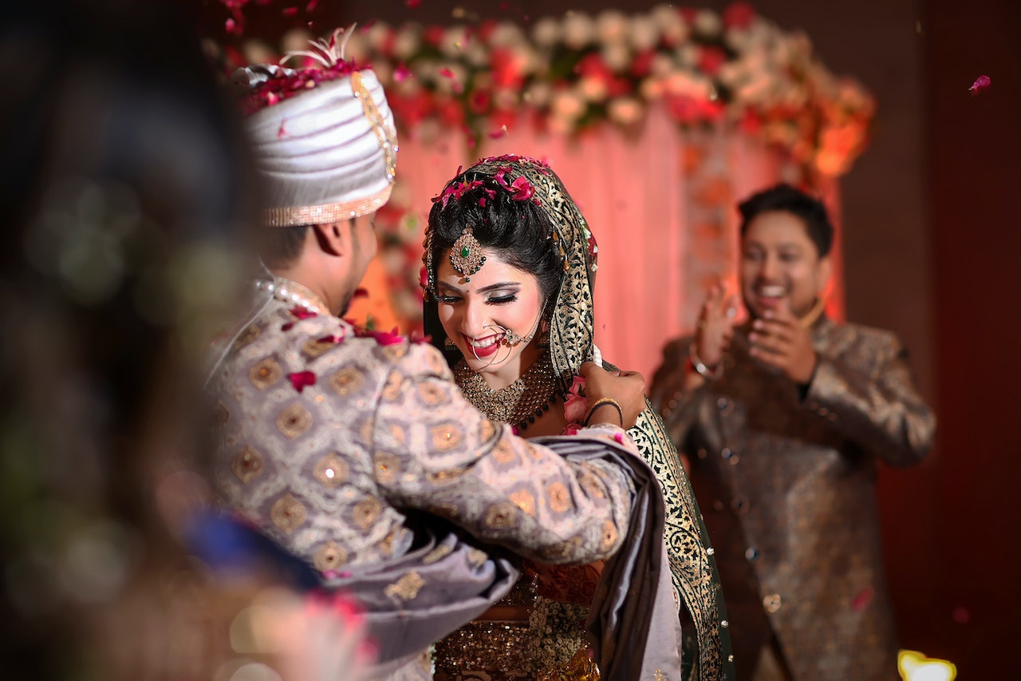
Imperial Wedding provides elite matrimonial services across India with 100% verified profiles, dedicated relationship managers, and over 30,000 successful matches—ensuring personalized, discreet matchmaking for high-status individuals.
Imperial Wedding’s Indian Marriage Bureau in the UK specializes in premium matchmaking for Indian communities like Aggarwal, Baniya, Punjabi, Jain, and Marwari. They offer verified profiles, dedicated support, and tailored assistance—creating culturally aligned, enduring partnerships.

Slide 3
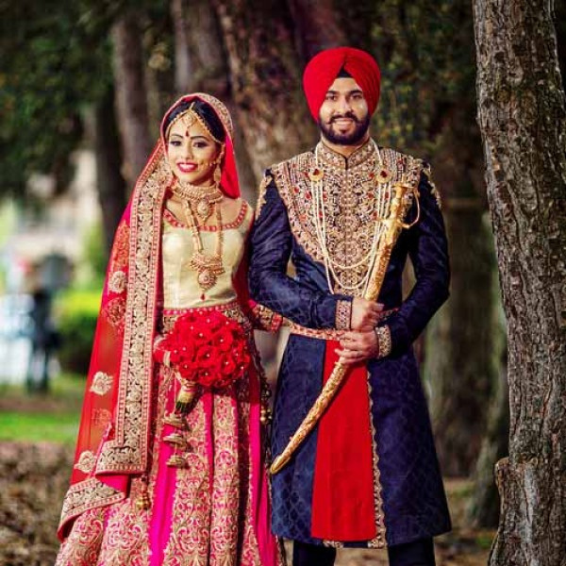
Address
117, 1st Floor, NDM-1, Netaji Subhash Place, Pitampura, Delhi-110034
Phone - +91 9773 525 525, 011-40505815
Email - info@imperial.wedding
Visit https://www.imperial.wedding/indian-marriage-bureau-in-uk

Slide 4
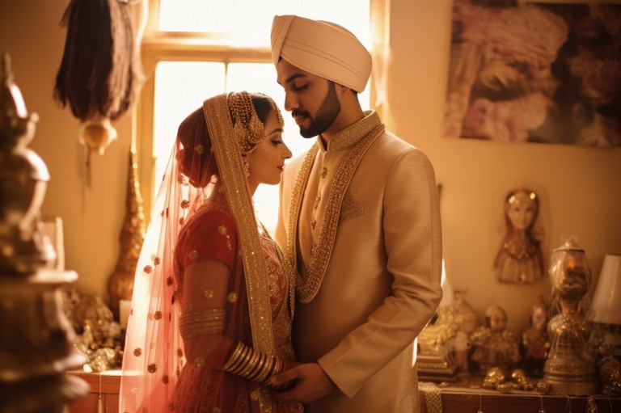
Thank You For Your Trust Towards Imperial Wedding
Visit - https://www.imperial.wedding/indian-marriage-bureau-in-uk

