Slide 1


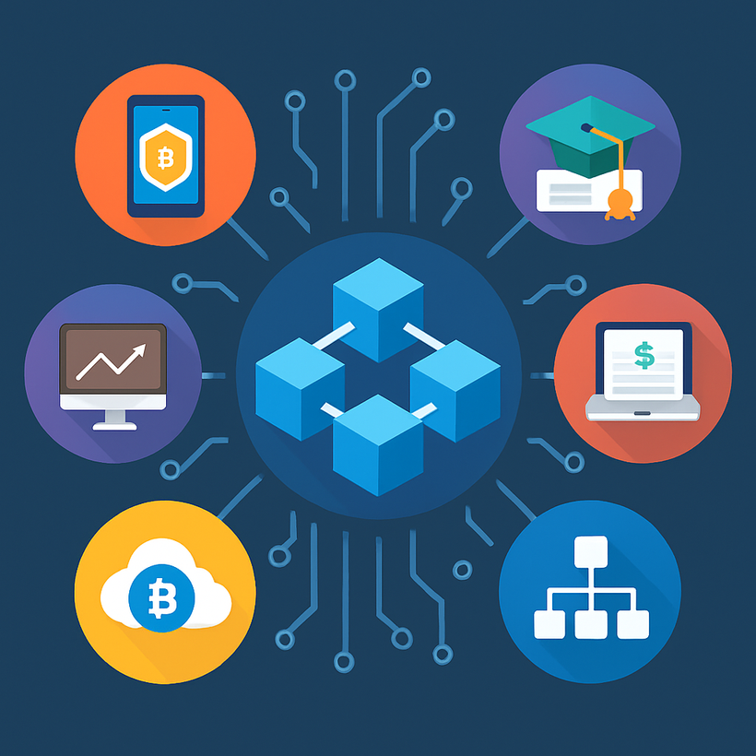

Top Blockchain Application Development Services in 2025
www.blockchainx.tech

Slide 2

Over recent years, the blockchain sector has reached a certain level of maturity. Adoption is currently peaking across industries such as banking, healthcare, logistics, and digital identity. Hence, businesses are not tinkering with blockchain anymore; they want to build real, scalable solutions. Providing Blockchain app development services forms the backbone of these innovations, assisting businesses in transforming their decentralized concepts into reality through expert consultation, development, and support. Such services become vital for any company wishing to stay ahead, cut inefficiencies, and forge a secure digital ecosystem worthy of user trust.

Slide 3
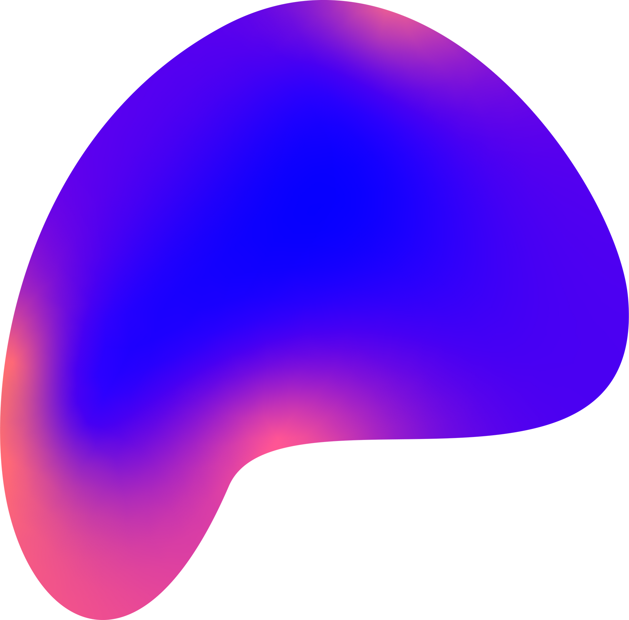

1. End-to-End Blockchain Consulting and Strategy
The very start of any successful blockchain solution rests upon a strategic foundation. Top engineers don't just dive into writing code but guide you in every step of crafting a solution. In general, the consulting process comprises the identification of use cases, choice of the right blockchain protocol (be it Ethereum, Solana, or Hyperledger), and if applicable, the designing of tokenomics. This is followed by an assessment in 2025 of how scalable, interoperable, and fit within regulations each solution is considered to be. They then begin working alongside the stakeholders in defining the milestones that they must achieve on the path to avoid technical pitfalls and create a realistic roadmap that aligns itself with the short-term objectives and the long-term vision of another party. Hence, this layer ensures that strategic projects are not built and their success lies within this frame.

Slide 4
2. Smart Contract Development
Smart contracts are programmable engines behind almost every blockchain application. These contracts self-execute, thereby removing intermediaries, limiting chances of fraud, and allowing for consistent execution. In 2025, top-tier blockchain development firms provide high-end smart contract development with a few extra features such as gas optimization, modular logic, upgradeability, and a fluid way to consume external data from oracles. The companies undertake further testing in testnets and audit across tools and manual auditing. Whether you are trying to build a DeFi protocol, an NFT marketplace, or a DAO voting system, the backbone is a good smart contract that is usually ensured by top developers for strength and safety.

Slide 5
3. dApp Development Across Multiple Platforms
dApps are becoming crucial to countless industries, their doors open to censorship resistance, user control, and global reach. The most trusted blockchain app developers in the year 2025 will provide full-cycle dApp development, beginning with user-centric design and finalizing with a rock-solid backend infrastructure and blockchain layer integration. They have the capability to make the application cross-chain, like Ethereum, Avalanche, Arbitrum, or BNB Chain. Services also extend to wallet integrations (such as MetaMask and WalletConnect), gasless transactions, and token gating. Furthermore, the professionals are now including AI capabilities inside the dApp for enhanced user experience, workflow automation, and decision support.

Slide 6
4. Blockchain Integration with Legacy Systems
Many enterprises operate on legacy infrastructure that simply does not support decentralized applications. Yet, the best blockchain service providers foster the capacity to address this gap through custom-built middleware solutions. These integrations connect the blockchain networks with CRMs or ERP systems such as SAP or Oracle; cloud environments, including AWS and Azure; and conventional databases. With such advanced feature capabilities as real-time syncing, event triggers, and data mirroring between the on-chain and off-chain layers, companies can go the last mile and apply blockchains in operations without interrupting any processes. Moreover, besides acting as technical compatibility services, they add alternative layers for compliance and audit trails that regulated industries may require, such as finance and healthcare.

Slide 7
5. NFT and Tokenization Solutions
NFT technologies will make everything possible to be tokenized across industries everywhere in the year 2025-from tokenizing of properties, luxury items, digital identities, to academic credentials. Major blockchain developers deliver an end-to-end NFT solution including token creation (ERC-721, ERC-1155, etc.), marketplace development, cross-chain minting, and intricate advanced metadata management. Compatibility with legal regulations incorporating royalties, auction systems, and secondary sale mechanisms is also considered. With an increasing demand to tokenize real-world assets, companies are relying on experienced developers to build secure, scalable platforms that enable liquidity and digital ownership.

Slide 8
6. Private and Consortium Blockchain Development
Private blockchain systems, and more so consortium ones, are preferred in many businesses to control access, increase transaction speed, and maintain confidentiality, in contrast to public systems that are ideal for transparency. Custom solutions are provided by blockchain developers in 2025 using Hyperledger Fabric, R3 Corda, and Quorum, among others. These services include setting up the network, managing permissions, deploying smart contracts, assigning roles and access, and more. Defining governance structures will also be aided by them together with processes for onboarding and rules for consortium members. For industries such as supply chain, insurance, or healthcare, where privacy and control are a top concern, these private blockchain solutions strike a perfect balance between innovation and compliance.

Slide 9
7. Blockchain Maintenance and Support
Once your blockchain application goes live, it needs to be continuously monitored and maintained to remain functional, secure, and updated. The elite service providers offer 24/7 monitoring, performance optimization, scalability improvements, and bug fixing on the fly. They provide dashboards for real-time analytics and support upgrades when protocols differ and even have features for end-user support. A proactive approach to maintenance will ensure that your blockchain app continues to deliver value, adapt to user demands, and comply with network upgrades or regulatory mandates. Long-term support is especially vital in keeping up with the rapid advancement brought about in the blockchain landscape.

Slide 10
8. Web3 Wallet and Exchange Development
Since wallets and exchanges make the bridge to the blockchain world, they have to act as the foundational pillars of Web3. By 2025, crème de la crème developers will be building Web3 wallets furnished with biometric login support, multi-chain token support, staking options, and DEXs-in-the-app themselves. They also make sure to engineer safe, compliant crypto exchanges, both decentralized and centralized, bearing features such as real-time trade engines, liquidity management, fiat gateways, and user verification workings. The applications should support heavy load, attack resilience, and have a flawless user experience on a desktop as well as on mobile.

Slide 11
The increase in blockchain adoption in 2025 changed the transparency, automation, and security expectations of conducting business. However, developing a successful blockchain solution requires more than just passion: it takes skills, planning, and execution. The greatest opportunities decentralization has to give are granted to those who choose a firm that offers trustworthy, scalable, and future-ready custom blockchain app development services. When it comes to solving business problems through blockchain, smart contract development, dApp development, NFT development, and enterprise blockchain development, the right partner will ensure that the blockchain story of the client is both creative and meaningful.
Conclusion

Slide 12
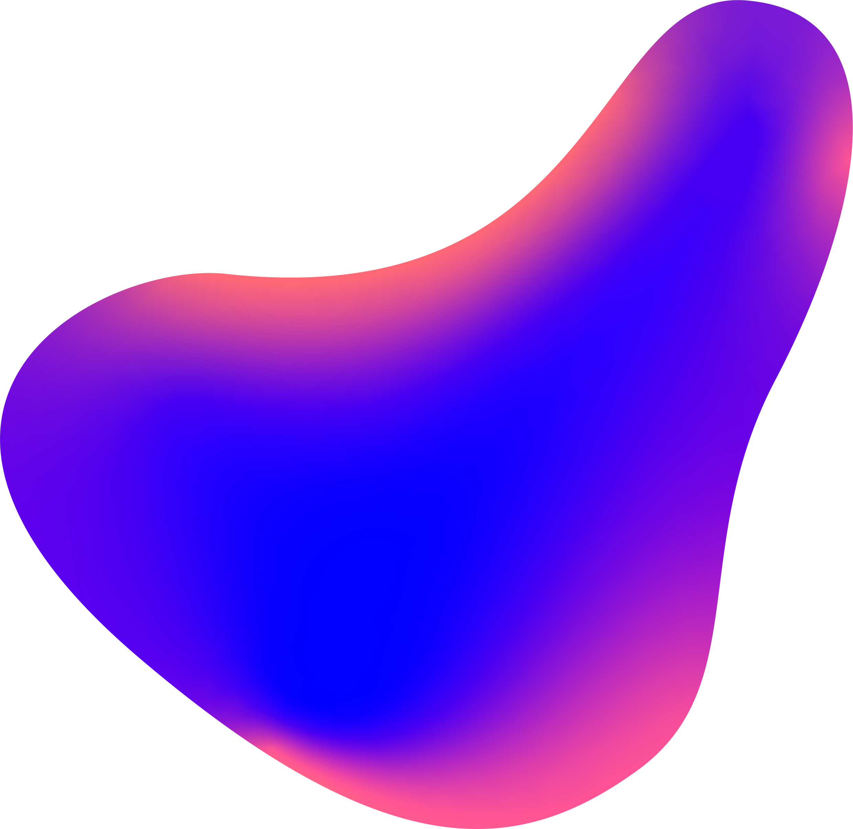
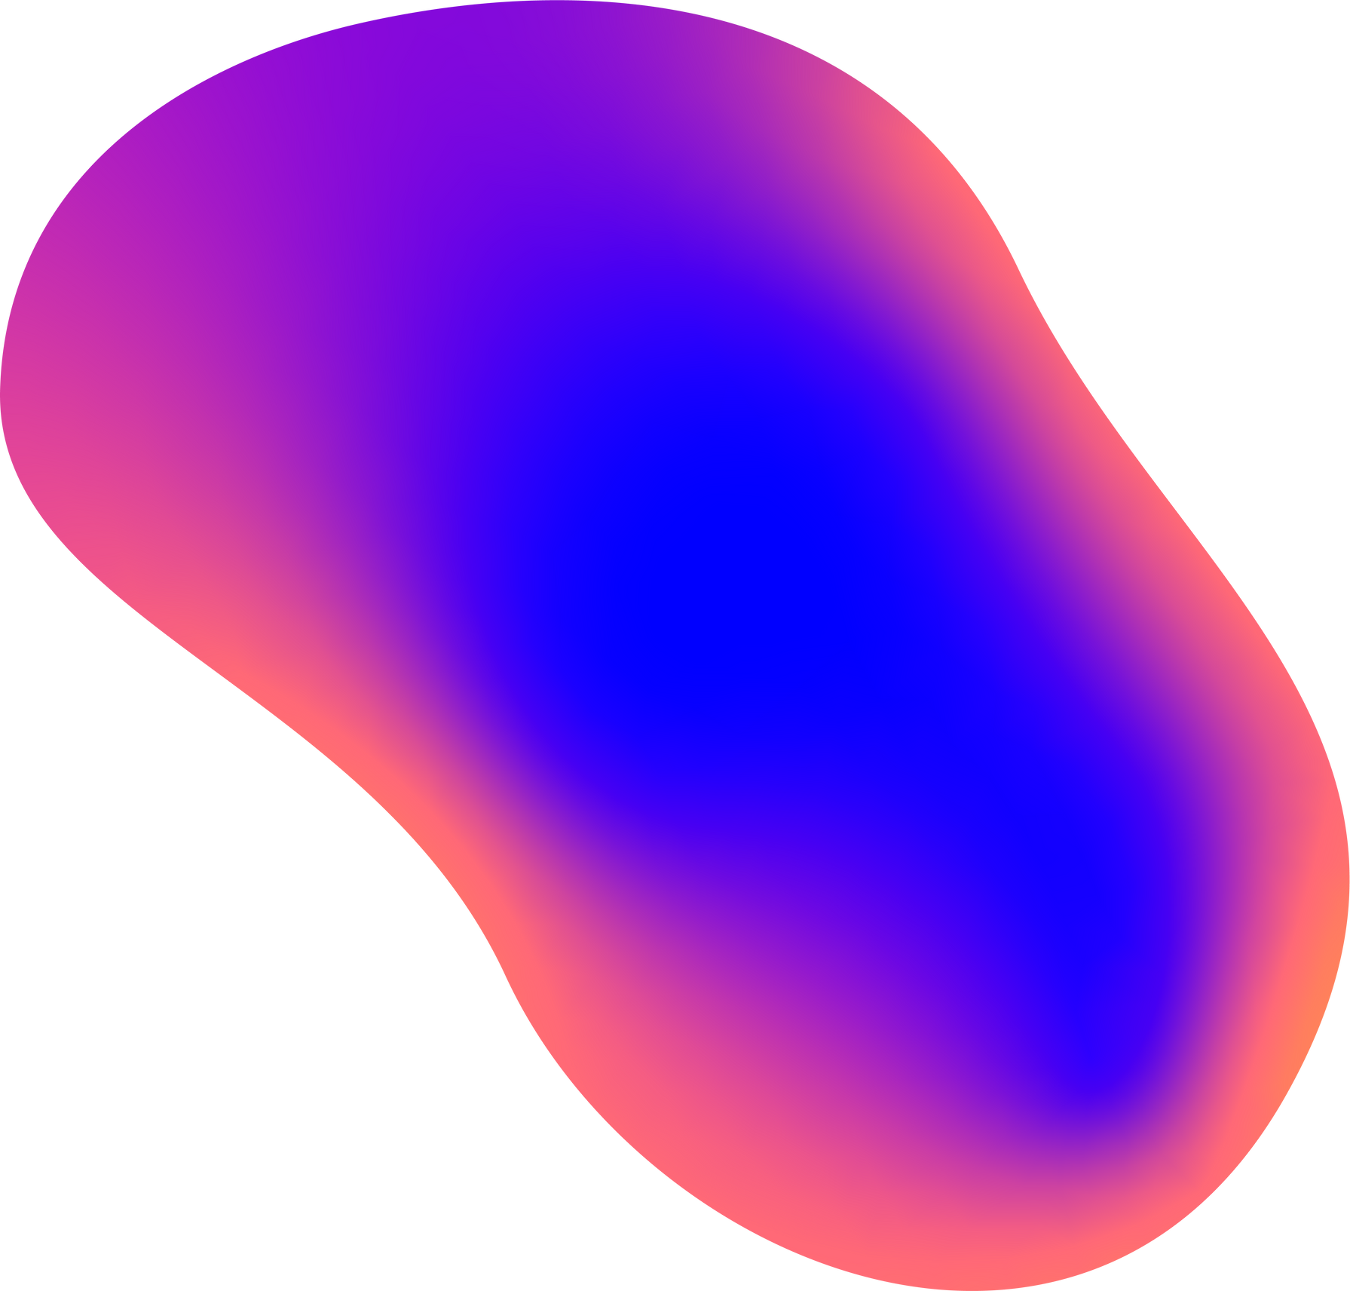
Thank You
Contact Us :
+91 77088895550
contact@blockchainx.tech
www.blockachainx.tech

