Slide 1
Discover the ultimate bachelorette party spots
BEST BACHELORETTE PLACES

Slide 2


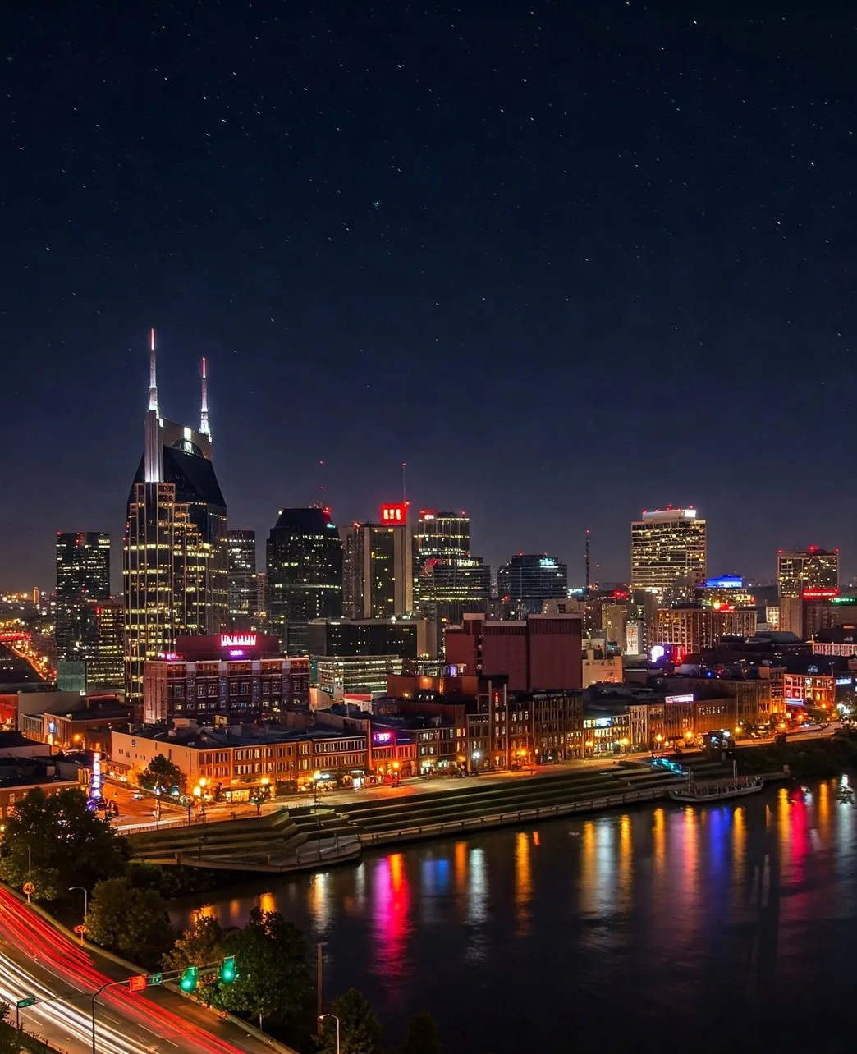

Best Bachelorette Places in Nashville
Nashville offers an exciting atmosphere for bachelorette parties, featuring live music, vibrant nightlife, and unique activities tailored for a memorable celebration. Explore the city's charm and create unforgettable moments with Love and Letters Bach & Balloons.

Slide 3


Top Nightlife Spots for Bachelorette Parties
Nashville boasts an exciting nightlife scene, perfect for bachelorette parties. With a variety of bars and clubs, each venue offers a unique experience that amplifies the celebration.
From vibrant dance floors to cozy lounges, Nashville's nightlife caters to every group's taste. Enjoy live music, specialty cocktails, and unforgettable memories in this lively city.

Slide 4
Unique Experiences for the Ultimate Bachelorette Party
Nashville offers an array of exciting themed parties tailored for bachelorette groups, ensuring a memorable celebration filled with fun and laughter.
Interactive activities like line dancing lessons and themed scavenger hunts add a unique twist, allowing brides-to-be and their friends to create lasting memories together.
With fabulous venues and vibrant nightlife, Nashville is the perfect backdrop for an unforgettable bachelorette experience that blends celebration, adventure, and love.

Slide 5

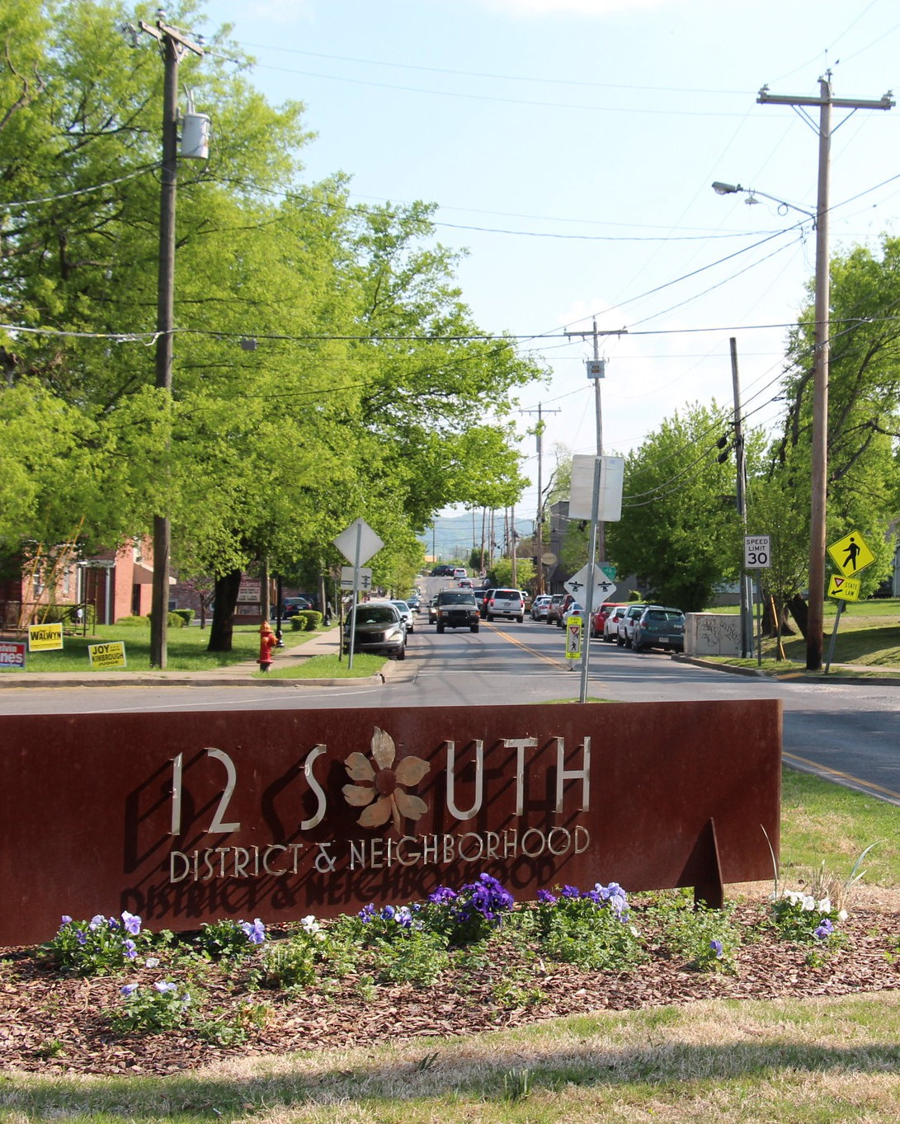

Top Brunch Hotspots for Bachelorette Groups
Nashville offers vibrant brunch spots perfect for bachelorette celebrations, featuring delicious food, fun atmospheres, and memorable experiences that will ensure an unforgettable time for the bride-to-be and her friends.

Slide 6
“Celebrate the joy of friendship and love, making memories that last a lifetime during your bachelorette adventure!”
– Unknown

Slide 7


Get in touch with Love and Letters Bach & Balloons!
Booking Link
www.loveandlettersdesignco.com
Tiktok
@loveandlettersbach
Location
Nashville, TN

