Slide 1


How to Launch a Secure and Scalable Peer-to-Peer Crypto Exchange

Slide 2


P2P EXCHANGE
Introduction
Cryptocurrency is developing fast, and this is causing increased interest in decentralized ways of handling money. A very significant change in this field is the growth of P2P exchanges, where users are matched to connect and trade with each other with no third parties involved. Since centralized exchanges deal with censorship, thefts, and lack of clarity, people are inclined to use P2P alternatives. Choosing to work in the blockchain industry, creating your own P2P crypto exchange with secure and strengthened gives you a chance to succeed and give back to the DeFi sector.
01

Slide 3
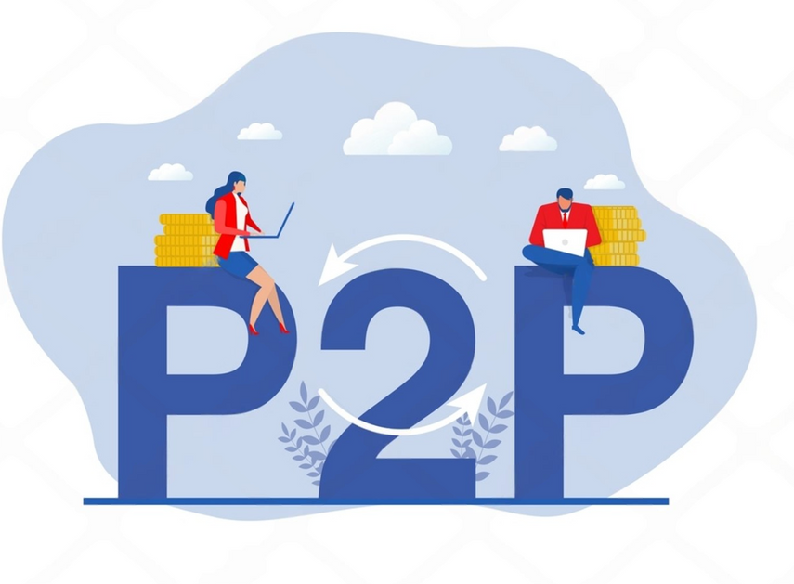

The Rise of Peer-to-Peer Crypto Trading
P2P EXCHANGE
  Peer-to-peer trading has appeared in many markets for a long time. Yet, blockchain technology has made P2P trading much easier by offering a system that does not depend on any authority and trusts nobody. Unlike major exchanges, where you put your money in their wallets, P2P exchanges help users trade tokens in a safe chain wire-to-wire way.
  There are many good sides to using crypto — users keep their money safe, enjoy more privacy, and tend to skip fees and geographical issues. People in parts of the world that do not have strong financial infrastructure have an easier way to participate in the crypto and global markets through P2P exchanges.
02

Slide 4

P2P EXCHANGE
Launch Peer-to-Peer Crypto Exchange
Understanding the P2P Exchange Model
It is necessary to first learn how P2P exchanges operate, for initiate the model to create. Basically, these models are matchers and help contact people. They act as a bridge for buyers and sellers, allow you to post offers and accept them, look after escrow, and handle problems if any.
Unlike order-book based centralized exchanges, P2P platforms usually act like marketplaces, with users adding their offers with set details such as the price and payment methods. Because the platform doesn’t look after user funds, it faces fewer rules and must act with extra caution and reliability.
03

Slide 5

P2P EXCHANGE
Market Research
A major part of building a P2P exchange is looking into the market well. Check whether you want to work with peoples from cryptocurrency-friendly areas like Southeast Asia or with less banked groups in Africa. Which cryptocurrencies and payment solutions are mainly being used by consumers in these markets?
It is important to also assess the rival companies. Who are the main competing businesses in the market (for example Paxful, LocalBitcoins, Binance P2P)? Which of the features or issues can be made better?
It is just as important to know about the laws and regulations. Although P2P protocols usually avoid certain custodial rules, these exchanges have to comply with KYC and AML laws more and more. You could choose to introduce different levels of verification to help people use the service, while still following regulations.
04

Slide 6
P2P EXCHANGE
Choosing the Right Tech Stack
The strength of your exchange comes from its technology base. The best choice is one that matches your project’s major goals, how much it may grow, and how much decentralization you need.
Developers in the backend field often choose Node.js, Python, or Go. If you choose React.js or Vue.js for frontend, you can create applications with engaging and responsive features. Web3.js or ethers.js are some of the libraries you can rely on to interact with the blockchain, depending on which network you use.
Some of the most important technology aspects are:
  Escrow is handled by using smart contracts.
  Wallet integration APIs
  You should add plugins that enable gateway payments.
  Examples of such include WebSockets and other similar technologies.
  For example, PostgreSQL and MongoDB are two types of database solutions.
  AWS, Azure, or IPFS (or other similar ones) are all types of cloud infrastructure.
06

Slide 7

P2P EXCHANGE
Designing Secure and Intuitive User Interfaces
If you focus on user experience, you can support your platform’s success. Because P2P crypto trading may be confusing to those new to the field, ease of use is very important. Make sure the procedures of posting your offer, verifying the user, and finishing a trade are easy.
Put security first, so alerts are highlighted, verification instructions are given, and users can easily report any problems. Since most people in these markets use phones more than any other devices, mobile responsiveness is very important.
Help users in different languages, allow them to switch between dark and light themes, and add user-friendly tutorials to increase the app’s ease of use.
07

Slide 8
P2P EXCHANGE
Building Core Features of a P2P Crypto Exchange
A number of important features are at the core of your P2P exchange.
  Escrow Services: You can use escrow for crypto trades by agreeing to release the money or coins once both traders accomplish their part of the deal.
  Multi-Currency Wallet Support: The ability to send, receive, and store many types of cryptocurrency should be included in a multi-currency wallet.
  User Profiles & Ratings: Trust scores should be set up from information such as your past trades, the feedback you receive, and who you are.
  Dispute Resolution System: It is important to have admin or decentralized arbitration services to handle conflicts that occur while trading.
  Advanced Search and Filtering: Application of search and filtering allows users to find offers suitable by place, price, payment options, etc.
  Notifications and Alerts: Trade status, KYC steps, and security warning notices should be provided to help users keep up to date.
08

Slide 9
P2P EXCHANGE
Testing and Deployment
You should run thorough quality tests on the frontend, backend, smart contracts, and all elements connected to third parties before starting the live version. Try to set up test environments that are the same as what you will do in real life.
Work with different rare situations, accounts with errors, disputed transactions, and stress your technology. Additionally, perform:
  Penetration testing
  Methods of unit and integration testing
As soon as the platform is done, start by letting a small group of users test the beta version. Get user input and deal with the problems noticed before launching your app.
09

Slide 10

Future-Proofing Your P2P Crypto Exchange
P2P EXCHANGE
  The start of running your exchange is just the first step. Since the world of cryptocurrencies grows quickly, you must always adapt to remain competitive.
  Continue to follow any changes, what users expect, and new trends in crypto, especially around Layer 2 scaling, trading on different blockchains, and Decentralized Finances. Keep expanding your list of payment methods, assisting new altcoins, and making your platform’s interface better.
  Work on developing online forums, support communities, ambassador initiatives, and learning materials to increase user loyalty and keep them around.
10

Slide 11

P2P EXCHANGE
Conclusion
All in all, constructing a reliable and scalable peer-to-peer crypto exchange requires combining reliable technology, understating the rules, thinking of users’ experience, and stressing on security. With decentralized finance changing the digital economy, P2P exchanges are a good way for users to experience more power, privacy, and easy access when trading cryptocurrencies. If you plan every stage of your platform well, you can end up with a future-oriented system that stands out in the competitive market and assures reliable long-term growth and trust.
05

Slide 12




Thank You!
P2P EXCHANGE

