Slide 1

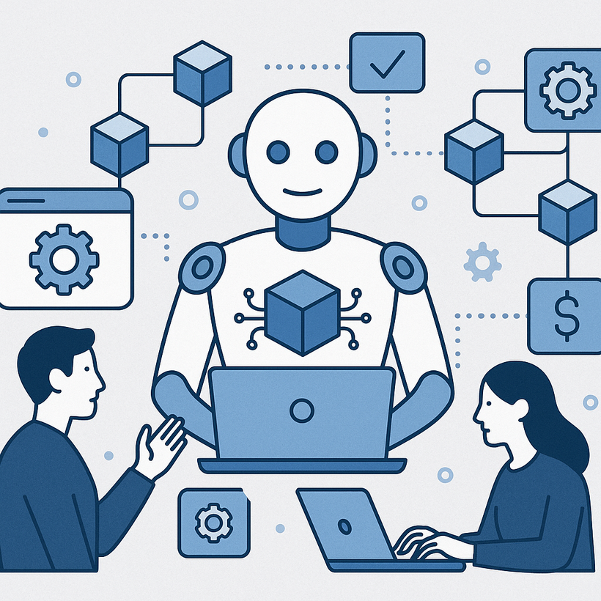
The Future of AI Agent Development: Trends to Watch
www.blockchainx.tech

Slide 2
As AI evolves at a rapid pace, autonomous agents, or AI systems that can make decisions, finish certain tasks, communicate with environments, and adapt without human intervention, emerge as one of the key optimization areas. More of a colleague than a tool, these agents gather context, learn from it, improve with time, and act in digital and physical environments. These AI agents are changing how we build and interact with software, powered from intelligent virtual assistants to DeFi bots to intelligent logistics! At the core of this revolution are AI Agent Development Solutions, which offer architecture and intelligence to begin adaptive, goal-oriented agents that can survive in ever-changing environments.

Slide 3
1. Rise of Autonomous AI Agents
The most transformative trend in the AI realm was the birth of a fully autonomous agent. These systems execute highly complex tasks ranging from managing workflows to solving customer queries to trading financial assets autonomously without human supervision. They would operate on long-term objectives using planning algorithms and memory systems, with reinforcement learning to change strategies as per feedback received. The entrepreneurs deploy these agents looking at operational cost reduction, improved accuracy, and availability. As these systems advance, we see the shift away from simple rule-based bots to intelligent agents that reason, infer, and adapt across real-time scenarios in areas like fintech, customer service, and logistics.

Slide 4
2. Integration of Multi-Modal Capabilities
The forthcoming population of AI agents would be defined by their capability to understand and process manifold forms of data—text, speech, vision, and any other environmental cue-all at once. The multi-modal ability makes AI agents more human-like, interpreting very nuanced contexts for the better decision. For instance, in medicine, AI agents investigate patient data, interpret X-ray images, and respond to verbal symptoms. Likewise, in the automobile sector, AI agents assist with driving while interpreting road signs, audio cues, and user commands. The better the foundational models such as GPT, DALL·E, and CLIP get, the more that multi-modal agents can fulfill their promise as all-purpose assistants.

Slide 5
3. Real-Time Personalization
Increasingly, AI agents are becoming capable of personalizing experiences for individual users in real-time. User requirements are expected by the agents as the systems analyze the behavioral data, previous interactions or preferences, and even the sentiments of the users, giving the most tempting responses or actions. On the e-commerce front, such an agent would suggest a product while considering not only the browsing history but also the customer's current emotional state inferred from tone and interaction pattern. In the field of education, AI tutors will go about their lessons slower or faster and adjust to fit the student's style of learning, depending on how well the student performs and how much engagement there is. Dynamically personalized interaction increases satisfaction; thanks in turn yield great results in sales, education, and entertainment.

Slide 6
4. Decentralized and Blockchain-Powered Agents
An AI agent-related growing frontier involves decentralization infrastructure such as blockchain. Such agents are operative in trustless environments executing smart contracts, managing token economies, and peer-to-peer services without any central authority. DeFi autonomous agents manage portfolios, execute arbitrage strategies, and monitor liquidity pools all around the clock. In the Web3 gaming setup, AI NPCs interact with users in a provably fair and autonomous manner. The transparency, security, and autonomy that these developments bring into the agent ecosystem, enrich applications that cannot be censored, that lower operational risk, and that guarantee data ownership for users.

Slide 7
5. Enhanced Security and Ethical Governance
As AI agents gain more control over sensitive data and critical systems, ensuring their secure and ethical operation stands at the forefront. Developers and organizations now place greater emphasis on ensuring AI agents are equipped with secure capabilities: secure multi-party computation, differential privacy, and zero-trust architectures are some examples. Inherent governance considerations are also present, with the technologies placing emphasis on transparency, accountability, fairness, and explainability. Regulations will probably evolve alongside, going so far as to stipulate auditing or human oversight of agent decisions bearing most weight. The deployment history of AI agents is going to be marred by lack of adherence by agents to ethical and legal standards in such fields as medicine, finance, or the law!

Slide 8
6. Collaborative AI Agents in Enterprise Workflows
Instead of replacing human jobs, many AI agents are set to complement human decision-making. These are collaborative agents working as intelligent assistants that evolve workflows, automate mundane processes, or simply notify action steps. In a large enterprise, the AI agent generates reports, schedules meetings, analyzes trends, writes CSS snippets, and so on. Because of their seamless incorporation within CRMs, project management tools, and analytics dashboards, agents are helping enterprises streamline and tweak human productivity. As human and AI agents work together seamlessly, enterprises will transition from seeing agents as mere tools to seeing them as team members within digital workspaces.

Slide 9
7. Low-Code and No-Code Agent Builders
Accessibility constitutes another driving force behind AI agent adoption. Businesses and individual creators can now develop intelligent agents with little to no programming knowledge, thanks to the advent of low-code and no-code engineering platforms. These platforms give drag-and-drop UIs, prebuilt templates, plug-and-play integrations with popular third-party services, etc. For example, a customer service manager could use such a tool to construct a chatbot agent that answers FAQs and escalates issues via simple logical flows. A startup might deploy an agent for product recommendation by setting a few parameters. As such platforms evolve, they will democratize adoption even more and stimulate innovation in more applications and industries.

Slide 10
8. Continuous Learning and Self-Improvement
From the ways of software development we knew, were the systems static after deployment, the agent in the modern perspective very much evolved with nature in different environments. An agent can further refine its behaviors by online learning, feedback loops, or reinforcement signals based on the Scientist-Type thought in terms of real-world performance. This means that an agent grows smarter with time, corrects mistakes, evolves to a changing environment, and honest some strategies. A practical example in retail could be learning customer preferences that change with the seasons. In cybersecurity, agents would detect new threats and autonomously configure defenses. This ability to improve themselves will be characteristic of next-gen agents and serve as a strong driver of continued value creation far beyond the initial deployment.

Slide 11
Conclusion
Healthcare agents today are defining how we work, communicate, and interact with digital ecosystems. As they get smarter, adaptive, and autonomously execute tasks, they will permeate across all major industries- changing workflows, user experiences, and value chains. Developers, innovators, and business owners should now see investment and exploration in scalable, secure, and versatile AI Agent Development Solution as the opportunity of a lifetime. Just as importantly, a developer should have an AI Agent Development Platform that allows modularity-technically performant and integratable so that agents can be built that are not just reactive but proactive, responsible, and able to bring about meaningful change in the days to come.

Slide 12




Connect with us.
contact@blockchainx.tech
www.blockchainx.com
+91 7708889555

