Slide 1

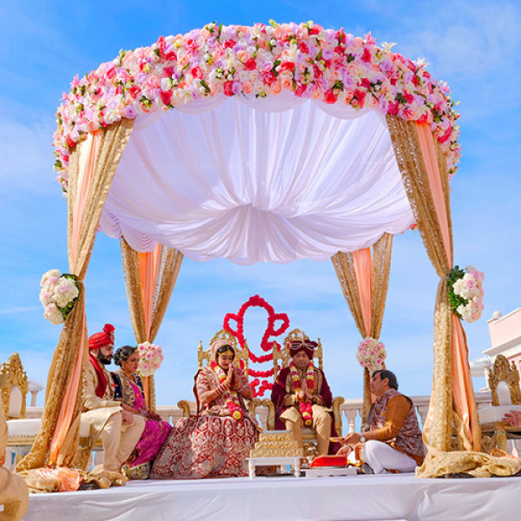


Indian Marriage Bureau in London
Visit - https://www.imperial.wedding/indian-marriage-bureau-in-london

Slide 2
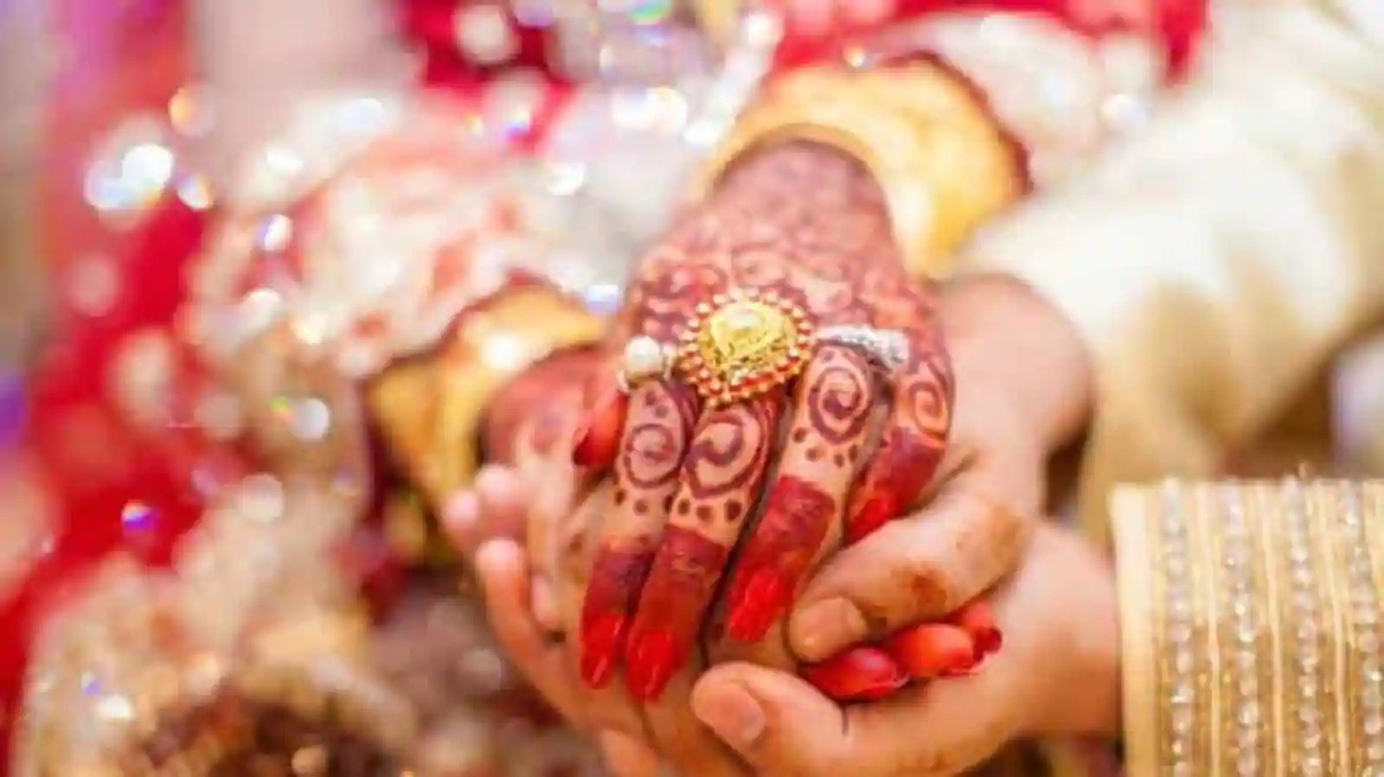
Imperial Wedding’s Indian Marriage Bureau in London offers elite, personalized matchmaking for Aggarwal, Baniya, Punjabi, Jain, and Marwari communities. With 100% verified profiles, a dedicated relationship manager, and over 30,000 successful matches, they ensure privacy, authenticity, and cultural alignment for life‑partner searches in the UK

Slide 3
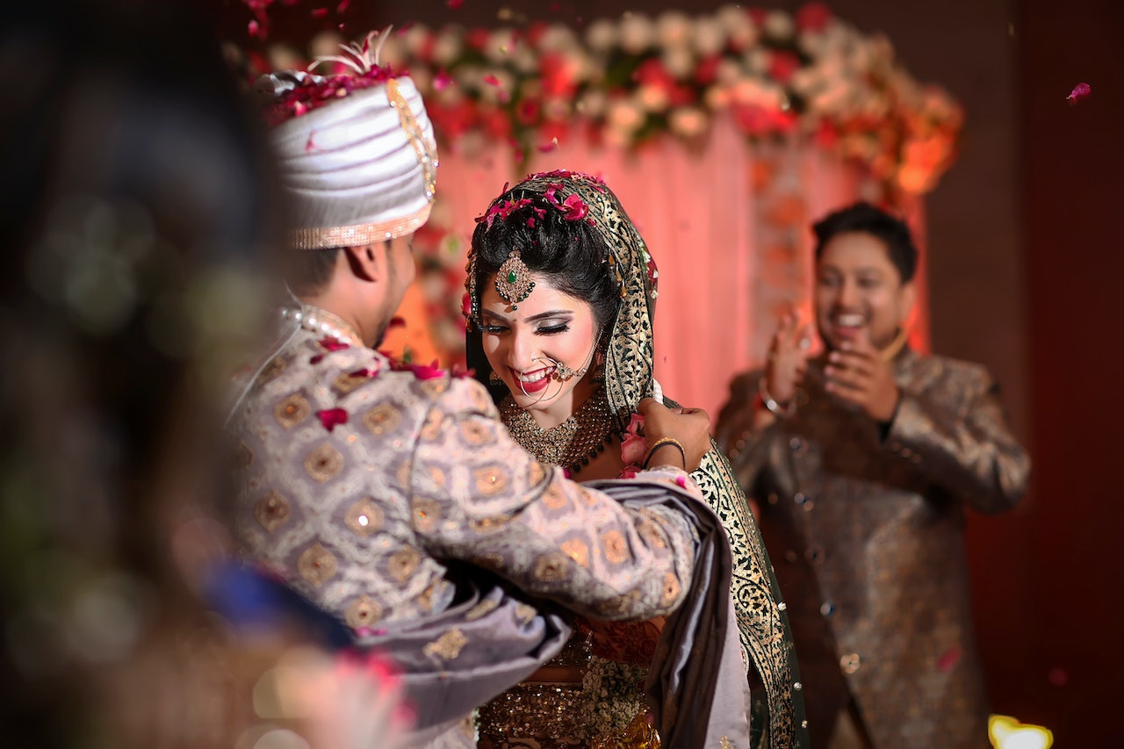
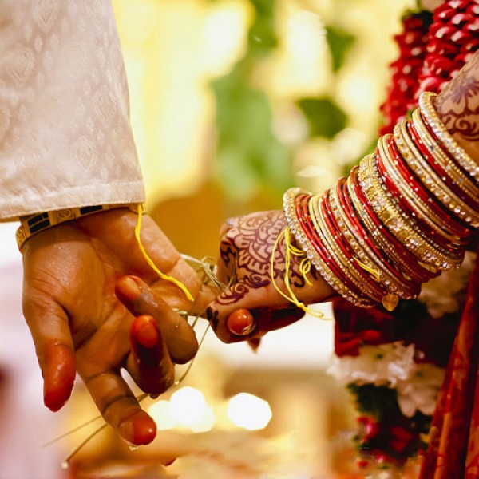
Address
117, 1st Floor, NDM-1, Netaji Subhash Place, Pitampura, Delhi-110034
Phone - +91 9773 525 525, 011-40505815
Email - info@imperial.wedding
Visit - https://www.imperial.wedding/indian-marriage-bureau-in-london

Slide 4
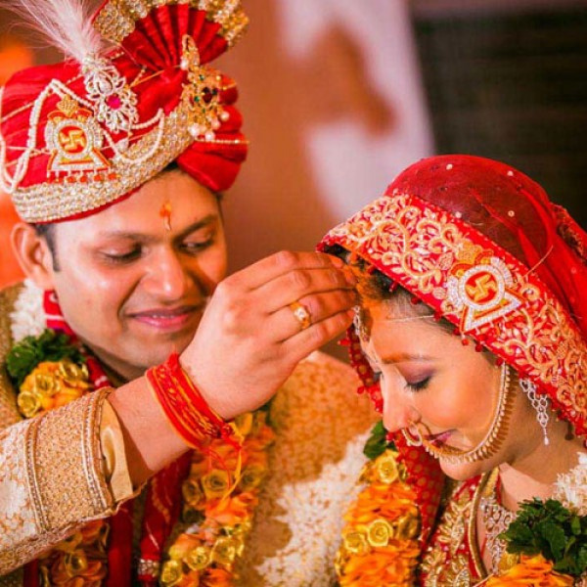
Thank You
Discover your perfect match in London with Imperial Wedding – start your elite matrimonial journey today!
Visit - https://www.imperial.wedding/indian-marriage-bureau-in-london

