Slide 1
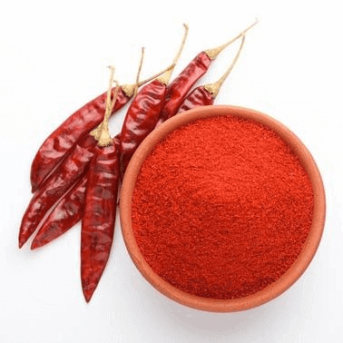
Red Chilli Powder
Exporters
Visit - https://www.spicesindia.net/types-of-dry-red-chillies-in-india/

Slide 2
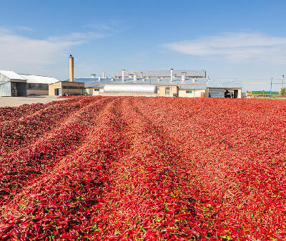
India produces over 50 dry red chilli varieties—from mild Kashmiri and Byadagi to fiery Guntur and Bhut Jolokia—delighting global markets. These chillies are ground into vibrant, flavorful red chilli powder, essential in cuisines worldwide for a rich color, consistent heat, and deep aroma

Slide 3
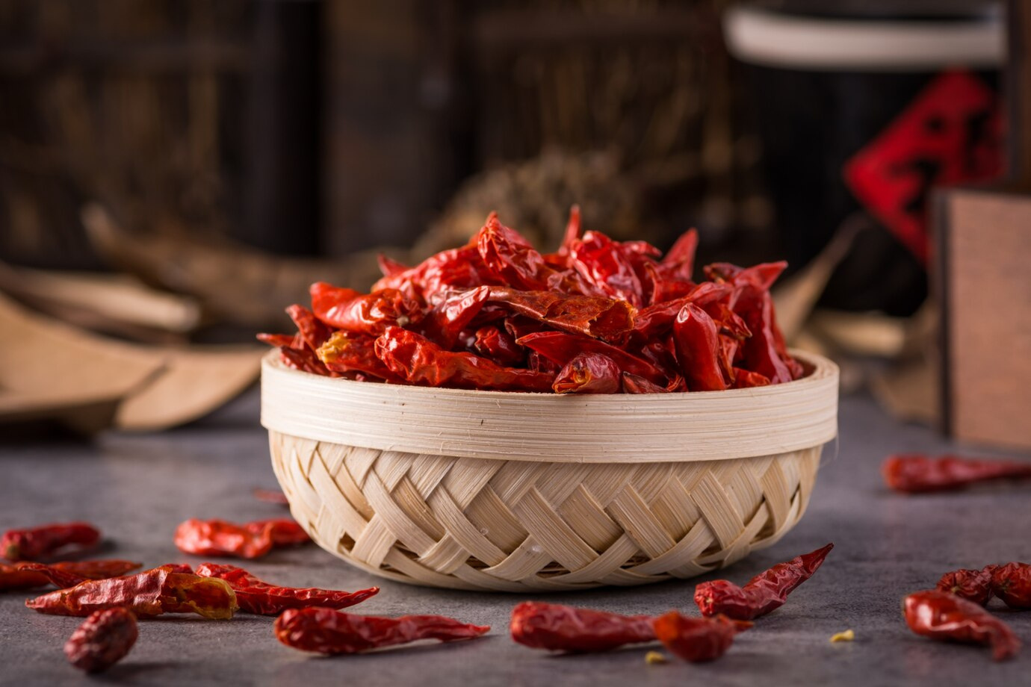
Address- D.No 25-16-180, 181, Mirichi Yard Road, Guntur, Andhra Pradesh, 522005
Phone Number: +91 9701363424
Mail: samsu@agrocrops.com
Website - https://www.spicesindia.net/types-of-dry-red-chillies-in-india

Slide 4
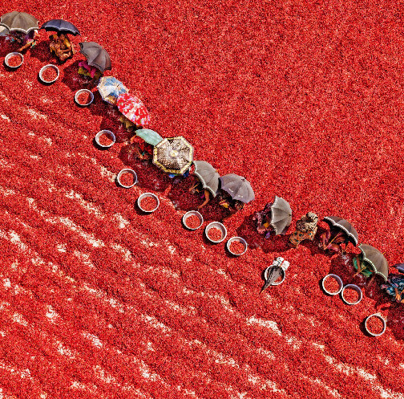
Get Authentic Flavors & India’s Spice Excellence at Spices India
Visit - https://www.spicesindia.net/types-of-dry-red-chillies-in-india

