Slide 1


Shri Ramswaroop Memorial University
Electrical Engineering College in Lucknow

Slide 2

Diploma in Electrical Engineering Program at Shri Ramswaroop Memorial University (SRMU):
  The 3-year Diploma in Electrical Engineering at SRMU covers electrical circuits, power generation, instrumentation, and automation, preparing students for industry roles.
  With state-of-the-art labs and industry exposure, SRMU equips students with practical skills for careers in electrical design, testing, and maintenance.

Slide 3

ADDRESS
Shri Ramswaroop Memorial University
Village - Hadauri, Post - Tindola, Lucknow-Deva Road
Phone: 18001026004, +91-9120007948
Email: examination.cell@srmu.ac.in, admissions@srmu.ac.in

Slide 4
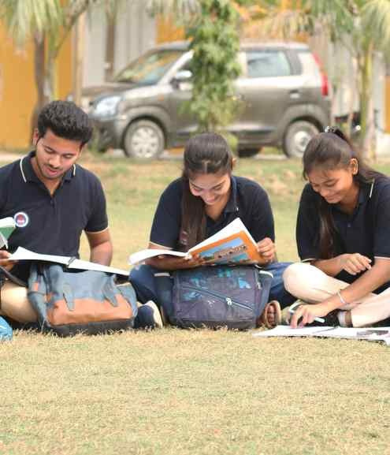
Thank You
Visit - https://srmu.ac.in/program/diploma-electrical-engineering

