Slide 1

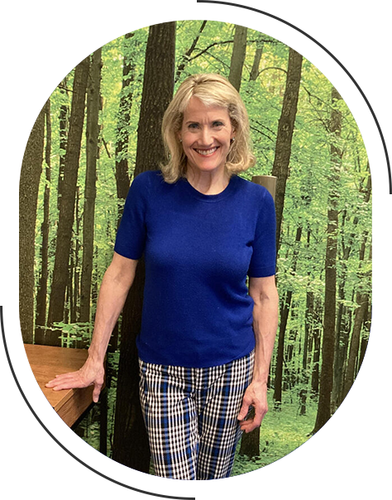
Dr. Amie Shimmel Handa
Chinese Medicine Acupuncturist in
Chicago

Slide 2

  Dr. Amie Shimmel Handa is a board-certified acupuncturist and chiropractic physician with over 35 years of experience.
  Her Chicago clinic offers holistic treatments, including acupuncture, chiropractic care, and nutritional support.
  Specialties encompass chronic pain relief, fertility support, stress management, and immune system enhancement.
  Services include complete acupuncture treatments, gentle chiropractic adjustments, and wellness programs.
  Patients can book a free initial consultation to explore personalized, integrative health solutions.

Slide 3

Address - 1 E Superior St #300, Chicago, IL 60611
Call - 312-877-5056
Email - dramieshimmel@gmail.com
Visit - https://www.dramieshimmel.com/

Slide 4

Thank You
Visit - https://www.dramieshimmel.com/

