Slide 1
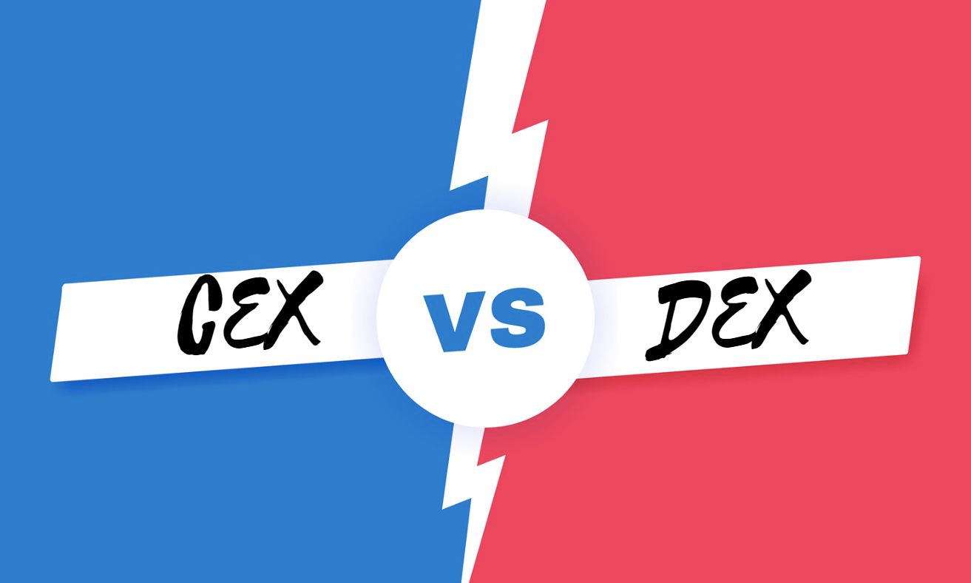



Difference Between Centralized and Decentralized Exchange Script: A Short Note

Slide 2
The expanding crypto space, due to its heft in value, shows demand for crypto exchange platforms. Entrepreneurs and startups face a very common question: "What kind of exchange should they set up, centralized or decentralized?" Both have relevant advantages, and the choice is generally tied to the business model and regulatory view as well as the target audience.
To make things easier, more often than not, these days people tend to go for ready-made exchange scripts that are customizable software solutions, which make the whole process of platform launching swifter and more efficient. In this article, we are going to cover the major differences between centralized and decentralized exchange scripts, their uses, and how to choose the right one for your crypto business.
INTRODUCTION

Slide 3
A centralized exchange script (CEX script) is software used to create a platform where the trade is operated and governed by rights with funds held by a central authority. Like traditional stock exchanges, these platforms offer high-speed trade, advanced features, along with customer support.
Key Characteristics:
  Assets of all users are held in centralized wallets.
  The admin has complete control over user data and transactions.
  Generally includes compliance tools like KYC/AML verification.
  Examples include Binance, Coinbase, and Kraken.
Centralized exchange scripts would suit businesses that ensure liquidity, scalability, and legal compliance.
What Is a Centralized Exchange Script?

Slide 4
Decentralized exchange scripting systems help turn peer-to-peer trading platforms into arenas where users trade directly from their wallets via smart contracts. There is no middleman holding funds or enforcing deals.
Key Characteristics:
  There is no one central authority managing the platform.
  Trades happen within smart contracts on the blockchain.
  Users retain their own custody of the funds.
  More transparent and generally resistant to censorship.
  Examples are Uniswap, PancakeSwap, and SushiSwap.
A DEX script is best for projects that aim to provide full unleashing of decentralization and privacy-based solutions to users.
What Is a Decentralized Exchange Script?

Slide 5
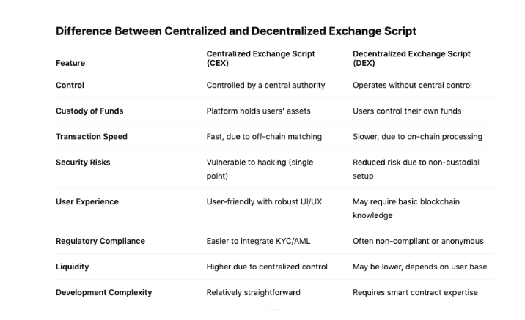
Difference Between Centralized and Decentralized Exchange Script

Slide 6
01
User Dashboard
Key Features of Cryptocurrency Exchange Clone Script
02
Trading Engine
03
Wallet Integration
04
Admin Panel
KYC/AML Compliance Tools
05
Liquidity APIs
06
07
Security Features

Slide 7
CONCLUSION
In the world of crypto exchange development, choosing between centralized and decentralized exchange scripts will set your business's destiny. Centralized exchanges provide better control of market offerings, liquidity, and user experience and are ideal in regulated environments and commercial undertakings. Decentralized exchanges, on the other hand, provide transparency, privacy, and true ownership of funds along with the capability demanded by communities seeking a trustless trading experience.
Understanding each one of those aspects and choosing accordingly for the sake of your business enables you to have on your side the correct crypto exchange script so you can secure funds for living in the space and grow competitively with a strong marketing arm.

