Slide 1

Explosion Isolation Valve
Active and Passive Isolation Systems
+91 9156463116/5/4
sales@vcplin.com
www.vcplin.com

Slide 2
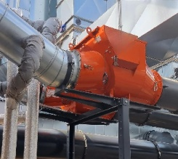
VENTIL Ignition Shield
Our Explosion Isolation Valves are essential for preventing the propagation of explosions in piping systems. Designed for high reliability and efficiency, these valves quickly isolate sections of the pipeline to enhance safety and minimize damage. With robust construction and innovative technology, our valves are your first line of defense against explosive hazards.
Lightweight flap reduces pressure loss and energy cost
Welded steel explosion pressure resistant design
Self-adjusting locking mechanism
Easy access inspection door
Custom Options Available
Dedicated Lifelong Expert Support
+91 9156463116/5/4
sales@vcplin.com
www.vcplin.com

Slide 3
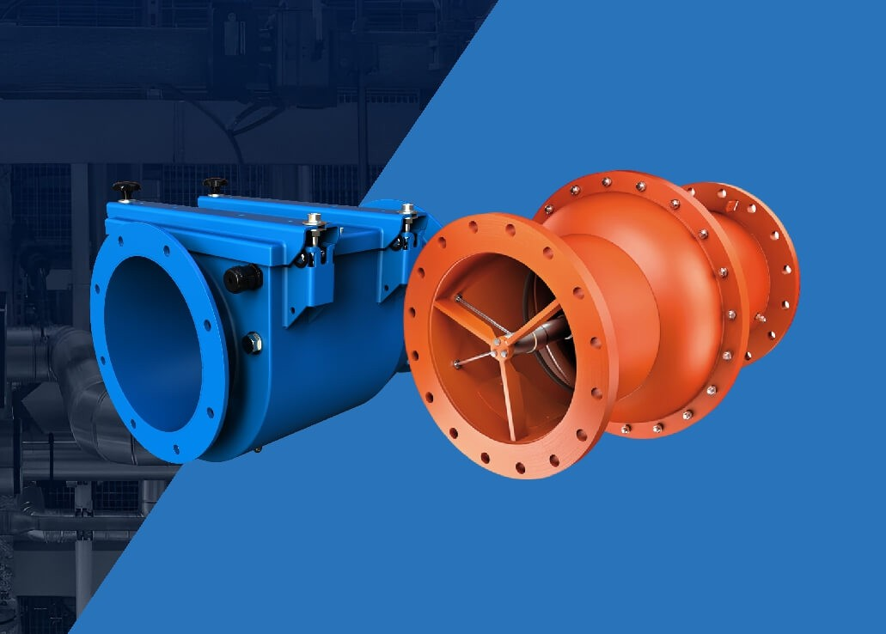
What Is an Explosion Isolation Valve?
An Explosion Isolation Valve (also called an explosion protection valve) is installed in ducts, pipes, or conveyors connecting different process equipment. In the event of an explosion — typically caused by combustible dust or flammable gases the valve rapidly closes to prevent the explosion from traveling further into the system.
Explosion Isolation Valve is widely used in industries such as:
Food & beverage and Chemical processing
Woodworking and Pharmaceuticals
Power plants and Petrochemicals
+91 9156463116/5/4
sales@vcplin.com
www.vcplin.com

Slide 4
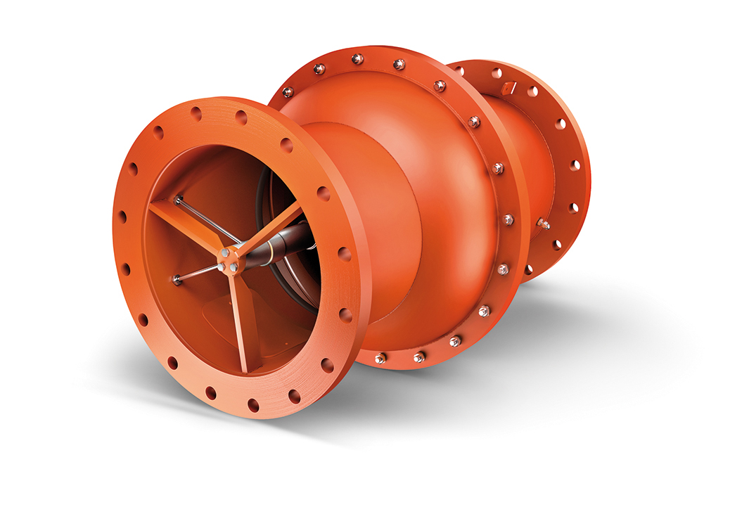
Types of Explosion Isolation Valves We Offer
Passive Isolation Valves
Also known as an Ventex Valve or Passive Explosion Protector
Cost-effective and reliable
Automatically activate during deflagration
Prevent flame jet ignition in upstream and downstream equipment
+91 9156463116/5/4
sales@vcplin.com
www.vcplin.com

Slide 5
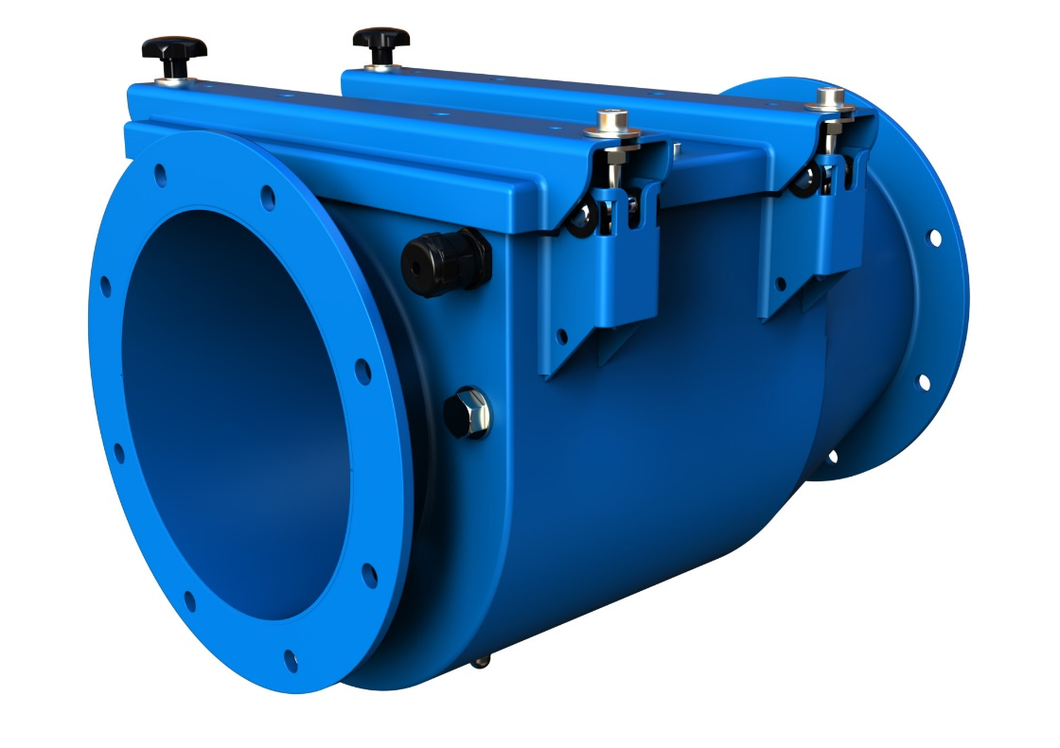
Explosion Isolation Flap Valve
Also known as an explosion flap valve or Redex flap valve
Passive isolation technology – no power supply needed
Closes automatically under the force of an explosion
Ideal for dust collectors, baghouses, and filters
+91 9156463116/5/4
sales@vcplin.com
www.vcplin.com

Slide 6
Key Features of Our Explosion Isolation Valves :
Automatic closure in milliseconds during an explosion event
Robust construction for high-pressure and high-temperature environments
Maintenance-friendly designs with easy inspection access
Available in passive, flap-type, and active isolation configurations
Compatible with systems requiring Ventex valves, Redex flap valves, or custom explosion valves
+91 9156463116/5/4
sales@vcplin.com
www.vcplin.com

Slide 7
Technical Specifications:
Valve Type: Passive / Flap / Active
Response Time: < 50 milliseconds
Material: Carbon Steel, Stainless Steel
Operating Pressure: Up to 2 bar (g)
Duct Sizes Available: DN100 to DN800+
Certification: ATEX, CE, ISO, NFPA compliant
+91 9156463116/5/4
sales@vcplin.com
www.vcplin.com

Slide 8
Industrial Explosion Isolation Valves Applications:
Our industrial Explosion Isolation Valve are ideal for:
Dust collectors
Pneumatic conveying systems
Silos and hoppers
Spray dryers
Mills and grinding systems
Cyclones and filters
+91 9156463116/5/4
sales@vcplin.com
www.vcplin.com

Slide 9
Why Choose Ventil Components as Your Explosion Isolation Valve
Manufacturer?
Looking for a trusted Explosion Isolation Valves manufacturer in India? Connect with Ventil for
customized passive, flap, and Ventex-type valves. Contact us today to request a quote or
consultation. Get the Best Explosion Isolation Valves for Your Industry from Ventil!
+91 9156463116/5/4
sales@vcplin.com
www.vcplin.com

Slide 10




Speak with Our Expert:
Ventil Components Pvt Ltd. 246/9, Maan Hinjawadi, Phase1, Tal- Mulshi, Pune
411057, Maharastra
+91 9156463116/5/4
sales@vcplin.com
www.vcplin.com
+91 9156463116/5/4
sales@vcplin.com
www.vcplin.com

