Slide 1


The Ultimate Guide to Blockchain Application Development in 2025
www.blockchainx.tech

Slide 2
By 2025, development of blockchain applications has ceased to be niche or speculative and has undergone sufficient growth to become one of the foundational pillars involved in digital transformation across multiple industries. From banks that want transaction transparency to healthcare organizations securing patient data, blockchain is central to many breakthrough solutions. As Blockchain application development snowballs into a global demand, a strategic investment is being considered first by both startups and enterprises. The technology aims desirably at cutting out intermediaries, cutting down on operational costs, and creating costs that can never be changed. thus, something even more valuable in an increasingly decentralized and secure world. In 2025, developers are creating blockchain innovation using sophisticated toolkits and frameworks, project development of blockchain is now more robust, more user-friendly, and more scalable than ever before.

Slide 3
Key Trends Driving Blockchain Development in 2025
The blockchain stratosphere is fast-aging and, as a result, key trends are sewn into development approaches for the year 2025. One of the biggest developments accelerating adoption is the modular blockchain structure, which permits tailoring to the needs of each project. Such platforms with all their thrust are currently required for real adoption; be it Ethereum 2.0, Polkadot, Cosmos, or Avalanche. Others that have yet to see the light of mainstream adoption, such as zkProofs or Layer 2 scaling solutions, aim at dealing with concerns around scalability and privacy without trade-offs in true decentralization. On the fringes, DeFi and NFTs are still maturing, and there is real buzz around tokenization of real-world assets and blockchain for supply-chain traceability. Moreover, developers are putting a lot of effort into the build-up of cross chain ecosystems to allow frictionless movement of assets and data across heterogeneous networks, thus ushering in the new dawn of collaboration and interoperability.

Slide 4
Choosing the Right Blockchain Platform
The decision on which blockchain platform to select plays a very big role in how applications release out to long-term success. Public blockchains such as Ethereum, Solana, and Near are the most suited for open, decentralized apps having too broad a user base and vigorous community backing. They may, however, be useful only in rare cases. Usually, private and permissioned blockchains-or-intended enterprise use are such as Hyperledger Fabric, R3 Corda, and Quorum that might request a little more privacy, access control, and regulation. One must also look at parameters like consensus protocols, transaction price, development tools, community support, and ecosystem maturity in making this choice. If these parameters are fully looked into, the developers and organizations will make sure that their blockchain applications get built on a platform that supports their immediate needs and growth.

Slide 5
Design and Development Best Practices
Effective blockchain application development is much more than smart contract programming. It is about building secure, scalable, and user-centric systems that realize concrete value. Being well-versed with the problem in question and clearly defining the value that blockchain adds to it is the first step. While developing, one must follow secure coding standards, employ robust testing frameworks, and have smart contracts audited to the fullest. Keeping in mind the modular nature of components will allow reusability and easy upgradeability, while an appropriate integration with off-chain services allows for seamless run-time operations. The other important point here is the UX, where simpler interfaces, wallet connections, and onboarding processes might accelerate adoption immediately. Of course, this does assume all systems stay updated with changes in governance, fork events, and past protocol updates to ensure continued system integrity and performance.

Slide 6
The Role of Web3 and Decentralized Identity
Web3 is much more than a buzzword. It is a paradigm shift in user interaction with the internet. In 2025, the blockchain powered the key tenets of Web3: decentralization, data ownership, and peer interaction. Decentralized identity systems, or DID systems, are leading the way, whereby individuals can control and share personal information securely without depending on any centralized agency. This shift in orientation leads not only to more privacy and security but also to more trust among users of such digital platforms. Blockchain-based identity verification is applied in many scenarios, including but not limited to e-commerce, voting, healthcare, and education. Meanwhile, decentralized storage systems like IPFS and Arweave are granting developers the capability to build DApps that are fully decentralized and, thus, will not rely on conventional web infrastructure. In unison, these developments are reshaping the digital scene, with blockchain as the backbone for a fair vendor-transparent online world.

Slide 7
Conclusion
As blockchain continues to evolve, the demand for specialized skills and strategic guidance is more important today than ever before. Organizations trying to develop blockchain solutions must acknowledge that this technology demands not only technical skills but an understanding of cryptoeconomics, security, and user behavior. Collaborative teams of experienced experts offering end-to-end Blockchain application development services can guide clients through complexities like architecture design, protocol selection, smart contract auditing, and user interface development. These professionals will therefore assist the client to ensure their application is truly functional but also scalable, secure, and legally compliant. Through a combination of strategic roadmap and the apt development team, businesses can then harness the full power of blockchain to build their own strongholds in the digital economy of 2025 and beyond.

Slide 8
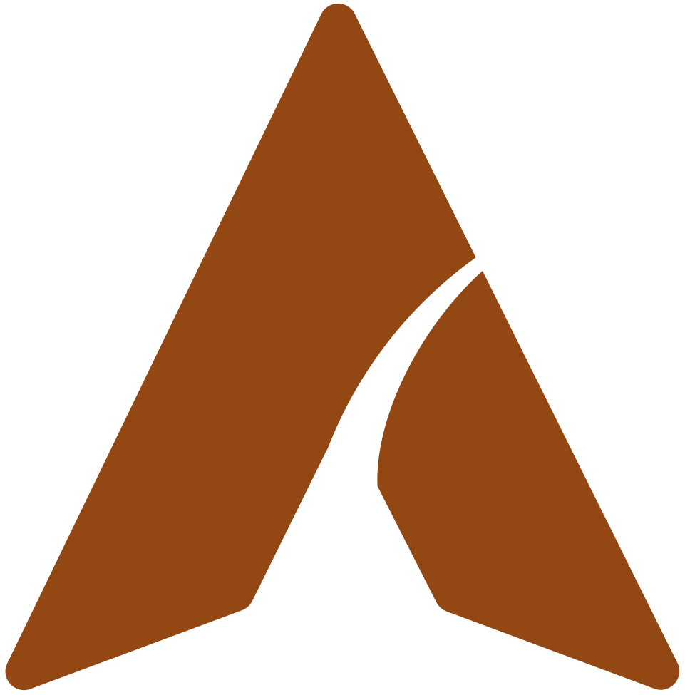
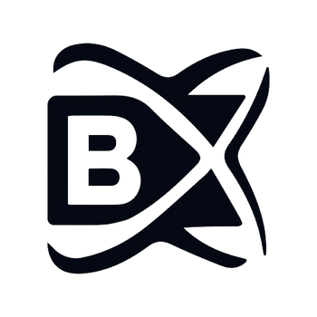


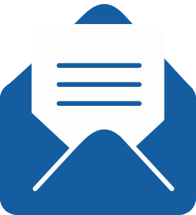
thank you!
  +91 7708889555
  www.blockchainx.tech
  contact@blockchainx.tech

