Slide 1

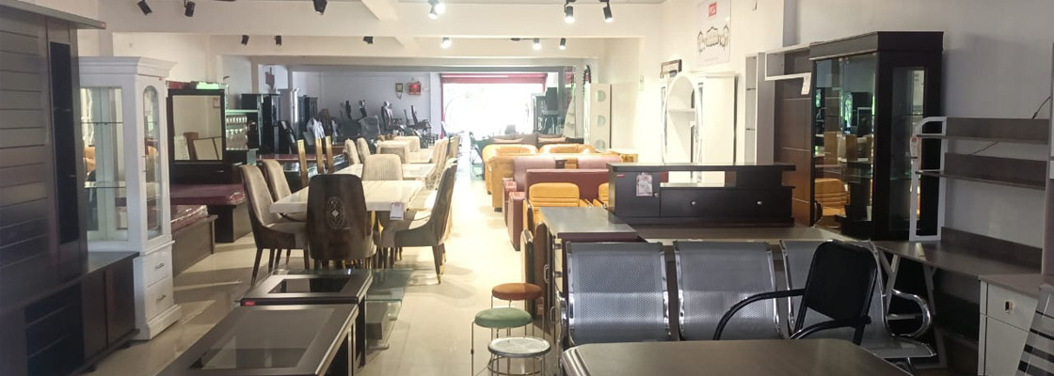
Office Furniture Online in Kolkata
Visit - https://www.pojfurniture.com/our-showrooms/kolkata

Slide 2
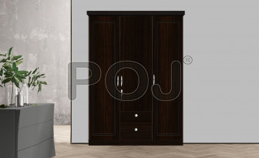
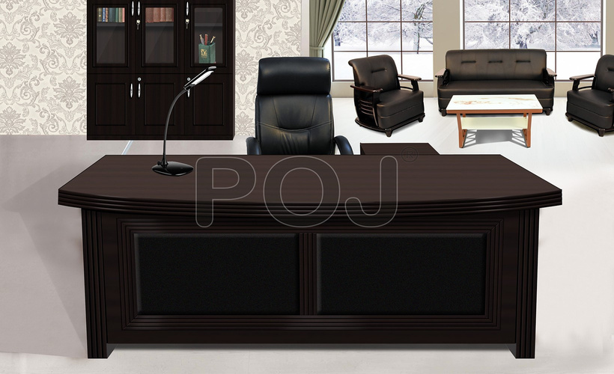
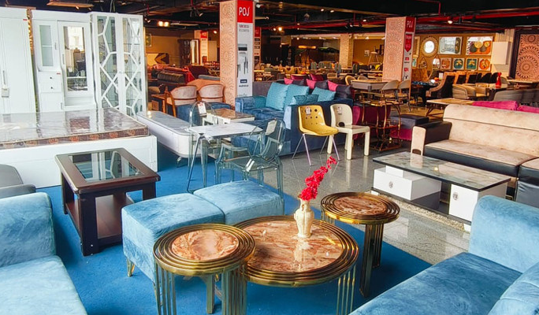
Explore premium furniture collections at the POJ Furniture showroom in Kolkata. From stylish living room sets to durable office furniture, find everything under one roof. Experience quality craftsmanship, elegant designs, and expert assistance to transform your space. Visit the POJ Furniture Kolkata showroom for the best in comfort and style.

Slide 3
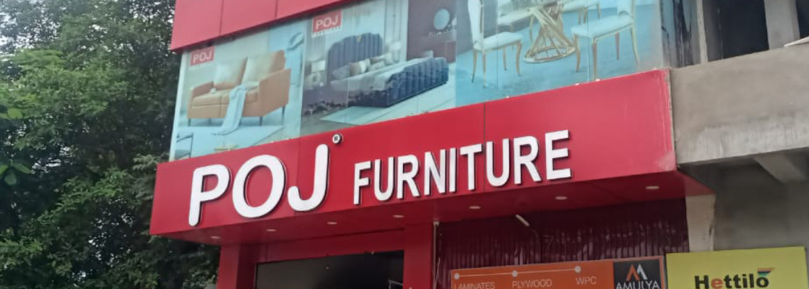
Thank You
Visit - https://www.pojfurniture.com/our-showrooms/kolkata

