Slide 1



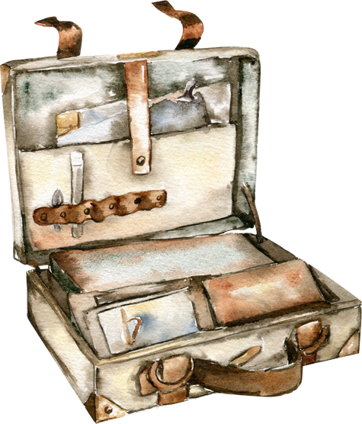
Delhi to Amritsar by Road
A Journey of Comfort with Tempo Traveller Services

Slide 2
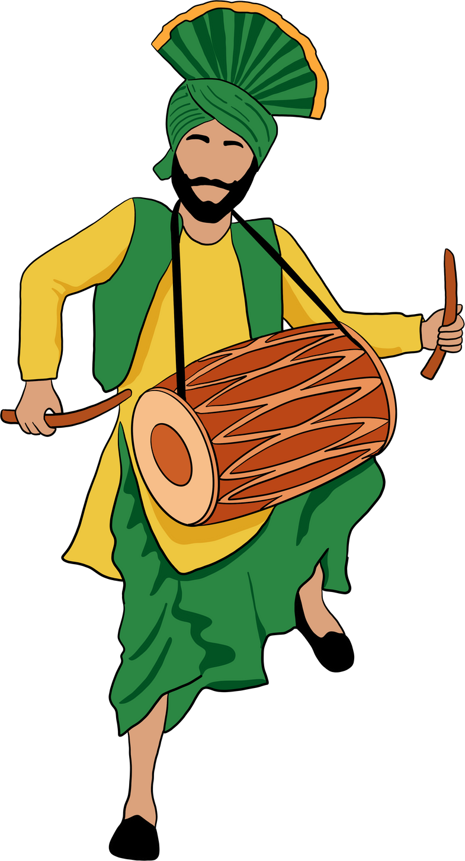
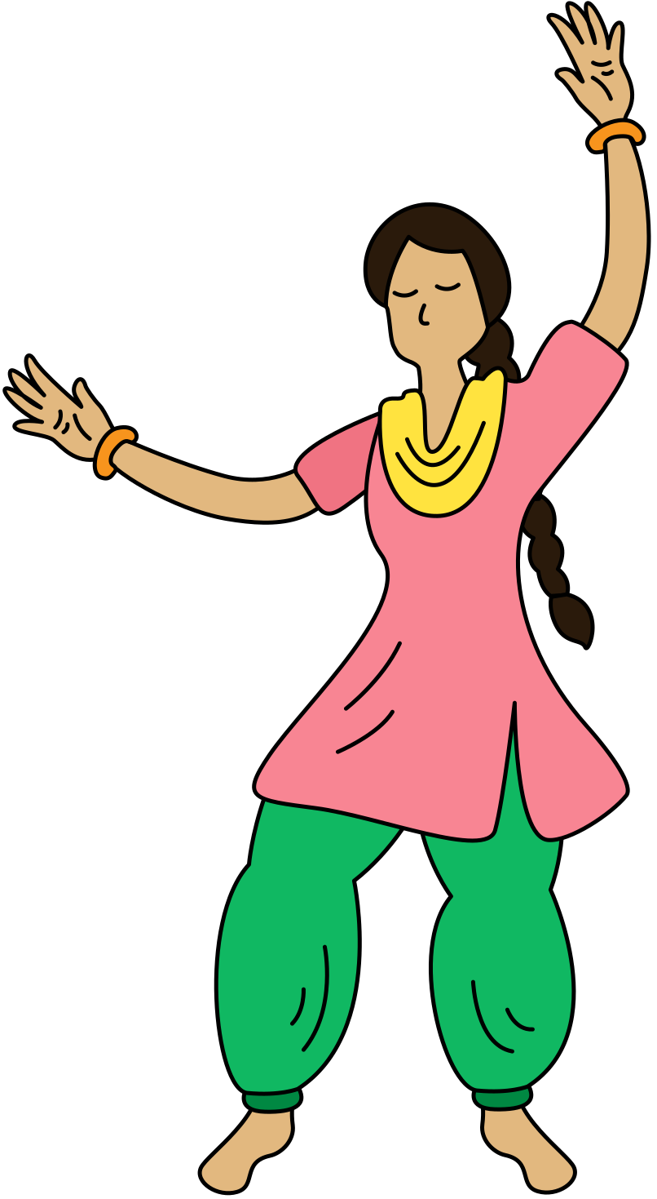
The Route Overview
Total Distance: ~450 km
Approx. Duration: 7–8 hours
Best mode: Road trip for group flexibility and scenic breaks

Slide 3

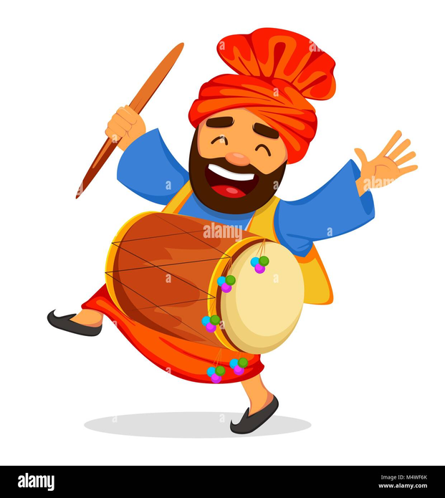

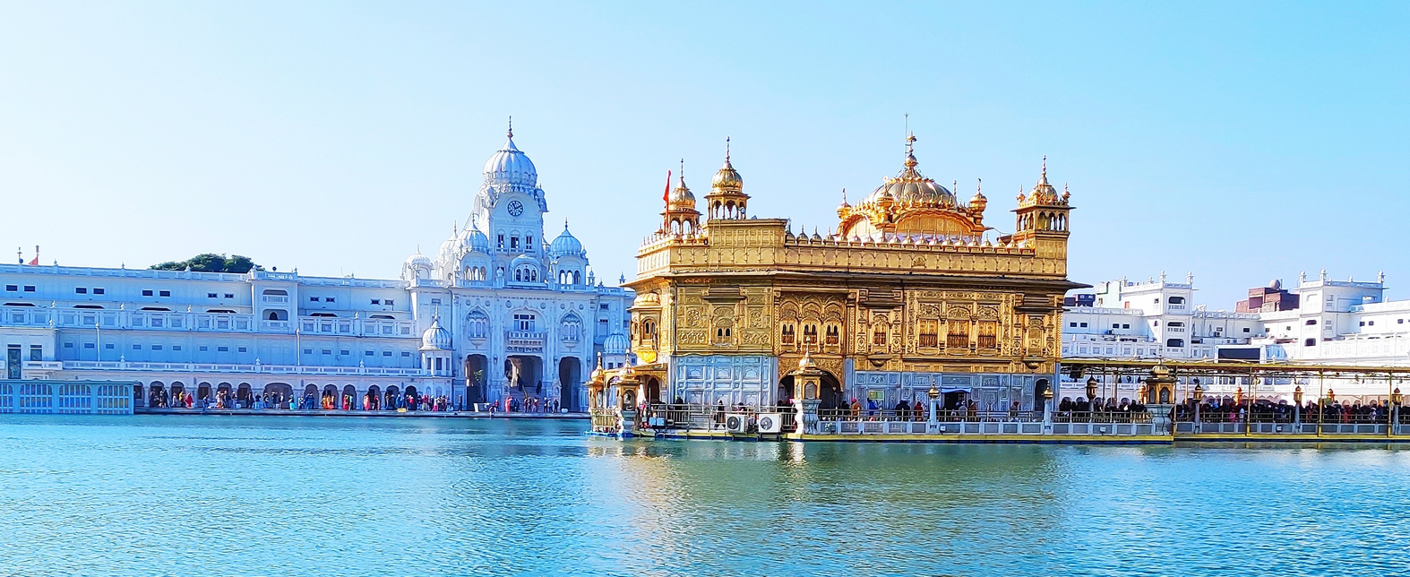

What Makes Amritsar Special?
  Golden Temple: Spiritual centre of Sikhism
  Wagah Border: Patriotic flag-lowering ceremony
  Amritsari cuisine: Kulchas, lassi, and street food
  Rich Punjabi culture and hospitality

Slide 4
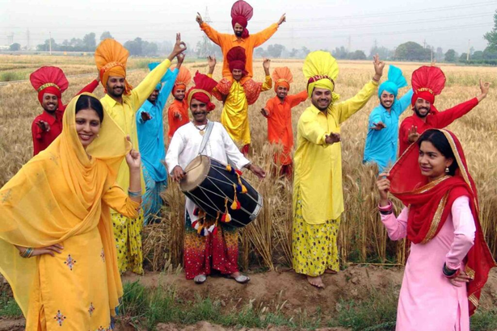
Why Travel by Tempo Traveller?
Designed for group comfort
Large luggage space, wide pushback seats
AC, music system, charging points onboard

Slide 5

Journey Highlights
  Stop at Murthal for breakfast (famous dhabas)
  Mid-route sightseeing (Karnal, Ludhiana)
  On-demand breaks and scenic photo stops

Slide 6
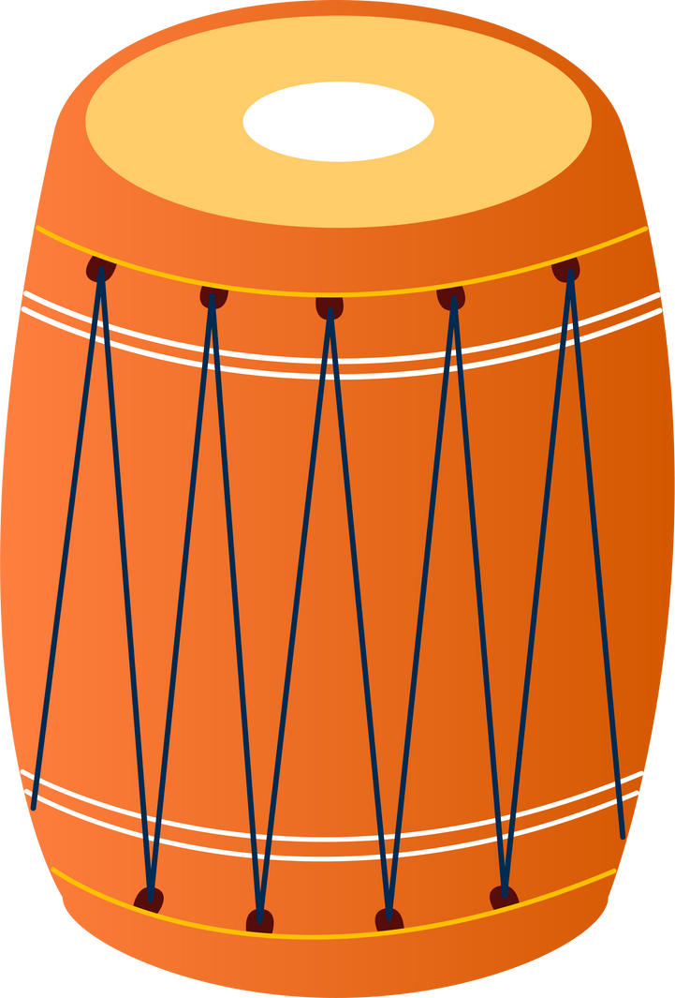
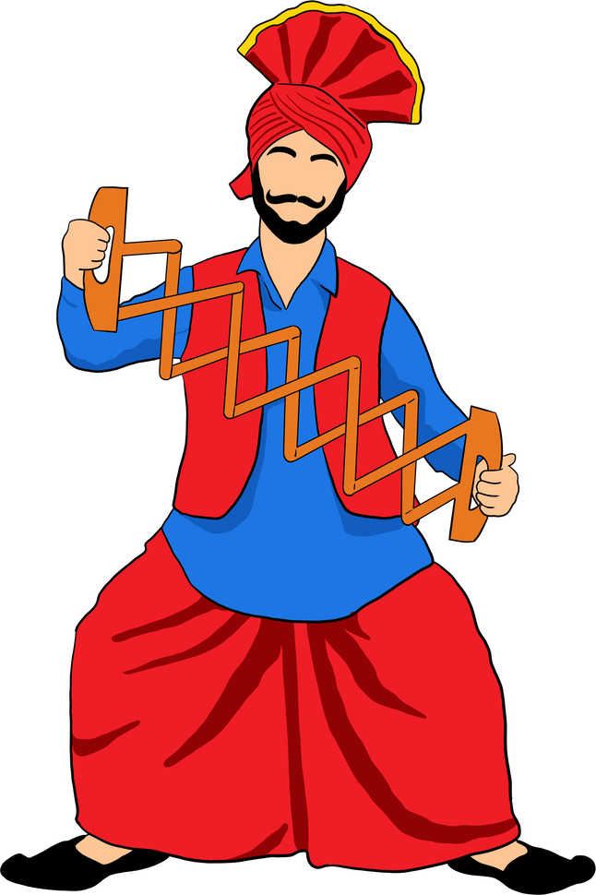
Types of Tempo Travellers Available
  9 Seater: Small family or team
  12 Seater: Medium-sized group
  17/20 Seater: Large groups with extra space
  Luxury Maharaja Tempo Traveller seating and LED screens

Slide 7
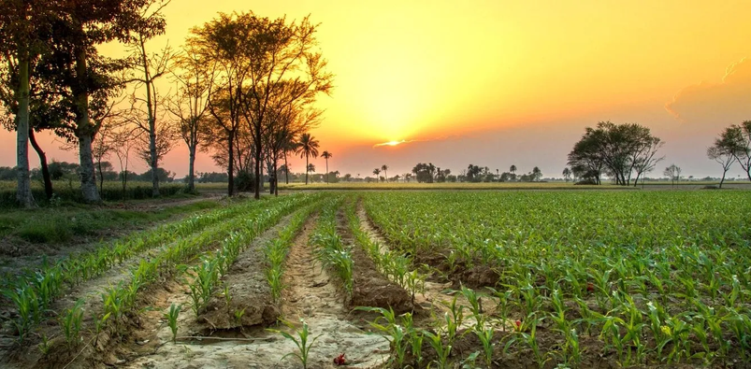
Comfort and Safety Features
  Clean & sanitized interiors
  Professional drivers trained for highway routes
  24/7 customer support
  GPS tracking and emergency response

Slide 8
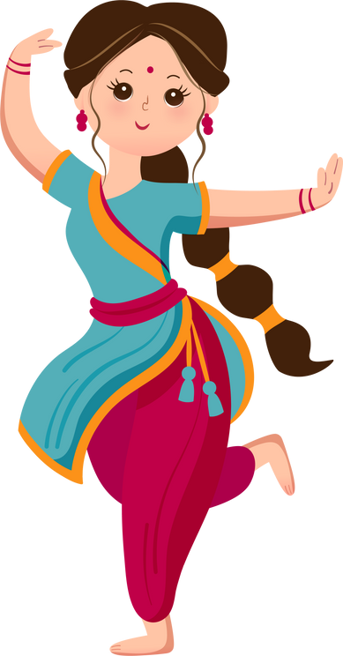
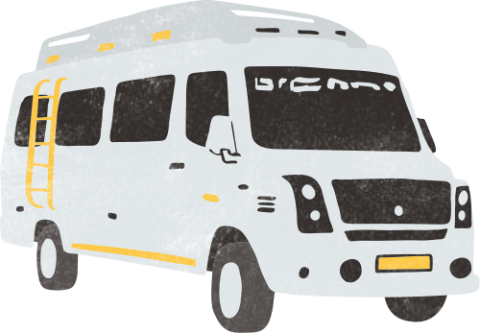
Sample Itinerary
  Day 1 Morning: Depart from Delhi
  Afternoon: Lunch stop on the way
  Evening: Arrive in Amritsar, hotel check-in
  Day 2: Visit Golden Temple, Jallianwala Bagh, Wagah Border
  Day 3: Return to Delhi or continue onward

Slide 9

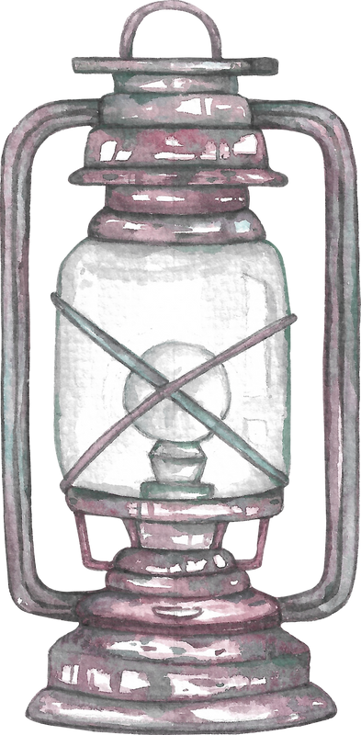
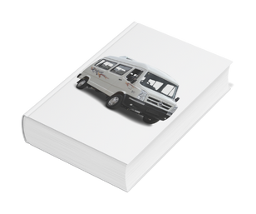
How to Book
Visit:
Tempotravellerindelhi.in
click book button , dates, and seating capacity
Get a quick quote and confirmation via email or WhatsApp

Slide 10
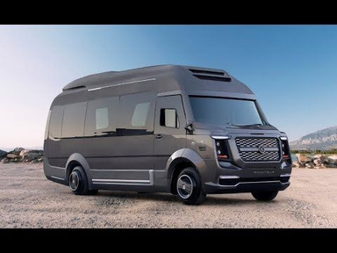
Final Takeaway
  Group road travel is now easy, safe, and affordable
  Make memories, not just a journey—book a Tempo Traveller for your next trip to Amritsar

Slide 11
Thank You
Contact Info
Website: www.tempotravellerindelhi.in
Phone: +91-8076619568
Email: info@tempotravellerindelhi.in

