Slide 1

KBSPets
Introducing the Eco-Friendly Cat Tree
A sustainable home for your feline friends, combining comfort, style, and environmental responsibility in one unique design.
Visit Us: www.kbspets.com

Slide 2
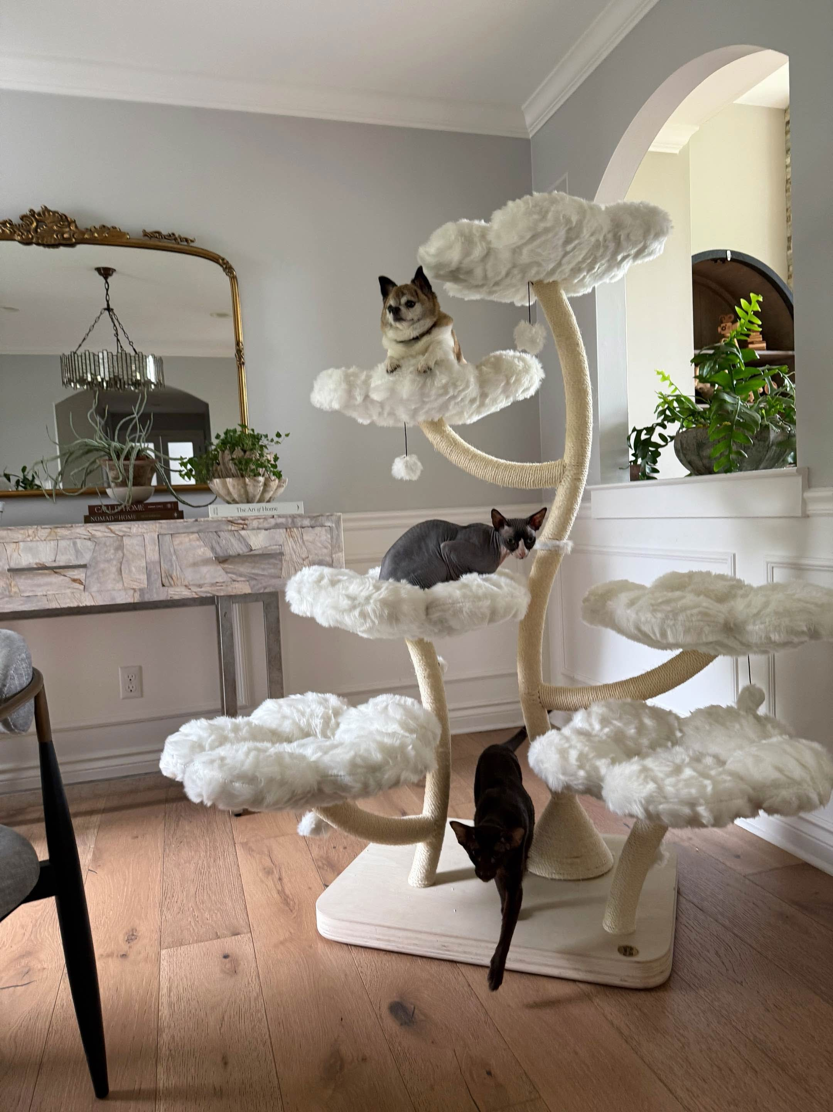
How eco-friendly materials benefit our furry friends
Sustainable Pet Products
Choosing sustainable materials in pet products not only promotes environmental health but also ensures the safety of our pets. Eco-friendly cat trees are made from natural, non-toxic materials that minimize harmful impacts on the environment. By investing in these products, we contribute to a healthier planet for future generations.

Slide 3
Durability
The KBSPETS Cat Tree is designed with high-quality materials to withstand daily use, ensuring your investment lasts for years while providing a reliable play area for your cat.
Aesthetics
Safety Comfort
With a stylish design, the cat tree blends seamlessly into your home decor, allowing you to showcase a functional piece that enhances your living space's visual appeal.
Safety is paramount; the KBSPETS Cat Tree features sturdy construction and non-toxic materials, giving you peace of mind as your feline friend explores and plays without risk.
Your cat will love the plush surfaces and cozy nooks of the KBSPETS Cat Tree, providing a comfortable haven for relaxation and play, tailored perfectly to their needs.

Slide 4
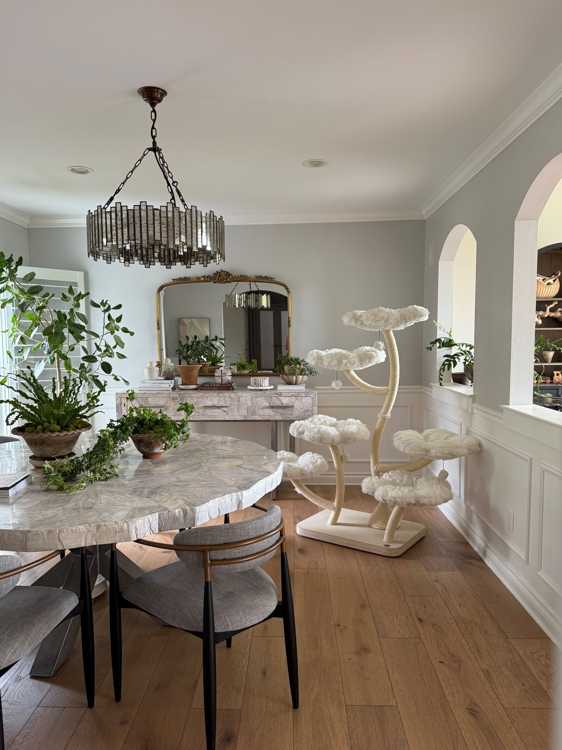
A Commitment to Sustainability in Pet Products
Choose KBSPETS
At KBSPETS, we believe in creating products that are not only safe for your pets but also environmentally friendly. Our eco-friendly cat trees are made from sustainable materials, ensuring minimal impact on the planet while providing your feline friends a cozy space to play and relax. Choose KBSPETS for a greener, healthier future for your pets and the Earth.

Slide 5
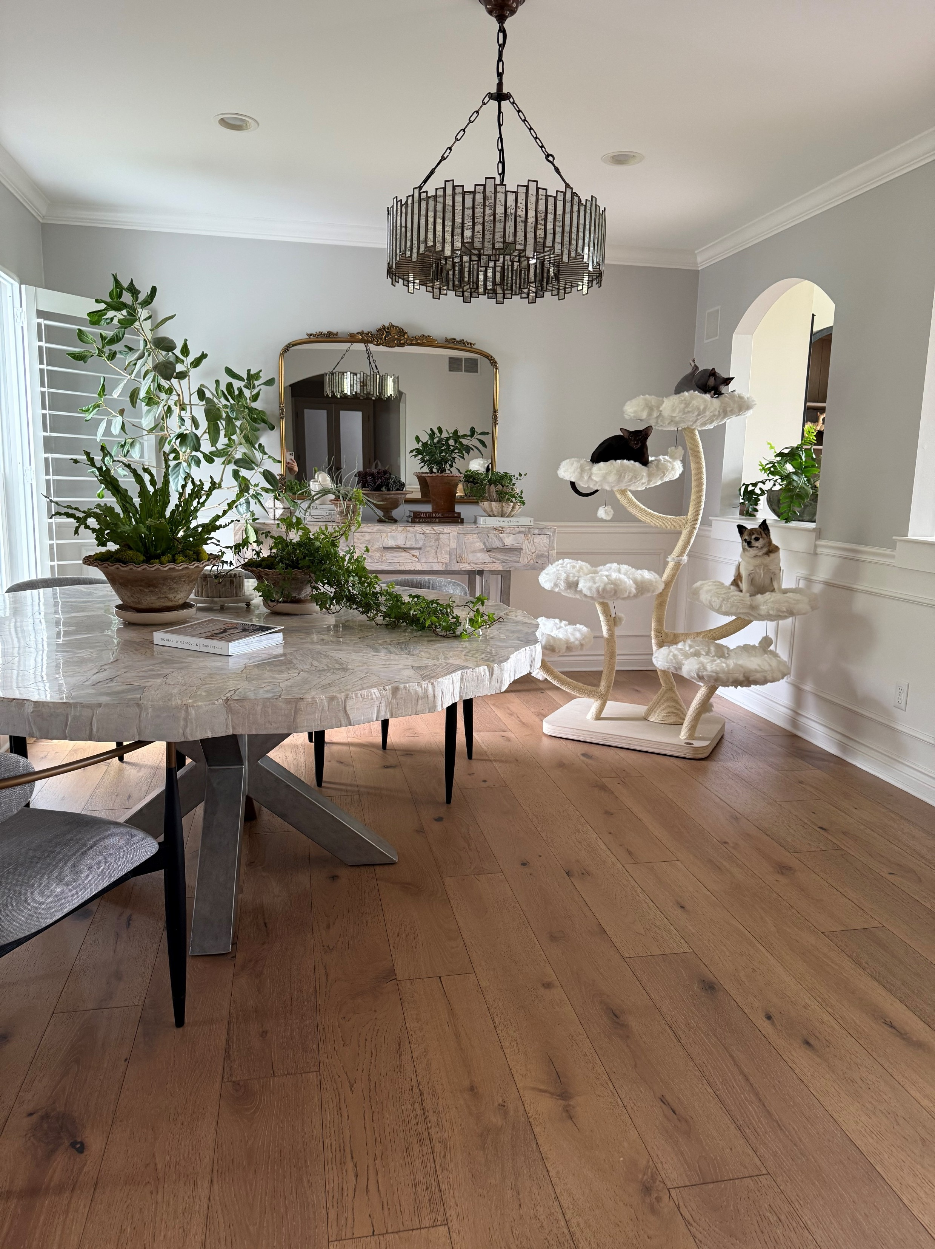
Why Our Customers Love Sustainable Choices for Their Pet
Eco-Friendly Cat Trees
Customers rave about our sustainability efforts in creating eco-friendly cat trees. Many have noticed their pets' increased happiness and engagement with our products. Not only do these trees provide a safe haven for their cats, but they also contribute to a healthier planet. By choosing KBSPETS, pet owners show their commitment to a more sustainable lifestyle while ensuring their furry friends have the best.

Slide 6

CONTACT US
ONLINE SHOP: KBSPets
EMAIL: info@kbspets.com WEBSITE: www.kbspets.com SERVED AT: Los Angeles, California
Every cat deserves a furrever home

