Slide 1

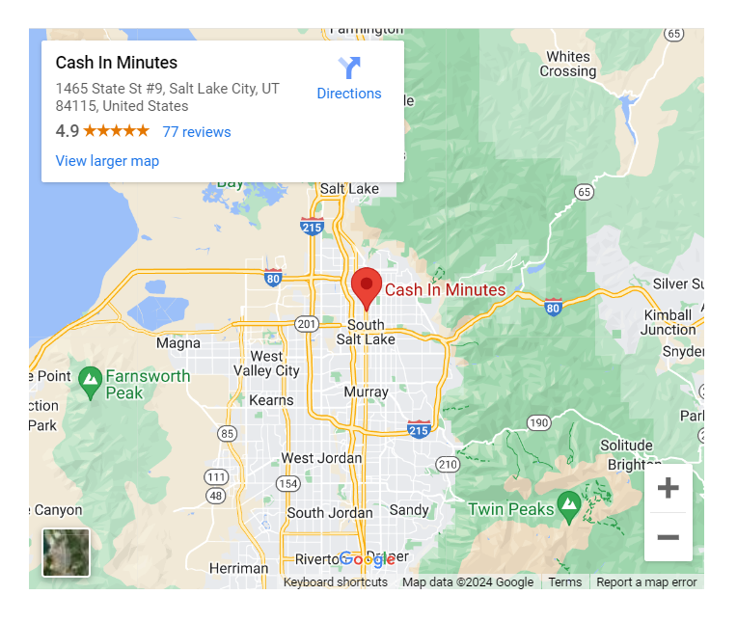
Are you seeking the best personal loans in Salt Lake City, Utah?
At Cash in Minutes, we offer our clients some of the easiest ways to get a personal loan of up to $1,500 approved quickly. In fact, we are often able to help you with your loan application and get you approved all on the same day making Cash in Minutes the best personal loan issuer in Salt Lake City.

Slide 2
Types of Personal Loans in Salt Lake City
Also known as either personal or installment loans here in Salt Lake City, Utah, one of our biggest benefits is that we give you freedom of choice when it comes to what to spend your loan on. It doesn’t matter the expense; it’s your money to do with as you wish.
Installment loans for personal use
No matter your financial situation, we have a loan to fit your needs. And the best part about the loans we offer in Salt Lake City is that all our loans come with a fixed interest rate and regular, equal monthly payments. We don’t need any collateral, which makes our loans available to everyone, even if you don’t have the best credit.

Slide 3
Benefits of Personal Loans Salt Lake City
Choosing a personal loan in Salt Lake City has lots of advantages, such as:
Fixed repayment terms: Personal loans have fixed interest rates and require regular, equal monthly payments, making it easier to budget for your monthly payments.
Personal loans can be utilized for various things, from house renovations to medical costs.
Competitive interest rates: If you have an excellent credit score, you can be eligible for a lower interest rate.
Quick funding: You can get your personal loan funds from Cash in Minutes the same day you apply.

Slide 4
How To Apply for Personal Loans in Salt Lake City
At Cash in Minutes, we have one of the easiest application processes in Salt Lake City, Utah. And you have the choice to apply from home online or stop by and visit us at our office in person.
To apply online, follow these easy steps:
  Visit our application webpage and fill out the simple 3-step online form by providing your personal details, employment information, and the loan amount you want.
  After you’ve submitted your application, one of our friendly loan officers will get in touch with you and explain all the details of your loan and answer any questions you might have.
  After everything is finished, all you need to do is come to our office to sign some papers to receive your money, which is frequently done on the same day your application was filed.
Alternatively, you can apply for your personal loan in person by visiting our Salt Lake City office. Our knowledgeable staff is available to assist you with your application and can address any queries you may have in order to make the procedure as quick and simple as possible.

Slide 5
Why Choose Cash in Minutes?
In Salt Lake City, Utah, we at Cash in Minutes are dedicated to offering the best personal loans. Here are some reasons why you ought to pick us:
Quick and simple application process: We have a quick and simple online application that requires very few documents. Also, you can apply in person at our Salt Lake City office.
Customized service: After receiving your application, a member of our knowledgeable team will analyze it and get in touch with you right away to go over the terms and circumstances of your personal loan.
Competitive interest rates: We give you the best value for your loan by providing some of the lowest interest rates in the Utah Valley.
Exceptional customer service: Our helpful and professional staff is ready to assist you at every turn, making the loan application process as simple as possible.
Customizable loan options: With set interest rates and consistent, equal monthly payments, our installment loans are built to match your specific financial needs.

Slide 6
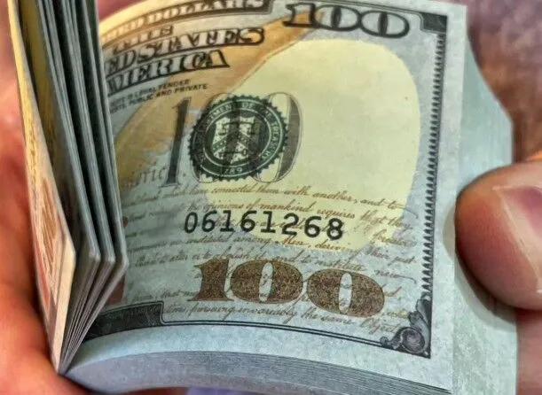
Why Choose a Personal Loan in Salt Lake City?
When you need some emergency money right now, there’s no better option in all of Salt Lake City than one of our personal loans. Our loans are not only quick and easy, but they also have longer payback periods than other loans like Payday loans which often require you to pay back the loan in full as soon as you get your next paycheck. With our loans, you get to spread out the repayment, so the loan doesn’t add any further financial pressures to your budget.

Slide 7
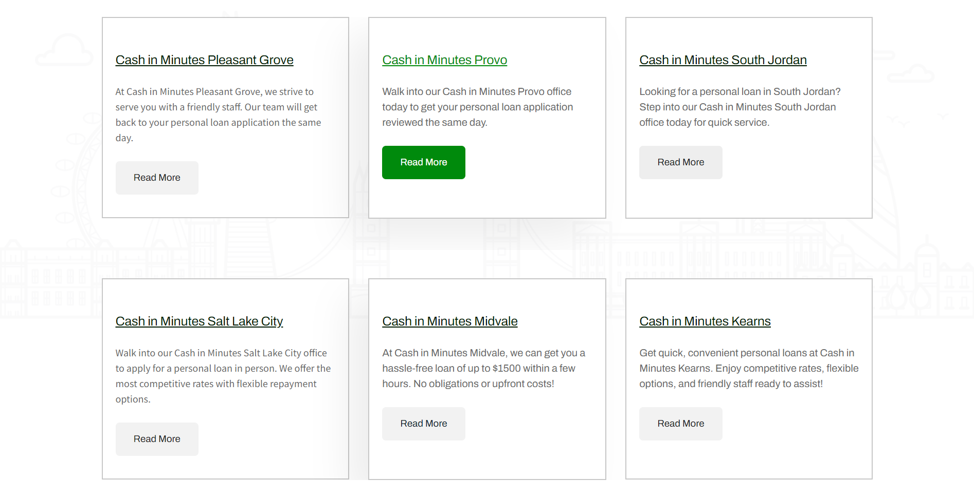

Slide 8



Are you a customer who needs help?
call us now
+1 (801) 899-4933
mycashinminutes.com
424 North Freedom Blvd Provo, Utah 84601

Slide 9


