Slide 1
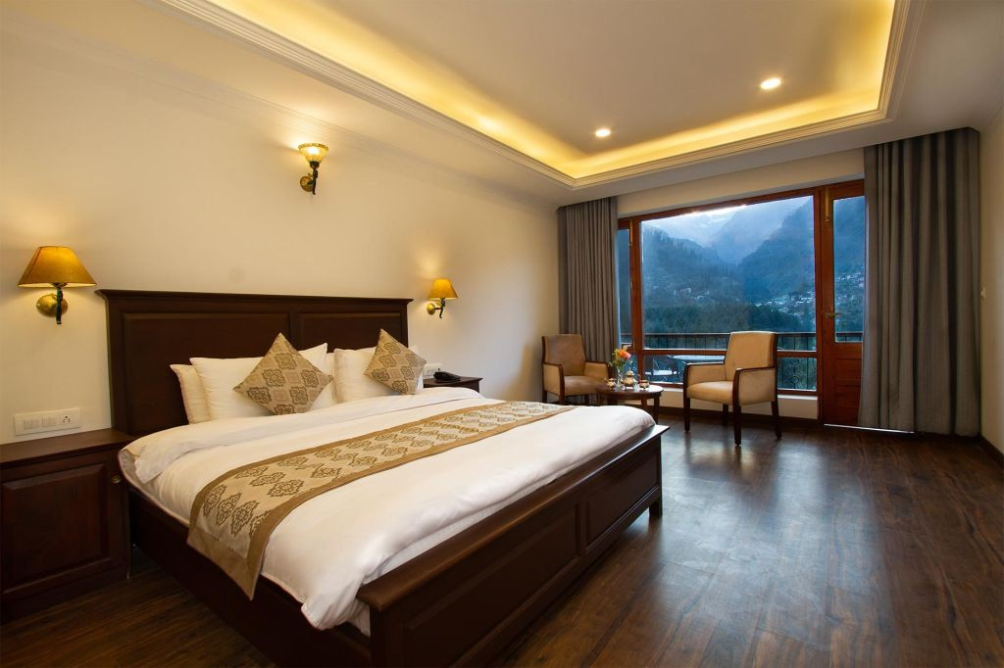
Luxury Resorts in Manali
Discover the ultimate
Luxury Resorts in Manali experience at Aloka Resort Manali, a luxurious haven
nestled amidst the Himalayas. Enjoy breathtaking mountain views from spacious rooms with private
balconies, indulge in delicious cuisine, and unwind with top-notch amenities like free WiFi, a kids'
club, and airport transfers. Aloka Resort Manali, rated 9.3 by guests, oﬀers unparalleled hospitality
and a serene escape, perfect for families and couples. Book your stay at this premier Resort in Manali
for an unforgettable Himalayan retreat.
Address: Chadyari, Tehsil Manali, Distt Kullu H.P, 175131, India Phone: +91 78386-09537, +91 98160-76122
Email: alokaresortmanali@gmail.com Website: https://alokaresortmanali.com

