Slide 1

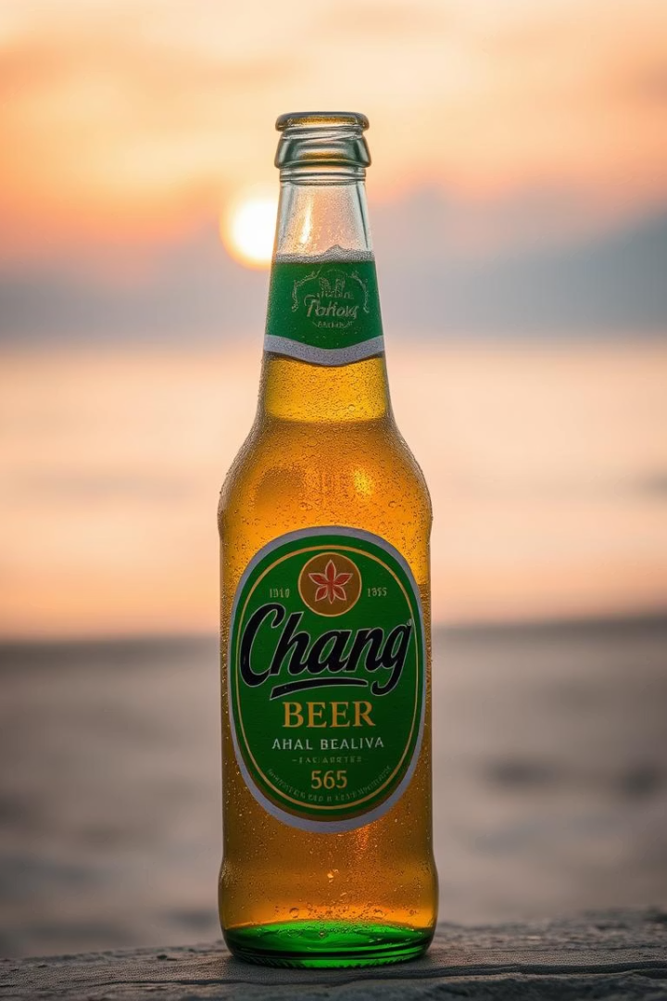
Introduction to Chang Beer
Discover Chang Beer, Thailand's iconic brew. It is brewed with a commitment to quality and tradition. Known for its smooth taste, it is a popular choice globally.
Notes:
1

Slide 2
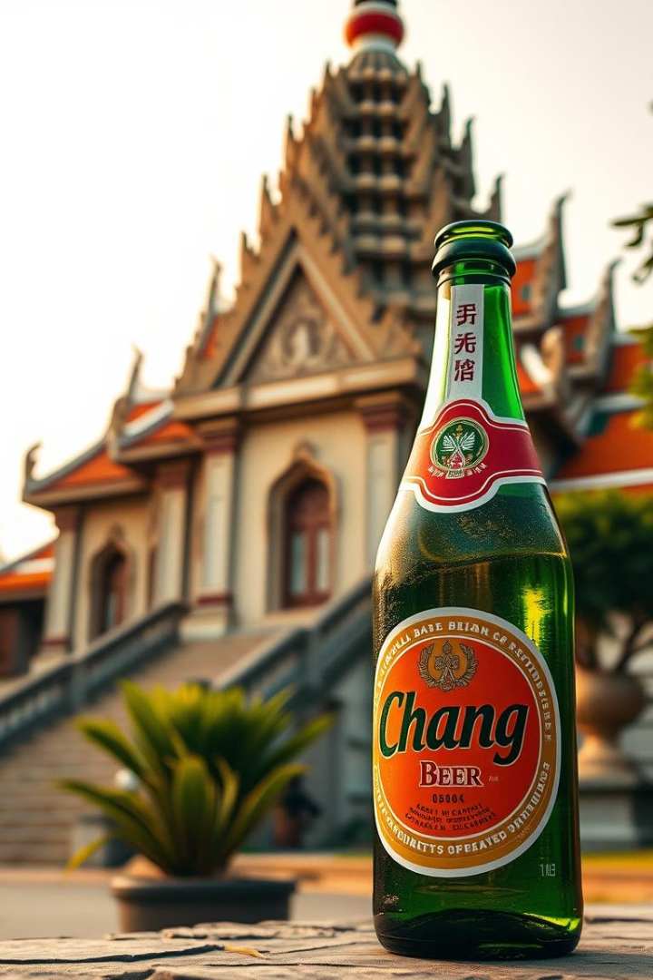
History and Heritage of Chang Beer
1
1995
Established by ThaiBev, building on rich brewing traditions.
2
Thai Spirit
Represents the spirit and heritage of Thailand.
3
Brand Reflection
Chang Beer's brand reflects its deep Thai roots.
Explore the rich history of Chang Beer and its cultural significance.
Notes:
2

Slide 3





Brewing Process of Chang Beer
Quality Water
Crafted using deep-well water for purity.
Select Ingredients
Uses only the finest, carefully selected ingredients.
Meticulous Process
Undergoes a precise and careful brewing process.
Crisp Flavor
Chang Beer's unique brewing ensures a refreshing taste.
A look at what makes Chang Beer so special.
Notes:
3

Slide 4
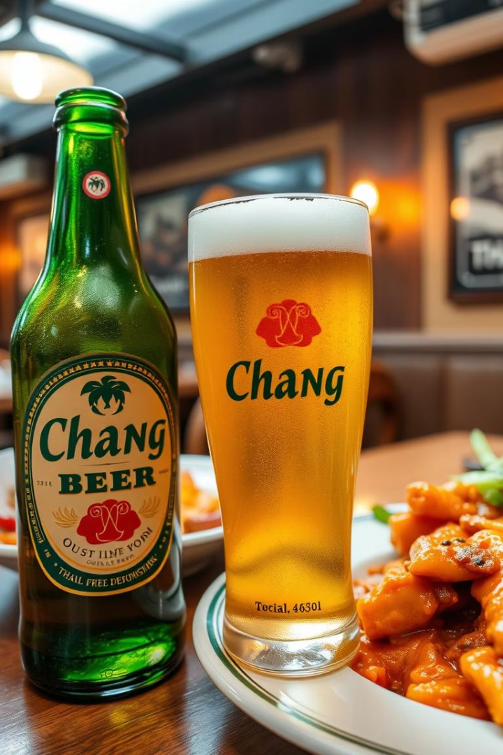
Taste Profile of Chang Beer
Smooth & Full-bodied
Balanced Flavor
Characterized by its smooth, full-bodied taste.
Has a balanced flavor with subtle hoppy notes.
Versatile Pairing
Chang Beer pairs well with various dishes.
Savor the exceptional taste of Chang Beer, perfect for any occasion.
Notes:
4

Slide 5
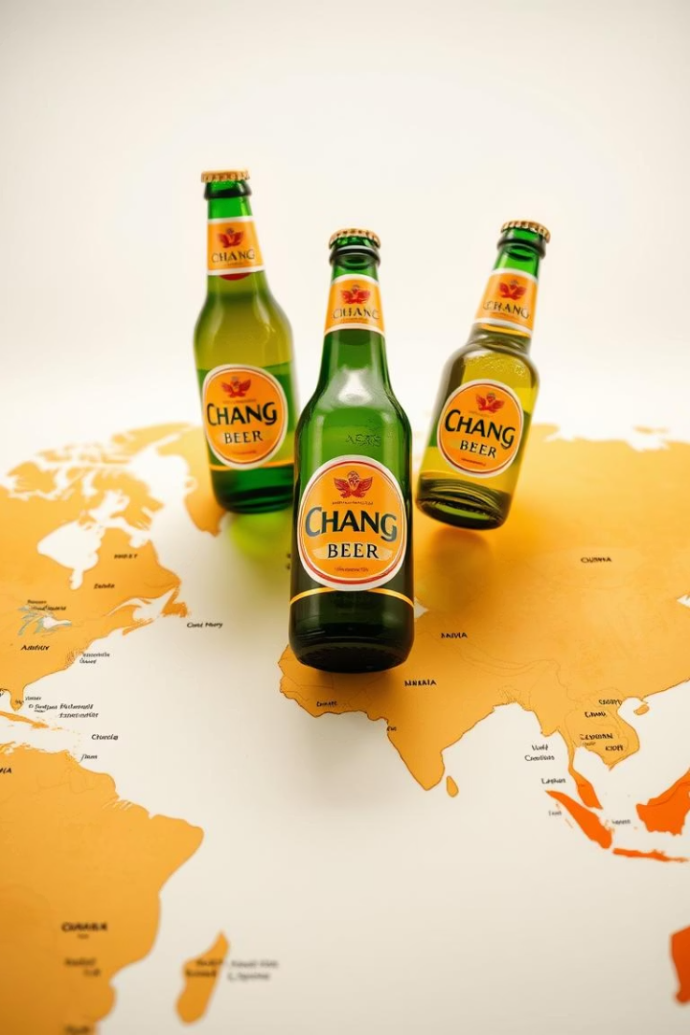
Chang Beer in the Global Market
🌍
🐘
Worldwide Enjoyment
Iconic Design
Enjoyed in numerous countries globally.
Recognizable for its green bottle and elephant logo.
⭐
Global Brand
Chang Beer is an internationally recognized brand.
Chang Beer's expanding global presence.
Notes:
5

Slide 6
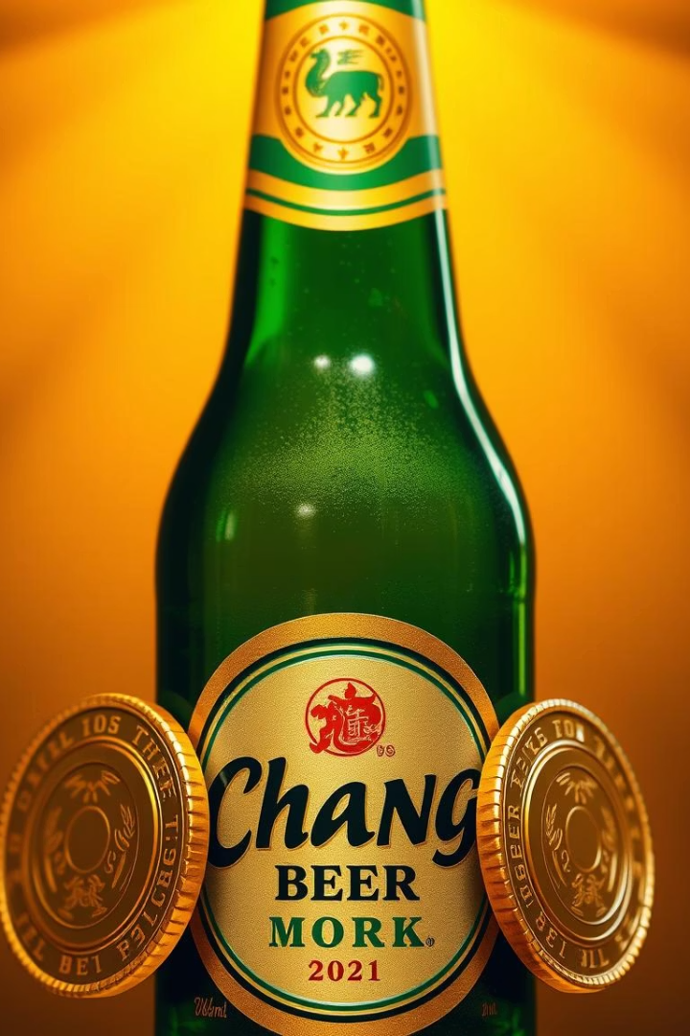

Awards and Recognition for Chang Beer
Accolades Received
High Standards
Has received numerous accolades for its quality and taste.
Continues to maintain high standards in brewing practices.
Excellence Reflected
Chang Beer's dedication to excellence is reflected in its awards.
Highlighting Chang Beer's achievements and quality.
Notes:
6

Slide 7
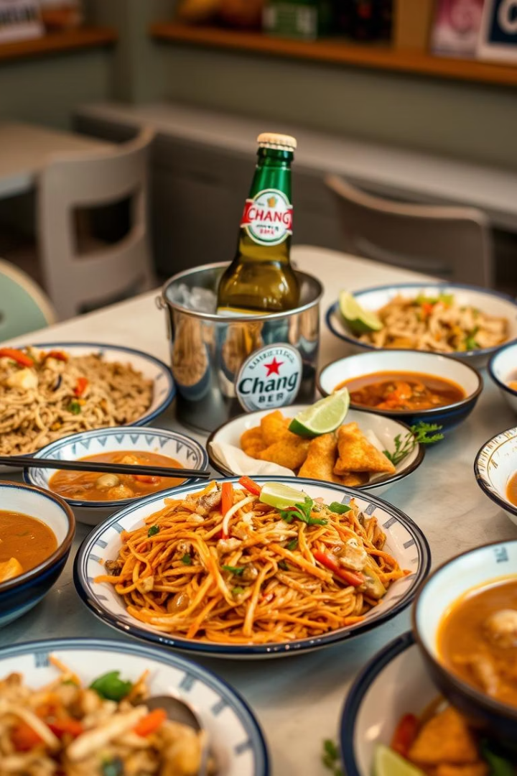



Pairing Chang Beer
Thai Cuisine
Grilled Meats
Seafood
Complements bold and spicy Thai flavors.
Pairs well with grilled meats and seafood.
Perfect companion for fresh seafood dishes.
Chang Beer enhances the flavors of a variety of dishes. Explore ideal food pairings with Chang Beer.
Notes:
7

Slide 8
Contact Us
Purchase
Phone
Email
Address
To purchase Chang Beer, visit https://www.a2zdrinks.com/
020 8243 8554
info@a2zdrinks.com
86-90 Paul Street, London EC2A4NE
Find out where to get your next Chang Beer.
Notes:
8

